Slide 1
Improving Test Score Interpretation
Michael C. Rodriguez
Educational Psychology

Slide 2
National Academies (2009)
A test score is an estimate rather than an exact measure of what a person knows and can do. The items on any test are a sample from some larger universe of knowledge and skills, and scores for individual students are affected by the particular questions included.
Board of Testing and Assessment

Slide 3
National Academies (2009)
A student may have done better or worse on a different sample of questions. In addition, guessing, motivation, momentary distractions, and other factors introduce uncertainty into individual scores.

Slide 4
Measurement Error
Sampling Error

Slide 5
Consider Sampling Error

Slide 6
2014-2015 Technical Manual for
Minnesota’s Title I and Title III Assessments
Understanding Measurement Error
When interpreting test scores, it is important to remember that test scores contain some amount of measurement error. That is to say, test scores are not infallible measures of student characteristics… measurement error must always be considered when making score interpretations. (p. 73)
Notes:
185 pages

Slide 7
2014-2015 Technical Manual
Using Objective/Strand-Level Information
Strand or substrand level information can be useful as a preliminary survey to help identify skill areas in which further diagnosis is warranted. The standard error of measurement associated with these generally brief scales makes drawing inferences from them at the individual level very suspect; more confidence in inferences is gained when analyzing group averages. (p. 74)

Slide 8
2014-2015 Technical Manual
When considering data at the strand or substrand level, the error of measurement increases because the number of possible items is small. In order to provide comprehensive diagnostic data for each strand or substrand, the test would have to be prohibitively lengthened. (p. 74)

Slide 9
MCA for Individual Interpretation
2014-2015 Yearbook Tables for
Minnesota’s Title I and Title III Assessments
Example: Grade 3 Reading
Score Distributions, p. 91

Slide 10
Scale Score | SEM | Achievement Level
338 | 5.0 | D
339 | 5.0 | D
340 | 5.0 | P
341 | 5.0 | P
…
348 | 5.0 | P
349 | 5.0 | P
350 | 5.0 | M
351 | 5.0 | M
Notes:
454 pages of tables
Does Not Meet
Partially Meets
Meets

Slide 11
Seeking More Information
Looking to Subscales for more info
Knowing subscales are shorter – less precision
Consider the role of measurement error in correlations
Randomness doesn’t correlate with anything
Measurement error (random noise) limits correlations

Slide 12
2015 MCA-III Summary Statistics
Grade 3 Reading (p. 134)
 | Items | Reliability
Total Scale | 48 | .89
Literature | 21-25 | .80
Information | 23-27 | .82

Slide 13
2015 MCA-III Subscale Correlations
Grade 3 Reading (p. 163)
 | Total Scale | Literature
Literature | .93
Information | .94 | .81

Slide 14
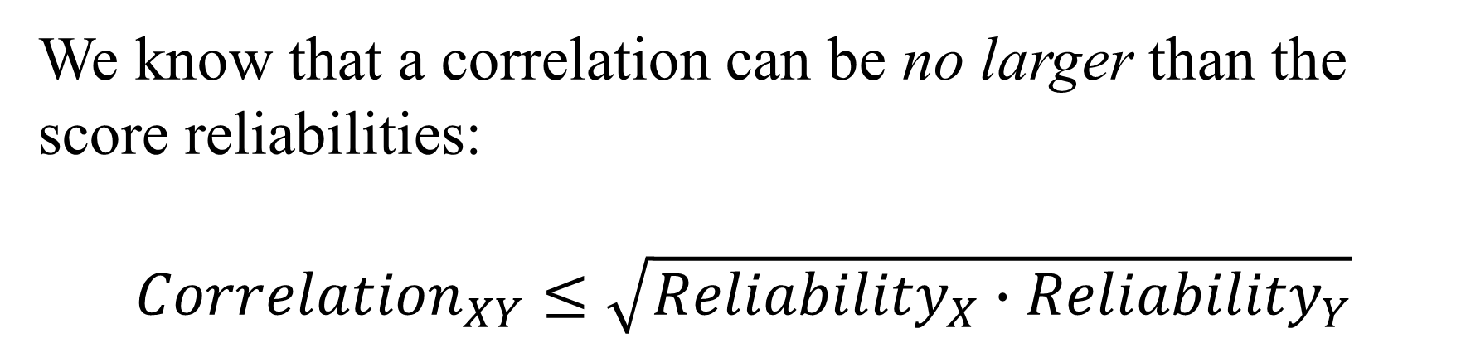
We know that a correlation can be no larger than the score reliabilities:
$${Correlation}_{XY}≤\sqrt{{Reliability}_{X}∙{Reliability}_{Y}}$$

Slide 15
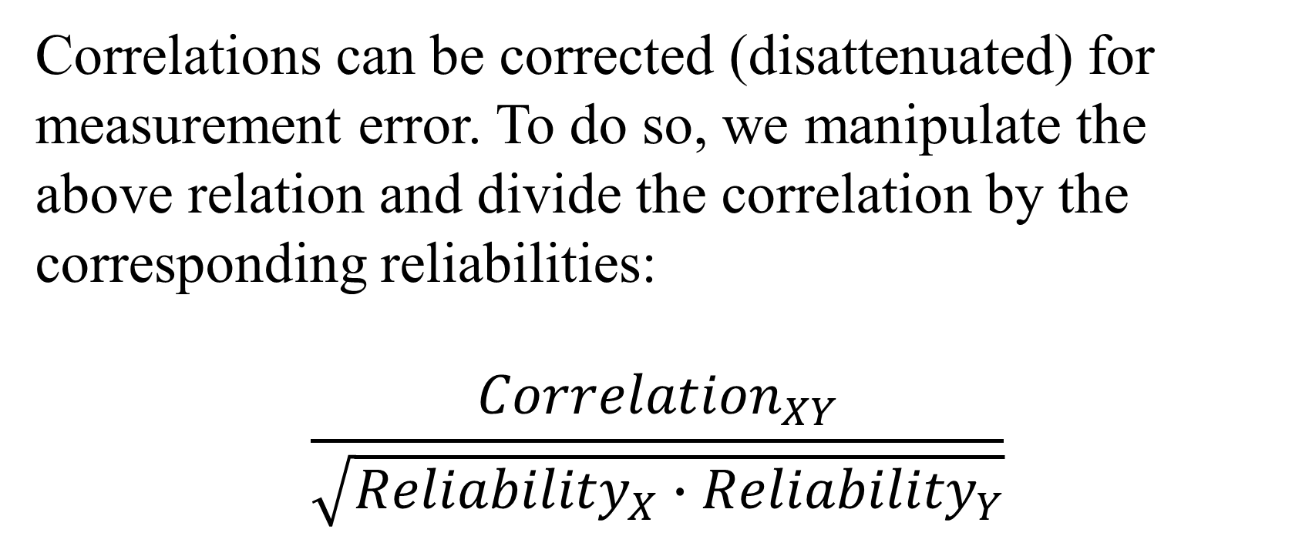
Correlations can be corrected (disattenuated) for measurement error. To do so, we manipulate the above relation and divide the correlation by the corresponding reliabilities:
$$\frac{{Correlation}_{XY}}{\sqrt{{Reliability}_{X}∙{Reliability}_{Y}}}$$

Slide 16
3rd Grade Mathematics Subscale Corrected Correlations
 | Number & Operation | Algebra | Geometry & Measurement
Algebra | .98
Geometry & Measurement | .99 | .97
Data Analysis | .96 | .93 | .96
2015 MCAs

Slide 17
6th Grade Mathematics Subscale Corrected Correlations
 | Number & Operation | Algebra | Geometry & Measurement
Algebra | .97
Geometry & Measurement | .98 | .97
Data Analysis | .98 | .96 | .95
2015 MCAs

Slide 18
8th Grade Mathematics Subscale Corrected Correlations
 | Number & Operation | Algebra | Geometry & Measurement
Algebra | .96
Geometry & Measurement | .97 | .97
Data Analysis | .94 | .99 | .94
2015 MCAs

Slide 19
Grade |  |  | Uncorrected | Corrected
 |  | Reliabilities | Correlation | Correlation
3 | Literature | .80 |  | 1.00
 | Information | .82 | .81
4 | Literature | .80 |  | .99
 | Information | .81 | .80
5 | Literature | .81 |  | 1.00
 | Information | .79 | .80
6 | Literature | .78 |  | 1.00
 | Information | .83 | .81
7 | Literature | .79 |  | 1.00
 | Information | .83 | .81
8 | Literature | .80 |  | .99
 | Information | .82 | .80
10 | Literature | .77 |  | .99
 | Information | .85 | .80
2015 MCA Reading Subscale Corrected Correlations:
Literature & Information

Slide 20
National Academies 2009
The choice of appropriate assessments for use in instructional improvement systems is critical. Because of the extensive focus on large-scale, high-stakes, summative tests, policy makers and educators sometimes mistakenly believe that such tests are appropriate to use to provide rapid feedback to guide instruction. This is not the case.

Slide 21
National Academies 2009
Tests that mimic the structure of large-scale, high-stakes, summative tests, which lightly sample broad domains of content taught over an extended period of time, are unlikely to provide the kind of fine-grained, diagnostic information that teachers need to guide their day-to-day instructional decisions.

Slide 22
National Academies 2009
…BOTA urges the Department to clarify that assessments that simply reproduce the formats of large-scale, highstakes, summative tests are not sufficient for instructional improvement systems.

Slide 23
A Basis for Score Interpretation
Criterion-Referenced Testing
The “criterion” in CRT is the content domain –the referencing system for the MCAs is the content domain.
To make CRTs effective, the content on the test must be a representative sample of the domain – so inferences can be made from a test score to the content domain.
When test content does not represent the intended content domain, CRT inferences are limited.

Slide 24
In Contrast…
Norm-Referenced Testing
In NRTs, a student’s score is referenced to the norming distribution of scores.

Slide 25
Performance Levels & Cutscores
To support CRT interpretation, performance levels are provided and cut-scores define each performance level. These performance levels are required by federal regulations; they support score interpretation relative to the content domain. The presence or absence of performance levels and cut-scores does not make the MCAs a CRT – the CRT aspect of the test is due to our ability to make inferences about what students know and can do relative to the content domains.

Slide 26
Supporting CRT Score Interpretation
The test specifications can be viewed as the sampling design, from which a sample of items is drawn to represent the content domain.
To the extent that the sample of items is a high quality representative sample of the domain, measurement error is minimized and scores are more consistent estimates of the domain knowledge, skills, and abilities of students.

Slide 27
Supporting CRT Score Interpretation
When the sample of items is poorly designed or small, more sampling error is reflected in the standard error of measurement (SEM).
In CRTs, the classical SEM is a statistical estimate of the error due to sampling items.

Slide 28
Supporting CRT Score Interpretation
When we have more sampling error (larger SEM), our inferences to the content domain are less precise and less consistent (less reliable): if a student took a different sample of items, scores would likely change – the extent to which they might change is reflected in the SEM.

Slide 29
MCA Score Interpretation Cautions
Scores on different subjects and different grades are not comparable.
Score differences are not comparable across subjects or grades. A difference of 5 points on one subject in a grade will represent an ability difference that does not compare to a 5-point difference on other subjects or grades.
Source: MN Technical Manual (2015), p. 122

Slide 30
MCA Score Interpretation Cautions
Achievement levels can more safely be compared across subjects and grades – rely on the performance level descriptors for a given test/grade.
Scores over time (within the same content standards period) are comparable within subject and grade.
Source: MN Technical Manual (2015), p. 122

Slide 31
Appropriate Score Use
The tests in the Minnesota Assessment System are designed primarily to determine school and district accountability related to the implementation of the Minnesota standards. They are summative measures of a student’s performance in a subject at one point in time. They provide a snapshot of the student’s overall achievement, not a detailed accounting of the student’s understanding of specific content areas defined by the standards.
Source: MN Technical Manual (2015), pp. 70-71

Slide 32
Appropriate Score Use: Parents
The information can help parents begin to understand their child’s academic performance as related to the Minnesota standards.
Source: MN Technical Manual (2015), pp. 70-71

Slide 33
Appropriate Score Use: Placement Decisions
The information can be used to suggest areas needing further evaluation of student performance. Results can also be used to focus resources and staff on a particular group of students who appear to be struggling with the Minnesota standards.
Source: MN Technical Manual (2015), pp. 70-71

Slide 34
Appropriate Score Use: Placement Decisions
Students may also exhibit strengths or deficits in strands or substrands measured on these tests. Because the strand and substrand scores are based on small numbers of items, the scores must be used in conjunction with other performance indicators to assist schools in making placement decisions, such as whether a student should take an improvement course or be placed in a gifted or talented program.
Source: MN Technical Manual (2015), pp. 70-71

Slide 35
Appropriate Score Use: Program Evaluation
Test scores can be a valuable tool for evaluating programs. For example, a school may use its scores to help evaluate the strengths and weaknesses of a particular academic program or curriculum in their school or district as it relates to the Minnesota standards.
Source: MN Technical Manual (2015), pp. 70-71

