Slide 1
Accessible Assessment
EPSY 5221
Principles of Educational & Psychological Measurement

Slide 2
Improving Accessibility
Test items provide opportunities for students to display construct-relevant knowledge, skills, and abilities.
From a measurement perspective, item modifications should be done to
Provide access to the item for all students
Improve measurement of the construct
The hypothesis is: By providing greater access to each item, we improve measurement.

Slide 3
Modifications
changes to a test’s content or item format that make a test more accessible for most students
while continuing to assess grade-level content and skills
at the same depth of knowledge as unmodified items

Slide 4
Item Modification
Much of the language surrounding test item modification suggests that the goal is to make items “easier”.
But making items easier doesn’t necessarily improve measurement or accessibility.
Elements of Universal Design provide a model for making appropriate modifications; but can be taken too far to interfere with the construct being measured.

Slide 5
To be Consistent
We are compiling evidence from our own work and the work of others regarding the utility of being direct and explicit in our item writing, relying on good item writing guidelines, elements of Universal Design, concepts from Cognitive Load Theory, and research based on language complexity and accessibility for diverse students.
TAMI provides a systematic guide.

Slide 6
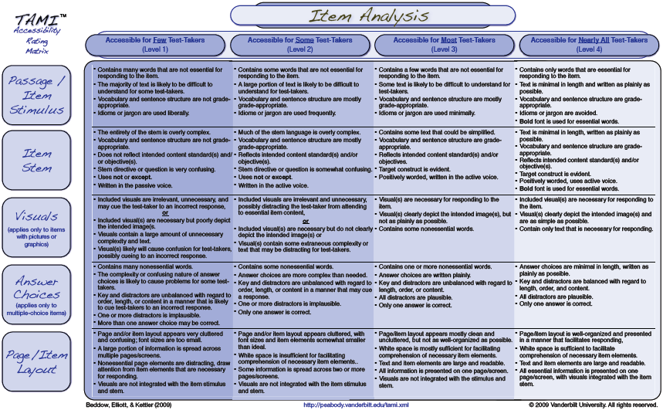

Slide 7
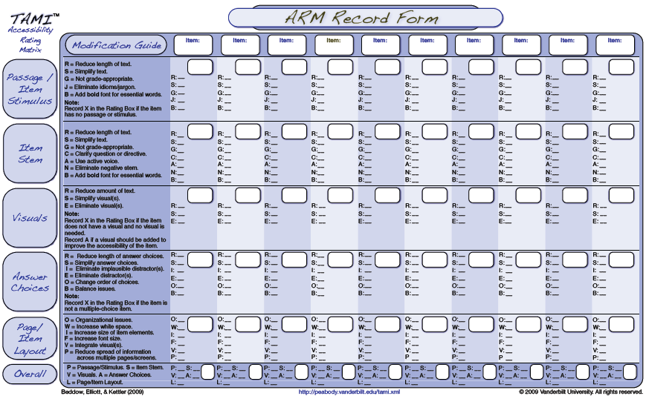

Slide 8
Effects of Item Modification
Item Difficulty
Item Discrimination
IRT Item location and Item Fit
Distractor Functioning
Proportion selecting the distractor
Point-biserial correlation (distractor-total r)
DDF
Qualitative Evidence

Slide 9
Consortium for Alternate Assessment Validity and Experimental Studies
Arizona, Hawaii, Idaho, Indiana
755 students (WOD, NE, E) in 8th grade
Develop a common set of items from Discovery Education Assessment reading and mathematics tests
CBT experimental control of item delivery
Cognitive Labs

Slide 10
CAAVES Modifications (TAMI)
Rating accessibility:
Passage and stimulus materials
Item stem
Visuals
Answer choices
Page format and layout
Fairness
Modification team: 12 teachers, 4 test developers

Slide 11
CAAVES Modifications
Removal of one option (3-option items)
Simplification of language (item passage, stem, response options)
Add graphic support
Reorganize layout (segment paragraphs, bold key words, add white space)

Slide 12
Overall Effects of Modification
Effect of Modified Test in Reading
Students Without Disabilities: 0.58
Students Eligible for Modified Test: 1.24
Effect of Modified Test in Mathematics
Students Without Disabilities: 0.46
Students Eligible for Modified Test: 0.81
Item difficulty was decreased on average
Item discrimination was increased on average

Slide 13
Focus Group Comments (7th Grade)
Preparing for State Test:
Sleep well, eat good, and stay awake
We get snacks during the test
To study, I read a lot and do practice questions
I don’t like to review my notes, it’s pretty boring
When I get bored I get the temptation for guessing, but I’m not doing that any more
We do extra writing in class, teachers take the time to help us practice so we don’t forget

Slide 14
Focus Groups cont.
Reaction to Modified Versions of Items
It has a complete question
“perplexed”? I have no idea what that means
There’s always one dumb answer – you don’t have to waste your time on that one
Just give us the problem straight up, you don’t need all of this other information
You get the question right at the part of the story where you need to answer it

Slide 15
Focus Groups cont.
Final Comments:
They tell us they are trying to prepare us for college, but they are showing us questions that we never get to in class
We shouldn’t be completely isolated from all students. If we could use devices to hear music, we wouldn’t be distracted.
Sometimes the story is so long and you don’t have time to read and they only have one or two questions for that story anyway.

Slide 16
Focus Groups cont.
You should make two kinds of tests. One is the regular old test and then the new and improved test. Then you give it to some kids with disabilities and some without so you can compare. But it has to be random so you know what matters.

Slide 17
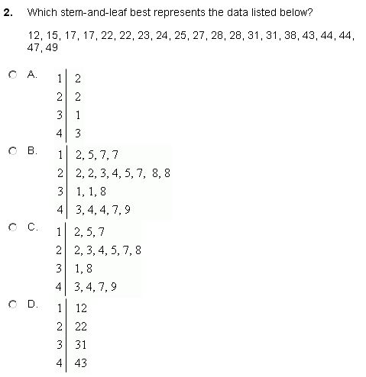

Slide 18
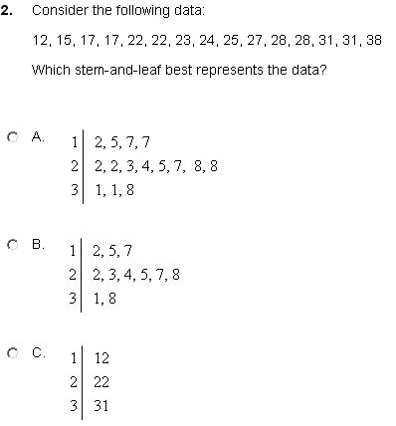

Slide 19
Option | N | % | Ptbs
A | 10 | 4 | -0.17
B | 161 | 69 | 0.38
C | 36 | 16 | -0.23
D | 25 | 11 | -0.18

Slide 20
Option | N | % | Ptbs
A [B] | 323 | 68 | 0.40
B [C] | 99 | 21 | -0.25
C [D] | 53 | 11 | -0.27
Option | N | % | Ptbs
A | 10 | 4 | -0.17
B | 161 | 69 | 0.38
C | 36 | 16 | -0.23
D | 25 | 11 | -0.18

Slide 21
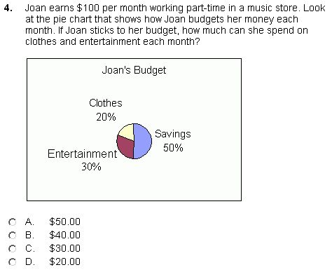
Option | N | % | Ptbs
A | 139 | 60 | 0.37
B | 24 | 10 | -0.25
C | 39 | 17 | -0.21
D | 31 | 13 | -0.08

Slide 22
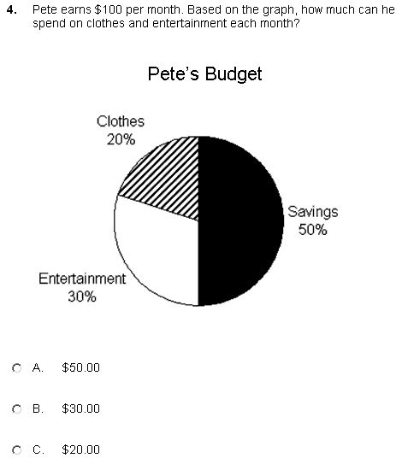
Option | N | % | Ptbs
A | 139 | 60 | 0.37
B | 24 | 10 | -0.25
C | 39 | 17 | -0.21
D | 31 | 13 | -0.08
Option | N | % | Ptbs
A | 323 | 68 | 0.35
B [C] | 88 | 19 | -0.34
C [D] | 67 | 14 | -0.10

Slide 23
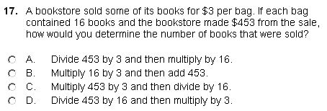
Option | N | % | Ptbs
A | 86 | 35 | 0.40
B | 51 | 21 | -0.28
C | 53 | 22 | -0.19
D | 53 | 22 | 0.01

Slide 24
Option | N | % | Ptbs
A | 86 | 35 | 0.40
B | 51 | 21 | -0.28
C | 53 | 22 | -0.19
D | 53 | 22 | 0.01
Option | N | % | Ptbs
A | 246 | 53 | 0.47
B | 107 | 23 | -0.41
C | 112 | 24 | -0.14

Slide 25
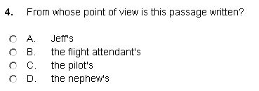
Option | N | % | Ptbs
A | 58 | 24 | -0.27
B | 24 | 10 | -0.37
C | 21 | 9 | -0.23
D | 136 | 57 | 0.59

Slide 26
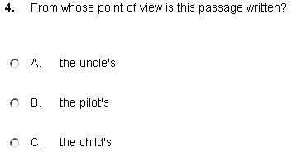
Option | N | % | Ptbs
A | 58 | 24 | -0.27
B | 24 | 10 | -0.37
C | 21 | 9 | -0.23
D | 136 | 57 | 0.59
Option | N | % | Ptbs
A [A] | 46 | 10 | -0.46
B [C] | 35 | 8 | -0.36
C [D] | 377 | 82 | 0.61

Slide 27
Option | N | % | Ptbs
A | 66 | 30 | -0.22
B | 111 | 50 | 0.49
C | 22 | 10 | -0.25
D | 24 | 11 | -0.24

Slide 28
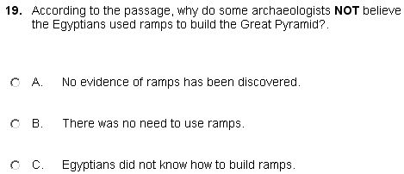
Option | N | % | Ptbs
A | 66 | 30 | -0.22
B | 111 | 50 | 0.49
C | 22 | 10 | -0.25
D | 24 | 11 | -0.24
Option | N | % | Ptbs
A [B] | 349 | 74 | 0.61
B [C] | 67 | 14 | -0.42
C [D] | 57 | 12 | -0.38

Slide 29
Option | N | % | Ptbs
A | 131 | 58 | -0.31
B | 30 | 13 | -0.10
C | 53 | 24 | 0.48
D | 10 | 4 | -0.07

Slide 30
Option | N | % | Ptbs
A | 131 | 58 | -0.31
B | 30 | 13 | -0.10
C | 53 | 24 | 0.48
D | 10 | 4 | -0.07
Option | N | % | Ptbs
A [A] | 123 | 26 | -0.38
B [B] | 85 | 18 | -0.23
C [C] | 265 | 56 | 0.51

Slide 31
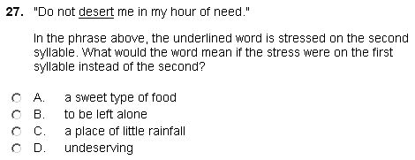
Option | N | % | Ptbs
A | 85 | 38 | 0.23
B | 69 | 31 | -0.26
C | 40 | 18 | 0.21
D | 30 | 13 | -0.21

Slide 32
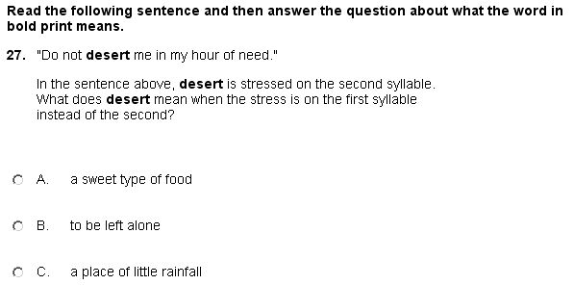
Option | N | % | Ptbs
A | 85 | 38 | 0.23
B | 69 | 31 | -0.26
C | 40 | 18 | 0.21
D | 30 | 13 | -0.21
Option | N | % | Ptbs
A [A] | 111 | 24 | -0.03
B [B] | 272 | 58 | -0.03
C [C] | 89 | 19 | 0.07

