Slide 1
EPSY 5244 Survey Data Analysis

Slide 2
Minnesota Student Survey
Population survey of students in grade 5, 8, 9, 11
162,034 students
Optional for schools
Administered every 3 years (2013 most recently)
Three forms of the survey
(5th [65 Qs], 8th [104 Qs], 9th/11th [116 Qs])
336 questions on the longer forms
Administered online and in paper form

Slide 3
Minnesota Student Survey - Intro
You can help your community and school learn more about the lives and feelings of young people like you. The questions on this survey cover many areas. Some questions might make you feel uncomfortable. You do not have to answer any question you don’t want to. You can choose not to complete the survey.
Do NOT write your name on this survey. No one will know how you answered these questions. Your answers will be kept private. Thank you for filling out this survey honestly and carefully.

Slide 4
MSS - Topics
Background
School
Out of School Activities
Health
Behavior

Slide 5
MSS Scaling
Developmental Skills | Developmental Supports | Developmental Challenges
1. Commitment to Learning | 1. Empowerment | 1. Bullying
2. Positive Identity | 2. Supported | 2. Bullied
3. Social Competence | 3. Teacher/School Support | 3. School Violence
 |  | 4. Mental Distress
 |  | 5. Family Violence

Slide 6
Measurement Model - CFA
Model fit is indicated by:
RMSEA < .05 is Good Fit; RMSEA < .08 is Adequate Fit
CFI > .95 is Good Fit; CFI > .90 is Adequate Fit
TLI > .95 is Good Fit; TLI > .90 is Adequate Fit

Slide 7
MSS – Commitment to Learning CFA
MODEL FIT INFORMATION
RMSEA (Root Mean Square Error Of Approximation)
Estimate 0.081
90 Percent C.I. 0.080 0.082
Probability RMSEA <= .05 0.000
CFI/TLI
CFI 0.943
TLI 0.921

Slide 8
MSS – Commitment to Learning CFA

Slide 9
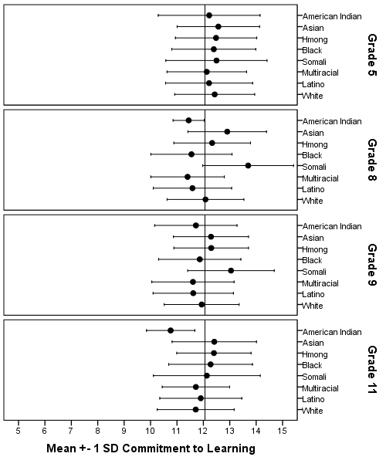
Commitment to Learning: Race Profiles

Slide 11
Disparities: Commitment to Learning

Slide 12
8th Grade MCA & CtL Disparities

Slide 14
Disparities in OST Participation v Non-Participation

Slide 15
% Equipped: Social Competence

Slide 16
Equipped & After-School Participation
 | % in at least one activity by grade
# of skills equipped | 5 | 8 | 9 | 11
0 | 70% | 67% | 66% | 61%
1 | 77% | 77% | 77% | 74%
2 | 81% | 84% | 84% | 82%
3 | 87% | 89% | 90% | 88%

Slide 17
Equipped and Grades
 | GPA by grade level
# of skills equipped | 5 | 8 | 9 | 11
0 | 2.7 | 2.4 | 2.4 | 2.5
1 | 3.1 | 3.0 | 3.0 | 3.0
2 | 3.3 | 3.3 | 3.2 | 3.2
3 | 3.5 | 3.5 | 3.5 | 3.5

Slide 18
Does working affect after-school participation?
In one anonymous school district: Not by much.
Of the students in grades 8-11 (the work question was not given to 5th graders), about 31% report to work at least 1 hour a week (of these, 22% work more than 10 hours per week).
Of those working, 77% participate in after-school activities.
Of those not working, 70% participate in after-school activities.

Slide 19
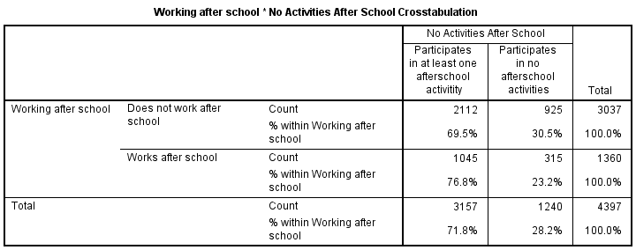

Slide 20
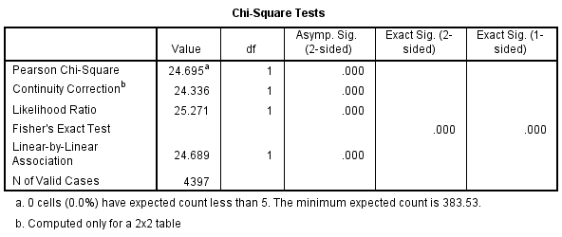
Chi-Square Test of Independence

Slide 21
Effect Size – Magnitude of Effect

