Slide 1


Hypothesis Testing for Ordinal & Categorical Data
EPSY 5245
Michael C. Rodriguez

Slide 2
Survey Data
Quantitative Data (not typical for surveys)
  Age, income, height, weight
  Counts of things (children, books, credits earned)
Qualitative Data
  Nominal Categories (gender, race, political affiliation, state of residence)
  Ordered Categories (level of satisfaction or agreement, frequency of behaviors)
  Descriptive Comments (open-ended responses)

Slide 3
Levels of Measurement
Nominal
Ordinal
Interval
Ratio

Slide 4
Steven’s Scales of measurement
A classification of scales of measurement.
Nominal, ordinal, interval, ratio.
“…measurement, in the broadest sense, is defined as the assignment of numerals to objects or events according to rules. The fact that numerals can be assigned under different rules leads to different kinds of scales and different kinds of measurement.”
“…the statistical manipulations that can legitimately be applied to empirical data depend upon the type of scale against which the data are ordered.”
Stevens, S. S. (1946). On the theory of scales of measurement. Science, 103, 677-680.

Slide 5
Quantitative Analysis of
Qualitative Data
There is a tendency to use numeric labels as category labels or as option labels.
On a scale of 1 to 4, please indicate your level of satisfaction with the following services, where 1 is dissatisfied and 4 is satisfied.
Dissatisfied | Somewhat Dissatisfied | Somewhat Satisfied | Satisfied
1 | 2 | 3 | 4
 |  | ● | ❍

Slide 6
Measuring Attributes
Continuity is a property of an attribute, not the measurements of that attribute.
  e.g., Length is a continuous variable but measured in inches it is discrete.
Ordinal variables can have two meanings:
  Attribute is continuous, but measurement is discrete and ordinal denoting order along the continuum (e.g., rating scales).
  Discrete variable that denotes rank.

Slide 7
Hypothesis Tests for Nominal Variables
Chi-square test of independence
Measures of strength of association
    Phi coefficient (2x2 tables)
    Cramer’s phi (larger than 2x2 tables)
  Proportional reduction in error
    Goodman & Kruskal’s Tau
    Lambda (based on modes – use with caution)

Slide 8
Proportional Reduction in Error
The value of the statistic tells us approximately how many fewer errors we will make when predicting the dependent variable when we know the values of the independent variable.
Example: Lambda = .45 between gender and religious affiliation. Errors in predicting religious affiliation are reduced by 45% when we know gender.

Slide 9
Chi-square test
Actually two-tests
  Goodness-of-fit test (one variable)
    Equal or predetermined expected frequencies.
    Answers the question: Do our observed frequencies fit the expected frequencies?
  Test of independence (two variables)
    This is the test we are interested in, expected frequencies calculated based on observed data.
    Answers the question: Are these two variables independent (i.e., are they related)?

Slide 10
Chi-square Test
Form of the chi-square:
Degrees of freedom = (J-1)(K-1)
  J = number of levels for first variable
  K = number of levels for second variable
Expected frequency for a cell (for test of independence)
  (Column total x Row total)/ Grand total

Slide 11
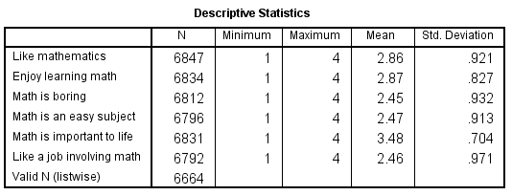
TIMSS 1994
SPSS analysis of 6 TIMSS middle school questions. 1=Strongly Disagree to 4=Strongly Agree

Slide 12
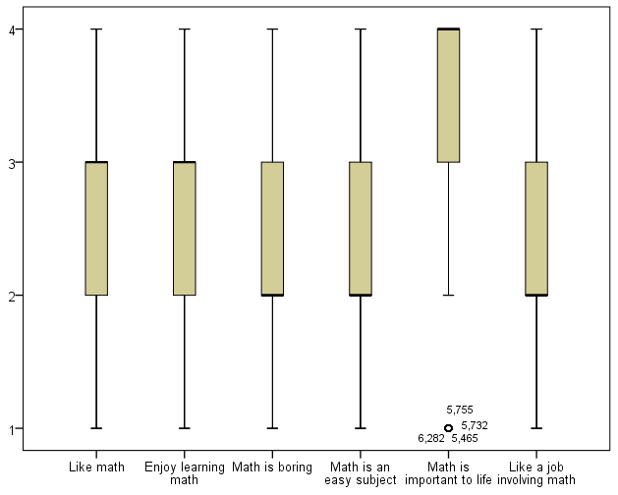

Slide 13
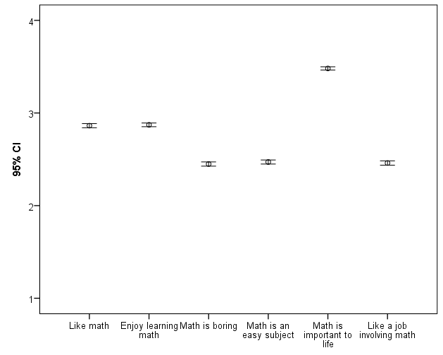

Slide 14
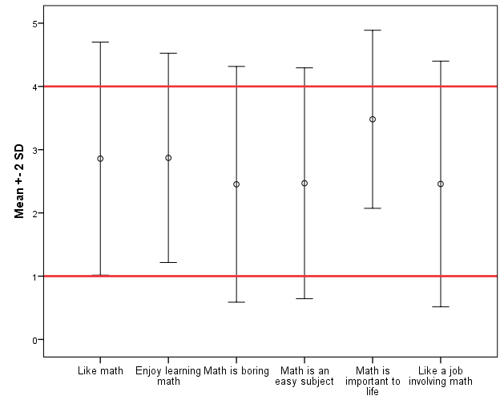

Slide 15
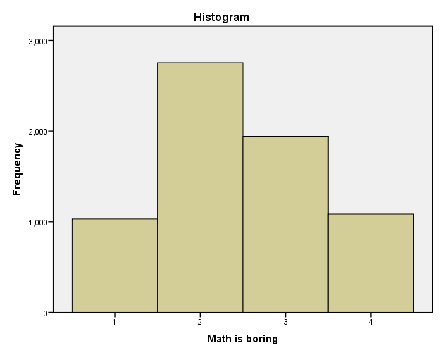
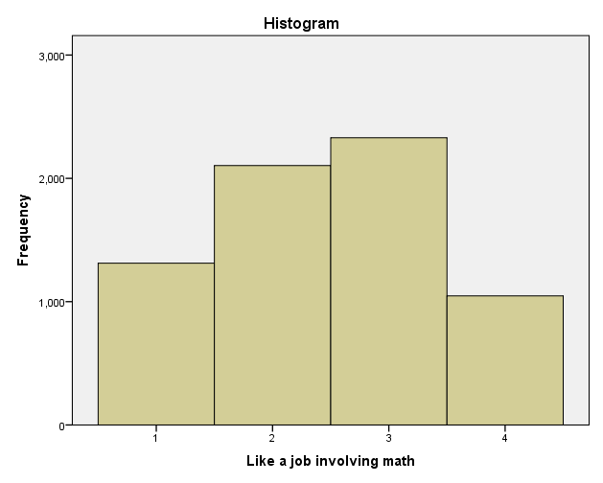
Mean = 2.45
Mean = 2.46

Slide 16
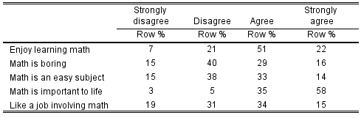
Table of Response %

Slide 17
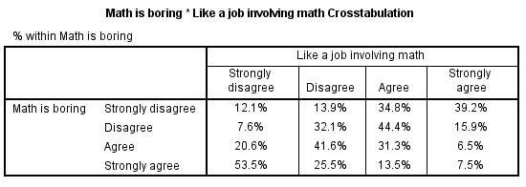
Crosstab of Boring/Job

Slide 18
Crosstab of Boring/Easy
χ²(9, n=6759) = 1794, p<.001.
Cramér’s phi magnitude of association = .29

