Slide 1


Graphical Displays of Data
EPSY 5245
Michael C. Rodriguez

Slide 2
Graphical Display of Data
Format depends on purpose
Make important data stand out
Draw attention to the important features of the data
Focus on the data of concern
Proofread and ask:
  Does this say what I need it to say?

Slide 3
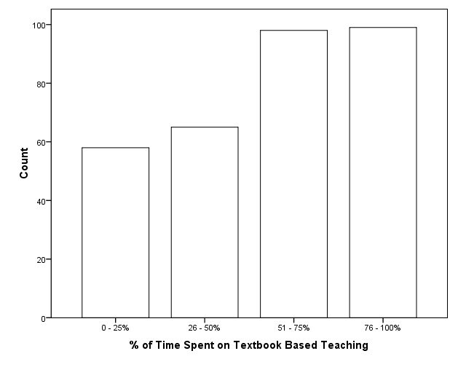
Notes:
Bar chart: counts, proportions, discrete variables – descriptive variables.
Bars should be wider than gaps. Consider gridlines carefully – not to distract, but to guide comparison.

Slide 4
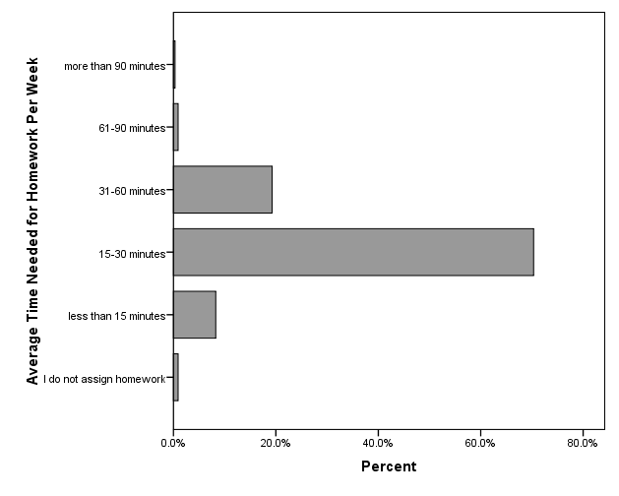
Notes:
Helps with longer labels, many labels.
Use logical order when possible; otherwise, order based on frequency.

Slide 5
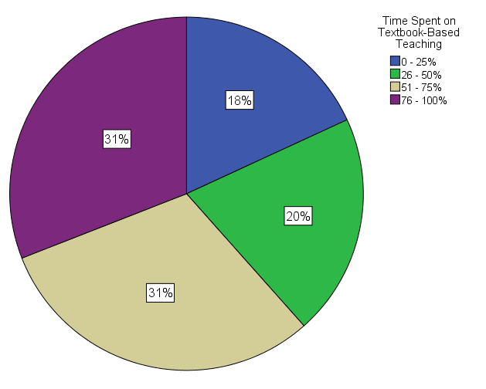
Pie Charts?
Useful to show parts of a whole
Composition

Slide 6
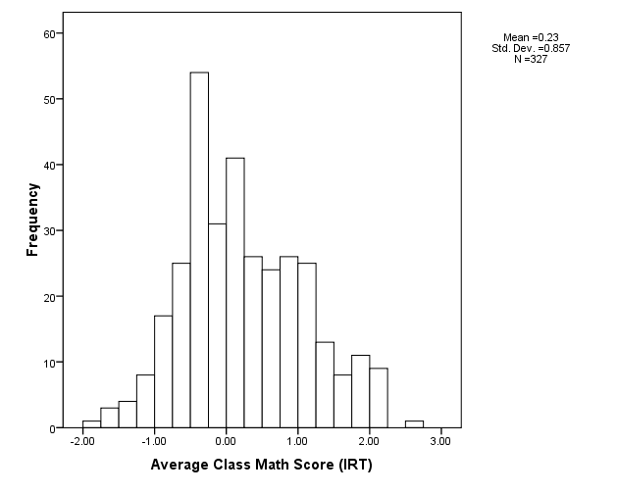

Slide 7
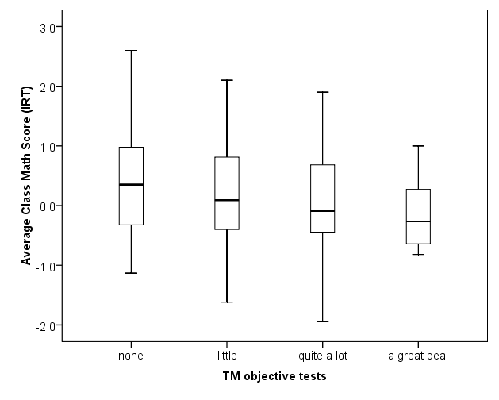
Notes:
Distributions of a quantitative variable conditioned on a qualitative variable
Median, interquartile range, min and max

Slide 8
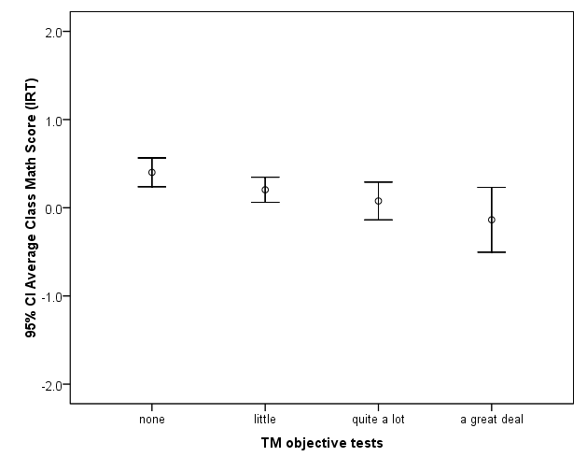

Slide 9
Graphs
Everything on the graph should be explained
  Title (descriptive & distinguishing, yet brief)
  Labels (scale metric, categories, data points)
  Legend (should also have a title)
Items on the graph should be easily distinguished:
  Design (draws focus to important data)
  Shading (remains distinguishable after poor copying)
  Size (legibility)

Slide 10
Graphs
The scale should be sensible – showing the full range of possible values
Avoid 3-D, creating distortion and false contrasts; unless you have a genuine 3rd dimension
At a minimum, displayed scale values should be consistent across a set of graphs
Date and source the graphs
  At the bottom, place the data the graph was produced and ID the producer

Slide 11
Notes:
Grouped bar charts. Only when there are two or three categories.

Slide 14
Note: Numbers above the bars report the percentage of students who improved by 10% or more.

Slide 15
Tables
Date (what time period is covered)
Complete title (descriptive and brief)
Labels should be descriptive and consistent across the set of tables
Decided between counts and percentages
  Are the proportions, actual numbers, or both important?
Always report totals and sample sizes
  Allow readers ability to recalculate percentages.

Slide 16
Table Notes
Notes to tables should provide details that may or may not be in the text, but are important to interpret the table results
  Sources of the data
  Special statistical tests
  Modified data (based on subgroups, or excluding some cases)
  Missing data (including number)

Slide 17
How often do you speak English at home?
 |  | Frequency | Percent | Valid Percent | Cumulative Percent
Valid | always or almost always | 6049 | 88 | 88 | 88
 | sometimes | 783 | 11 | 11 | 99
 | never | 80 | 1 | 1 | 100
 | Total | 6912 | 100 | 100

Slide 18
Table 1 How often do you speak English at home?
Response | Count | Percent
Always or almost always | 6049 | 88
Sometimes | 783 | 11
Never | 80 | 1
Total | 6912 | 100

Slide 19
Table 1
How often do you speak English at home?
 | Were you born in the USA?
 | No |  | Yes
 | Count | % | Count | %
Always or almost always | 312 | 50 | 5737 | 91
Sometimes | 271 | 44 | 512 | 8
Never | 40 | 6 | 40 | 1
Total | 623 | 100 | 6289 | 100

Slide 20
Figure 1. How often do you speak English at home?

Slide 23
 |  | n | Percent | Valid Percent | Cumulative Percent
Valid | Finish primary school | 219 | 3.2 | 3.5 | 3.5
 | Finish some secondary school | 678 | 9.8 | 10.7 | 14.2
 | Finish secondary school | 1602 | 23.2 | 25.3 | 39.4
 | Some vocational education | 579 | 8.4 | 9.1 | 48.6
 | Some university | 1688 | 24.4 | 26.6 | 75.2
 | Finish university | 1570 | 22.7 | 24.8 | 100.0
 | Total | 6336 | 91.7 | 100.0
Missing | I don't know | 419 | 6.1
 | System | 157 | 2.3
 | Total | 576 | 8.3
Total |  | 6912 | 100.0

Slide 25
Percent on FRL in SPPS

Slide 26
Percent in ELL in SPPS

Slide 27
Percent Below Average in Reading

Slide 28
% FRL v. % Below Average

Slide 29
Corrected Scales
Proportion on Free & Reduced Lunch

Slide 30
Highest Mother Ed & Math Score

Slide 31
Highest Mothers Ed & Math Score

Slide 32
Crosstab
What is the highest education level of your mother? * Usually Speak English at Home Crosstabulation
 |  | Usually Speak English at Home |  | Total
 |  | No | Yes | No
What is the highest education level of your mother? | Finish primary school | 116 | 103 | 219
 |  | 53.0% | 47.0% | 100.0%
 | Finish some secondary school | 120 | 558 | 678
 |  | 17.7% | 82.3% | 100.0%
 | Finish secondary school | 151 | 1451 | 1602
 |  | 9.4% | 90.6% | 100.0%
 | Some vocational education | 74 | 505 | 579
 |  | 12.8% | 87.2% | 100.0%
 | Some University | 136 | 1552 | 1688
 |  | 8.1% | 91.9% | 100.0%
 | Finish University | 135 | 1435 | 1570
 |  | 8.6% | 91.4% | 100.0%
Total |  | 732 | 5604 | 6336
 |  | 11.6% | 88.4% | 100.0%

Slide 34
Notes:
It is more useful to stack here, too many bars stacked are difficult to distinguish

Slide 36

Order of items from questionnaire
Source: Miller, 2013.
Notes:
This chart shows the same information as the preceding table, preserving the order of items from the GSS questionnaire. It is much easier to observe direction and magnitude of the response pattern from the chart than from the table. With the table, readers must perform mental arithmetic to figure out “Which is higher? How much higher?” In the chart, the relative heights of bars make it easy to see that pattern.
For slides to be used in a speech or to display a complex pattern, a chart is usually preferable. If precise numeric values are needed, a table is the better choice.
A second point to observe from this chart is that it is hard to discern a systematic pattern because the heights of the bars vary erratically from left to right. This order encourages writers either to report the height of each of the six bars individually, to describe a series of pairwise comparisons of agreement levels for different items, or to choose an arbitrary item or two to report. None of these approaches facilitates an understanding of the overall pattern.

Slide 37

Alphabetical order
Source: Miller, 2013.
Notes:
This chart reorganizes the items in alphabetical order, which is no better than the preceding chart for facilitating a clear description of the pattern. Again, the ordering encourages writers to report agreement rates for individual circumstances of abortion rather than teasing out a pattern among all six circumstances.
A second problem is that different researchers might abbreviate the question names differently, resulting in inconsistent alphabetical ordering of the same items. For example, what I called “wants no more” could have been labeled “married, wants no more,” which would place it 4th rather than 6th in the alphabetical sequence.

Slide 38
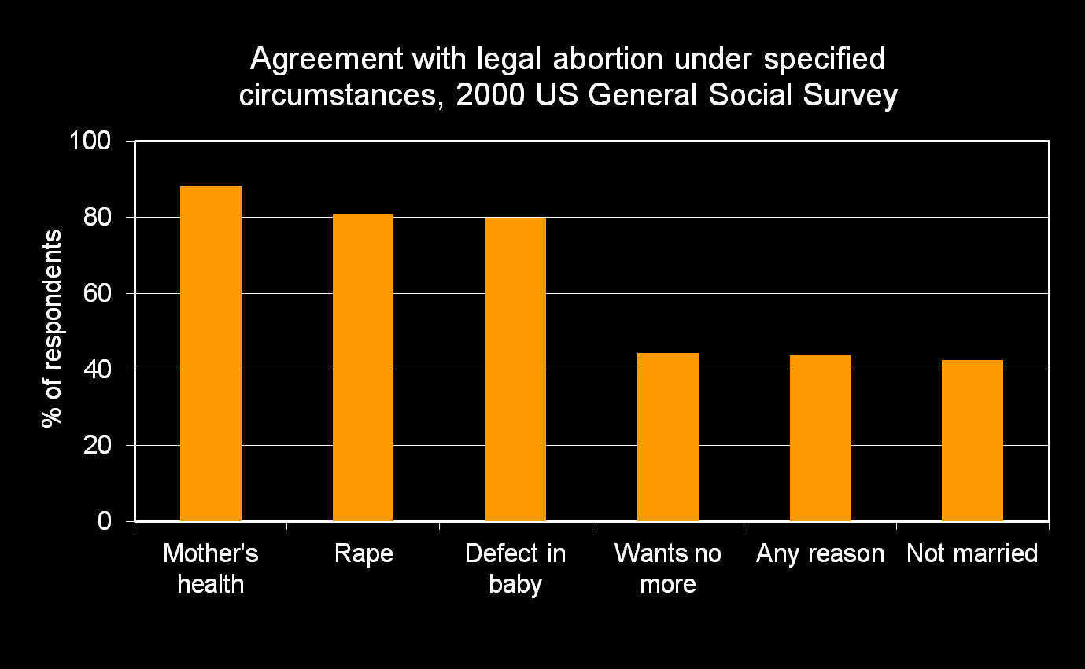
Empirical order (descending)
Source: Miller, 2013.
Notes:
This chart reorganizes the same information in descending empirical order of level of agreement. Immediately we have a much easier time identifying a pattern because the six items clearly cluster into two distinct groups. This encourages a systematic and condensed description: “Respondents were nearly twice as likely to agree with legal abortion under the three circumstances on the left than under the three circumstances on the right.” This description is a big improvement over six separate sentences, each reporting rates of agreement for a given abortion circumstance.

Slide 39
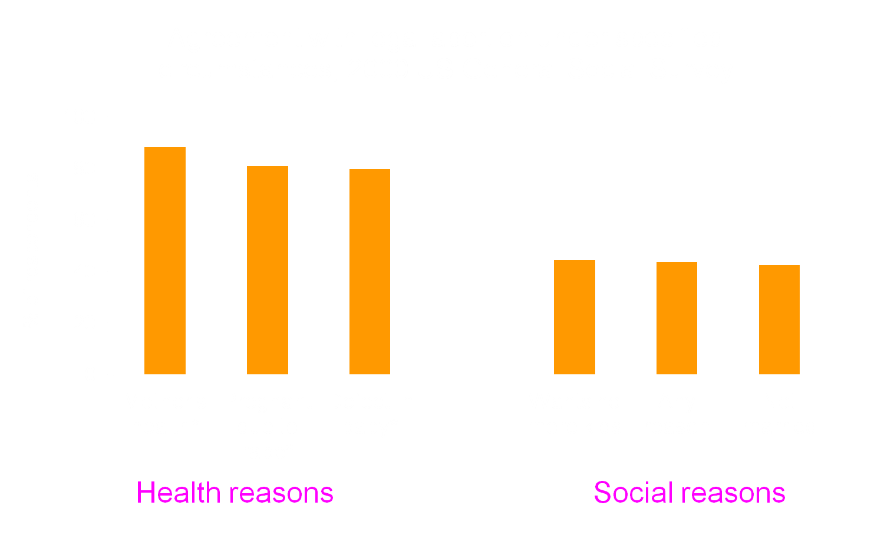
Theoretical grouping
Source: Miller, 2013.
Notes:
However, the emergence of this pattern begs the question “what do each of those clusters have in common that makes agreement levels so similar within each cluster?” In other words, is there a conceptual similarity among the three items in the cluster on the left? The three items in the cluster on the right?
A bit of thought yields possible labels for each cluster: mother’s health, pregnant due to rape, and defect in the baby can all be considered health reasons for seeking an abortion. Wants no more, any reason, and not married might be considered social reasons. Adding those labels to the chart conveys the theoretical distinction between the two clusters.

Slide 40
Final Notes
Make it easier for the reader
Keep graph and associated text (explanation) on the same page; text first, followed by graph
Graphs and associated tables can be presented, if discussed in the text – otherwise put associated tables in the appendix (especially if tables are large)
Use consistent font – so that when printed, is 12 pt.

Slide 41
MSS Reports
Gender by Grade
 |  |  | Grade 5 | Grade 8 | Grade 9 | Grade 11 | Total
Gender | Male | n | 1009 | 639 | 954 | 907 | 3509
 |  | % | 51.7% | 50.5% | 49.2% | 49.7% | 50.3%
 | Female | n | 941 | 627 | 985 | 918 | 3471
 |  | % | 48.3% | 49.5% | 50.8% | 50.3% | 49.7%
Total |  | N | 1950 | 1266 | 1939 | 1825 | 6980

Slide 42
Grade 5
 |  | Race/Ethnicity |  |  |  |  |  |  |  | Total
 |  | Am Indian | Asian | Black | White | Multi-racial | Latino | Somali | Hmong
I stay at my school or go to another school? | n | 7 | 27 | 80 | 77 | 35 | 54 | 14 | 81 | 375
 | % | 25.0% | 20.8% | 24.5% | 18.5% | 21.1% | 19.4% | 22.2% | 23.1% | 21.3%
Your home or another home such as a friend's, relative's or neighbor's? | n | 24 | 102 | 235 | 364 | 129 | 229 | 46 | 275 | 1404
 | % | 85.7% | 78.5% | 72.1% | 87.5% | 77.7% | 82.4% | 73.0% | 78.6% | 79.9%
A rec, community or other youth center? | n | 0 | 14 | 87 | 45 | 40 | 32 | 16 | 18 | 252
 | % | 0.0% | 10.8% | 26.7% | 10.8% | 24.1% | 11.5% | 25.4% | 5.1% | 14.3%
A park or other outdoor space? | n | 6 | 28 | 66 | 57 | 39 | 65 | 19 | 54 | 334
 | % | 21.4% | 21.5% | 20.2% | 13.7% | 23.5% | 23.4% | 30.2% | 15.4% | 19.0%
A library? | n | 6 | 34 | 45 | 23 | 20 | 28 | 18 | 50 | 224
 | % | 21.4% | 26.2% | 13.8% | 5.5% | 12.0% | 10.1% | 28.6% | 14.3% | 12.7%
A church, synagogue, mosque, or other spiritual/religious place? | n | 2 | 11 | 38 | 15 | 13 | 23 | 16 | 29 | 147
 | % | 7.1% | 8.5% | 11.7% | 3.6% | 7.8% | 8.3% | 25.4% | 8.3% | 8.4%
Some other place, such as a mall or movie theatre? | n | 6 | 25 | 82 | 47 | 56 | 87 | 22 | 82 | 407
 | % | 21.4% | 19.2% | 25.2% | 11.3% | 33.7% | 31.3% | 34.9% | 23.4% | 23.2%

Slide 43
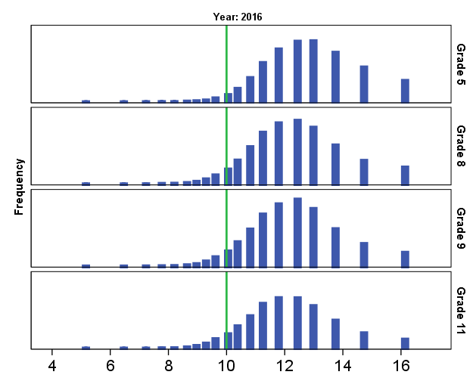
MSS Distributions

Slide 44
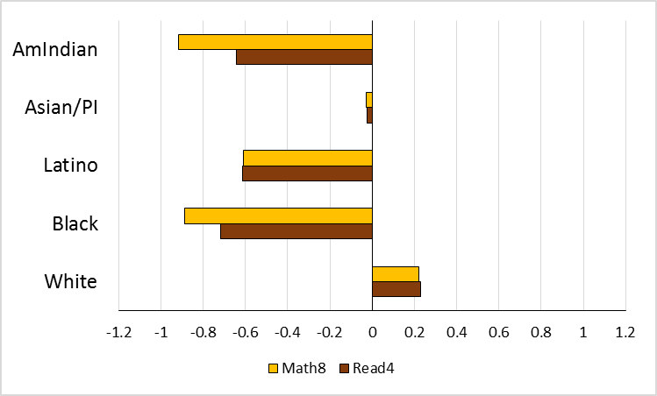
2015 NAEP Disparities

Slide 47
2016 MSS Disparities

Slide 48
MSS Profiles

Slide 49
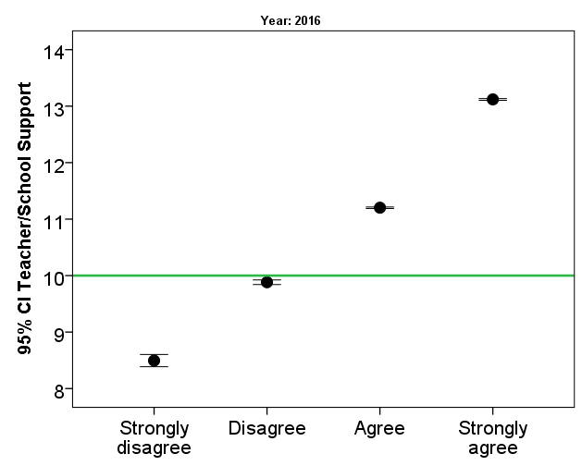
Bivariate Comparisons
Feel Safe at School

Slide 50
MSS: Post High School Plans

Slide 51
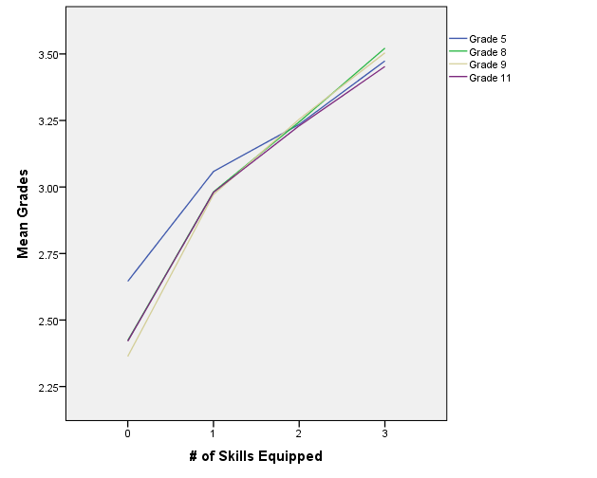
Default SPSS Output

Slide 52
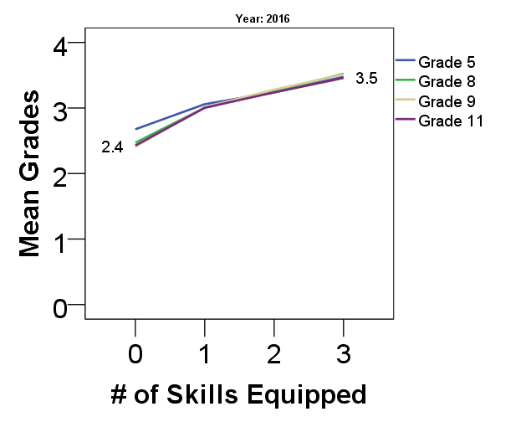
Bivariate Association

Slide 53
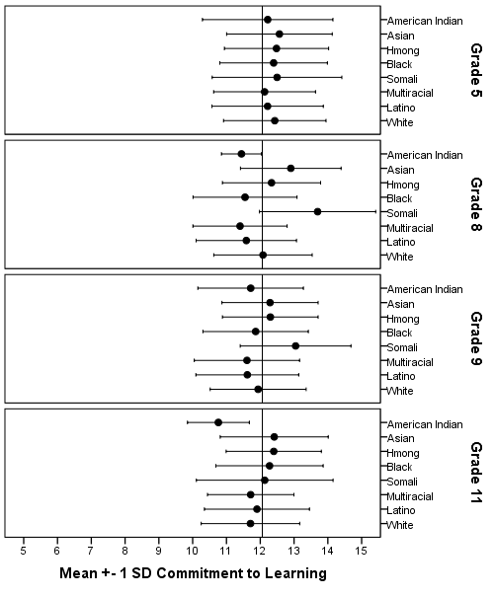
MSS Data displaying means and variability

Slide 54
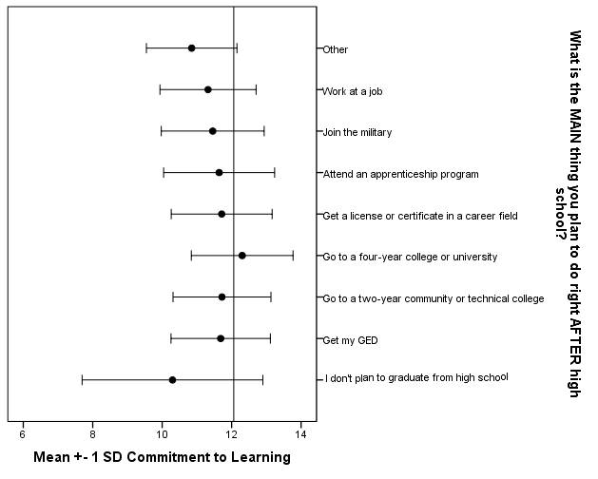

Slide 55
Positive Identity
4%
6%
6%
31%
3%
17%
13%
Social Competence
Commitment to Learning
Not Equipped: 20%

