Slide 1


Graphical Displays of Data: Avoiding Chartjunk and Other Graphics Advice
EPSY 5245
Michael C. Rodriguez

Slide 2
Rougier, Droettboom, Bourne (2014)
Know your audience
Identify your message
Adapt the figure to the support medium (paper, poster, screen)
Captions are not optional
Do not trust the defaults
Use color effectively
Do not mislead the reader
Avoid chartjunk
Get the right tool

Slide 3
Which charts to use
Line Charts
  To analyze trends, patterns, and exceptions
Bar Charts
  To illustrate specific comparisons in time
  To compare categorical data
Scatter Plots
  To visualize how two attributes vary together
Box Plots
  To view and compare distributions
Source: Lyons, 2010

Slide 4
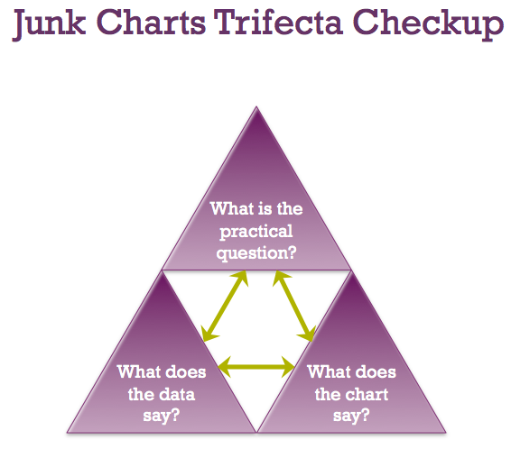
junkcharts.typepad.com

Slide 5
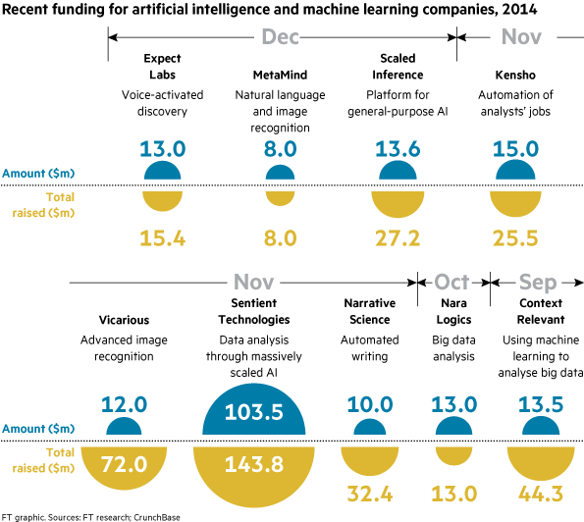
Self-Sufficiency: visual should be easier to read than the data
Financial Times

Slide 6
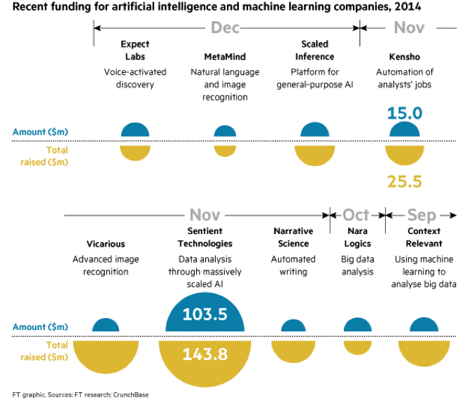
Self-Sufficiency Test

Slide 7
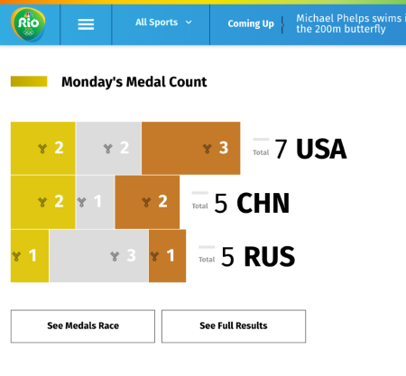
Olympic Medal Count
NBC

Slide 8
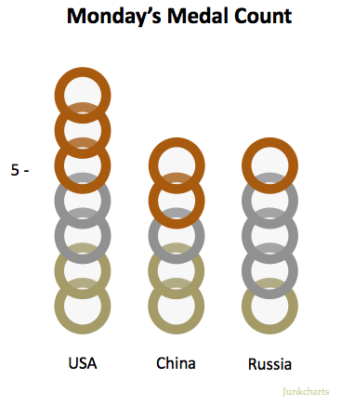
Revision

Slide 9
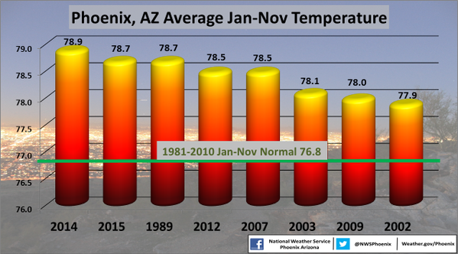

Slide 10
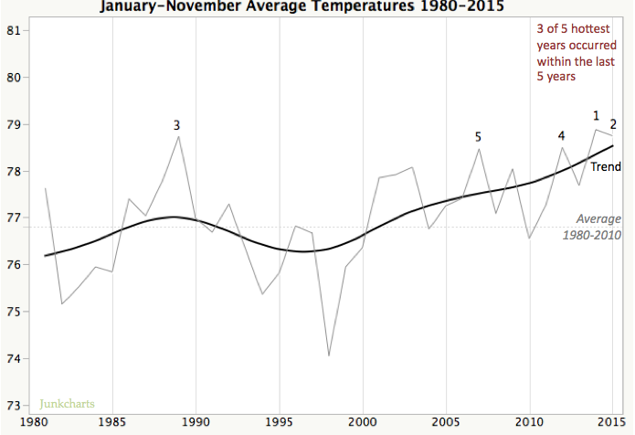

Slide 11
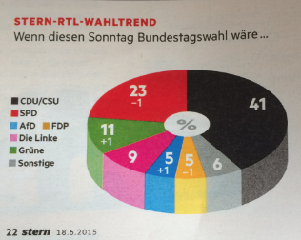
Poll results compared to prior results
Stern Magazine

Slide 12
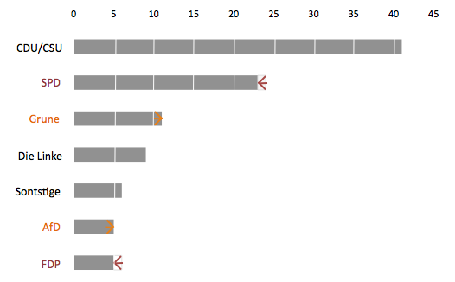

Slide 13
Roughly how long did you spend yesterday…watching television (not online) / using the internet on a laptop or PC / on a smartphone / on a tablet?

Slide 14
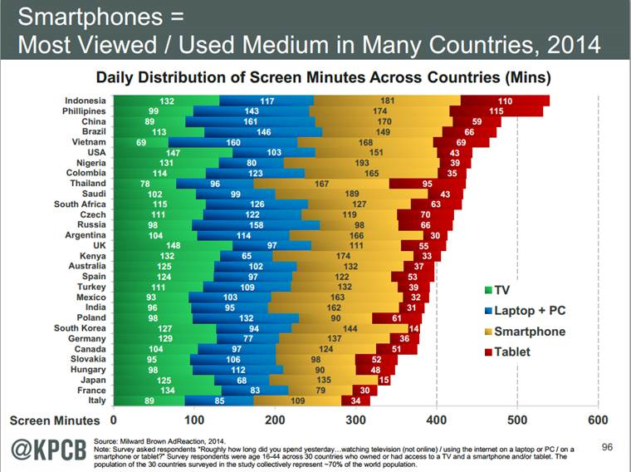

Slide 15
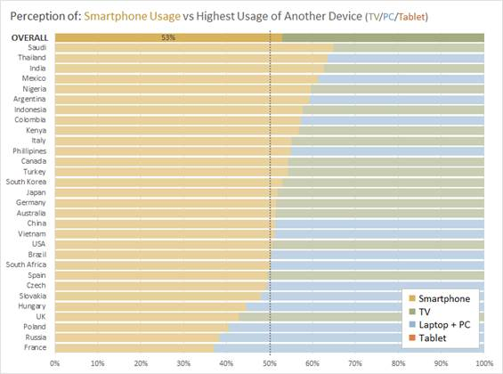

Slide 16
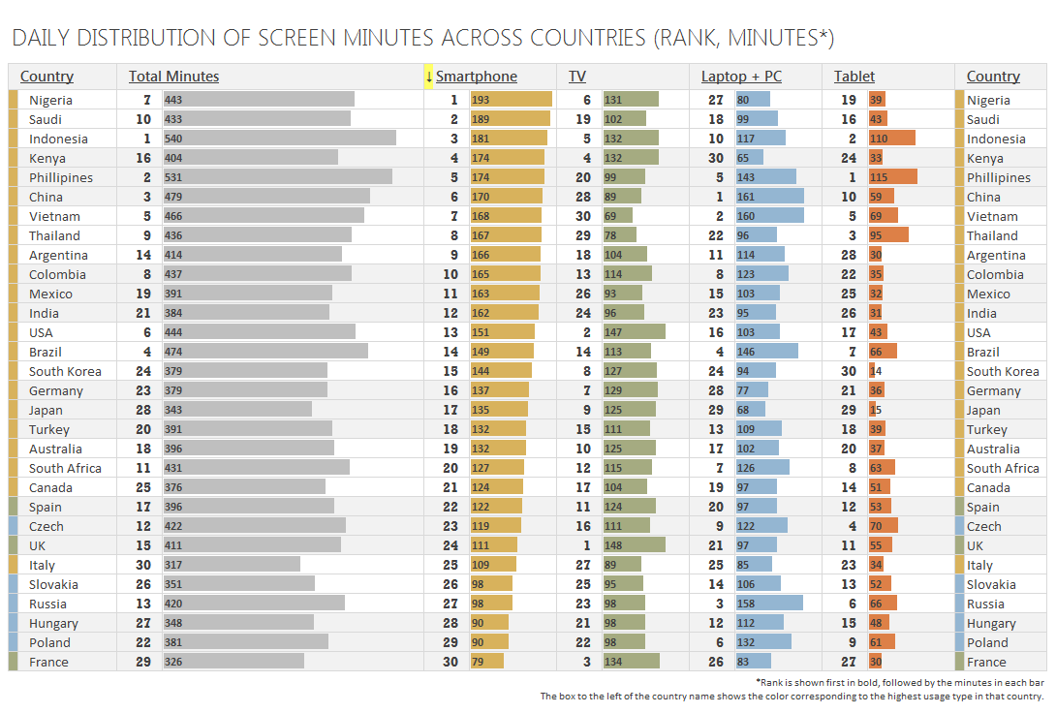

Slide 17
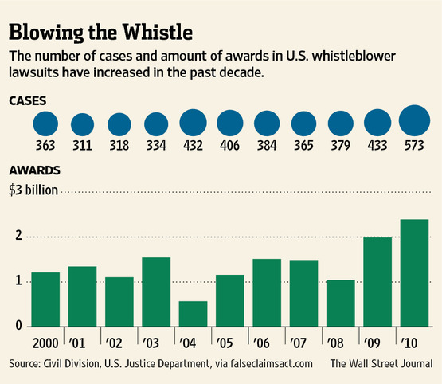

Slide 18
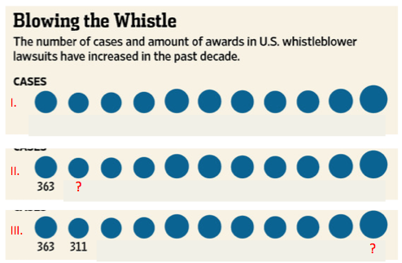
Self-Sufficiency Test

Slide 19
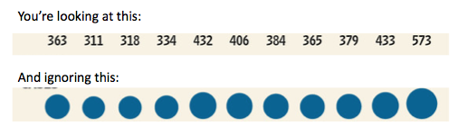
The conclusion about bubble charts:

Slide 20
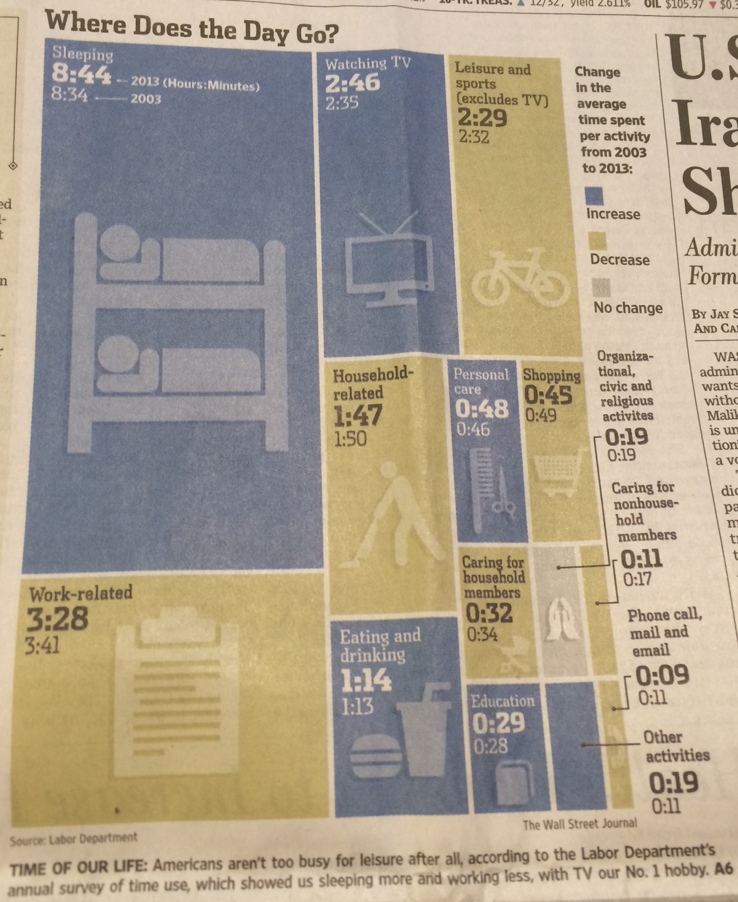
Wall Street Journal

Slide 21
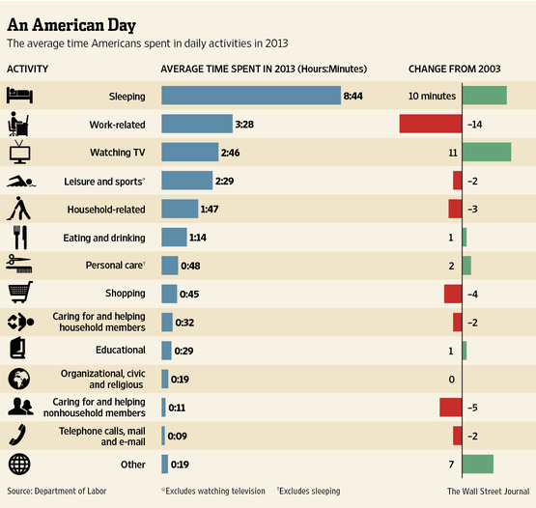

Slide 22
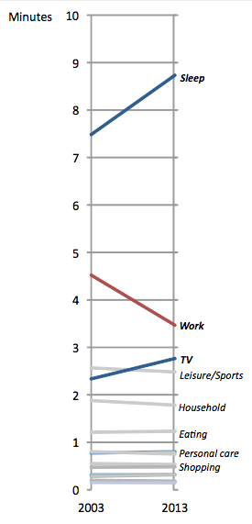
Bumps Chart

Slide 23
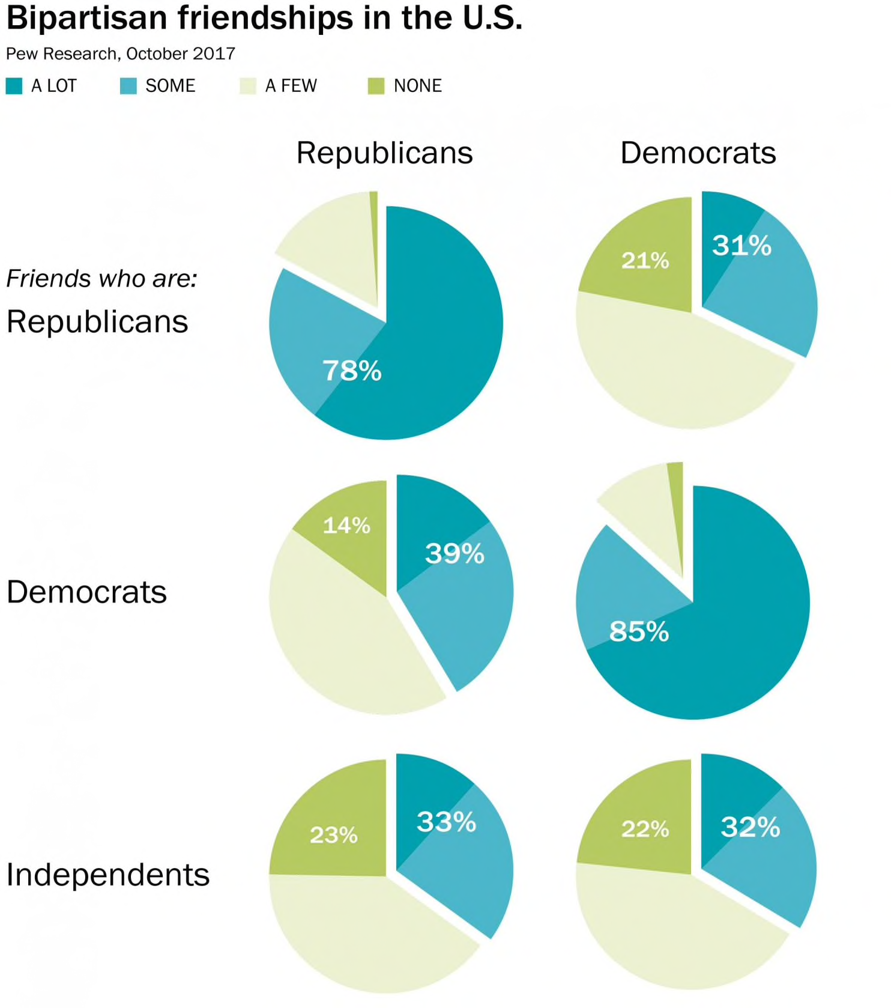
Washington Post

Slide 24
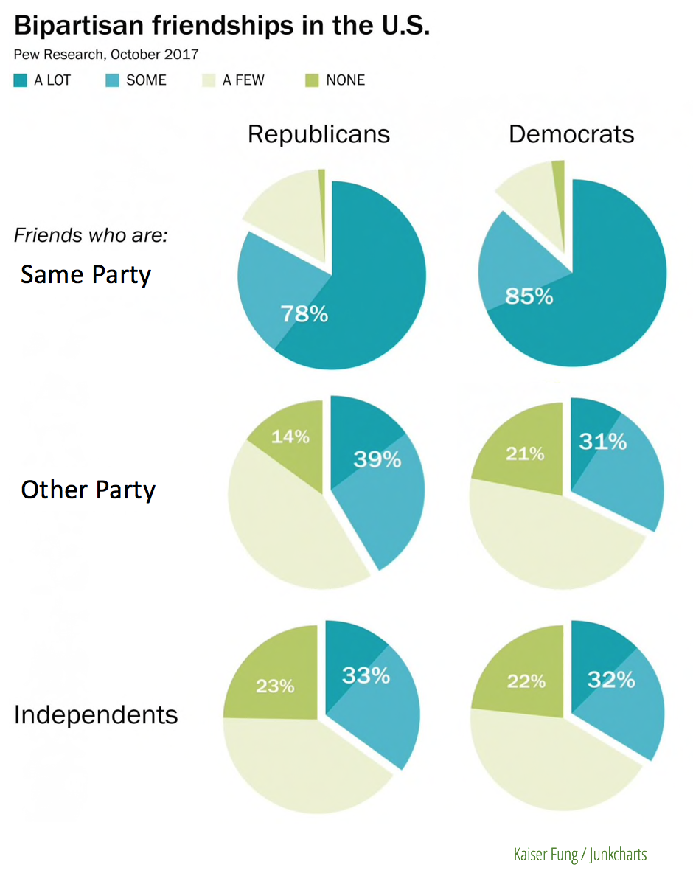
Reordered and relabeled

Slide 25
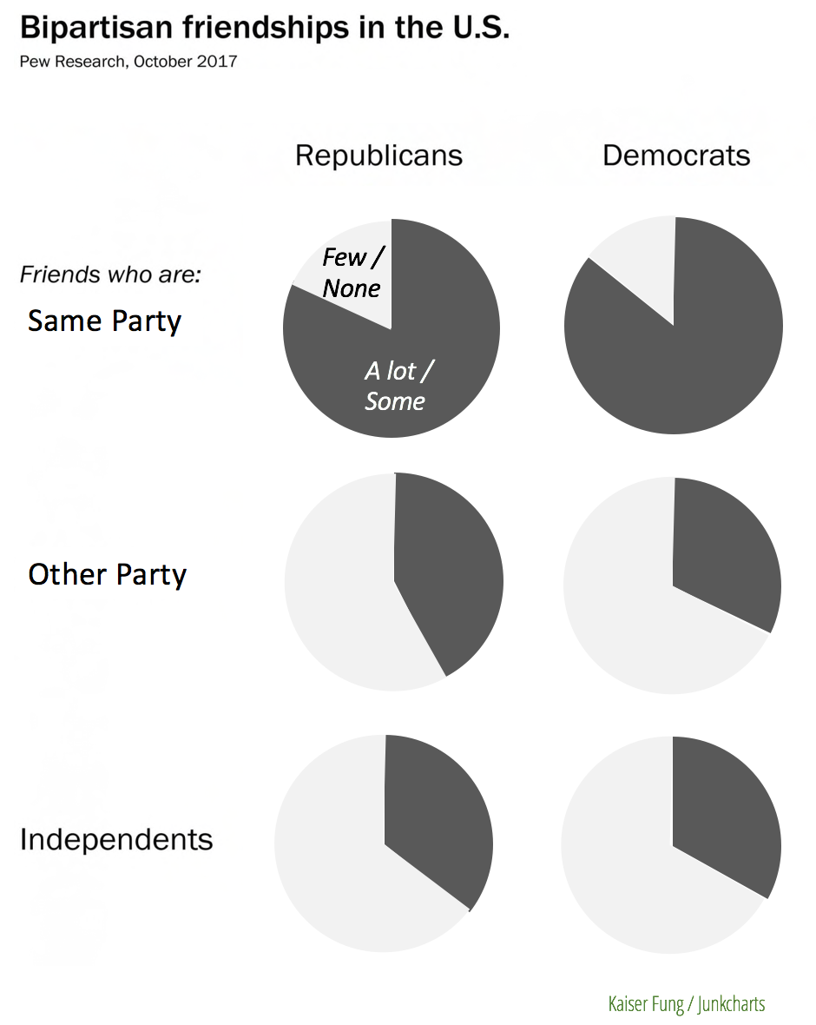
Simplify message

Slide 26
End of Junk Charts Examples

Slide 27
Common errors
Too much precision
Wrong graph type
Missing definitions or descriptions
Inconsistent scale
Misplaced zero point
Unnecessary chart effects (shading, 3D…)
Confusing length and area

Slide 28


All that glitters is not GOLD

Slide 29
Some Examples from Students in Class

Slide 30
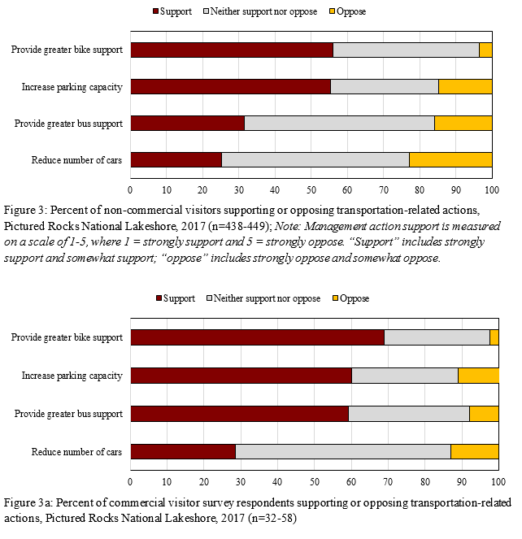

Slide 32
Table 1 shows the values of Cronbach’s alpha for each of the six subscales at both the pre and post-test administrations. All subscales showed sufficient reliability (alpha>0.70) using the same criteria as Schau and Emmioglu (2012).

Slide 33
Table 2 shows the average value of the subscales both pre- and post-course, as well as the change during the semester. Overall, students entered the course with generally neutral Affect and Difficulty attitudes (between 3.5 and 4.5), while Cognitive Competence, Interest and Value were positive (between 4.5 and 5.5), and Effort was very positive (above 5.5).

Slide 34
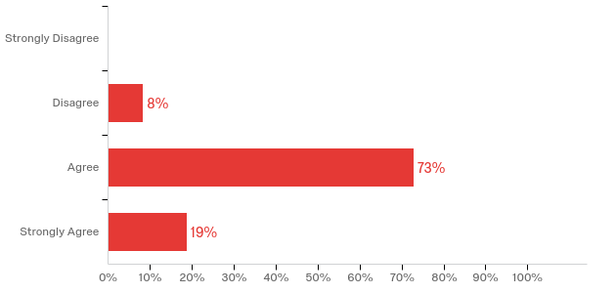
[Multiple Choice] My on the job tasks allowed me to continuously improve my skill sets.

Slide 35
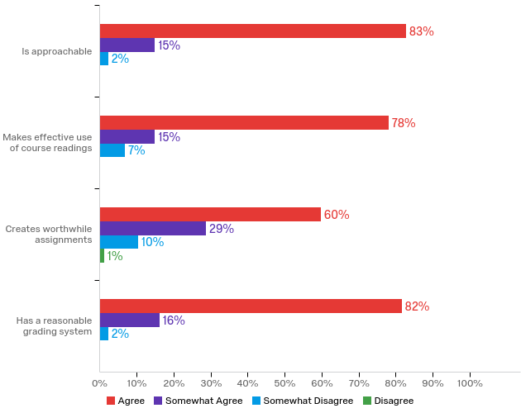
[Matrix Multiple Choice]
Rate your instructor in terms of the following characteristics:

Slide 36
Teacher and administrators rated each item using a 5-point, Likert-type scale (1 = not at all confidence, 2 = a little confident, 3 = somewhat confident, 4 = quite confident, 5 = very confident).

Slide 38
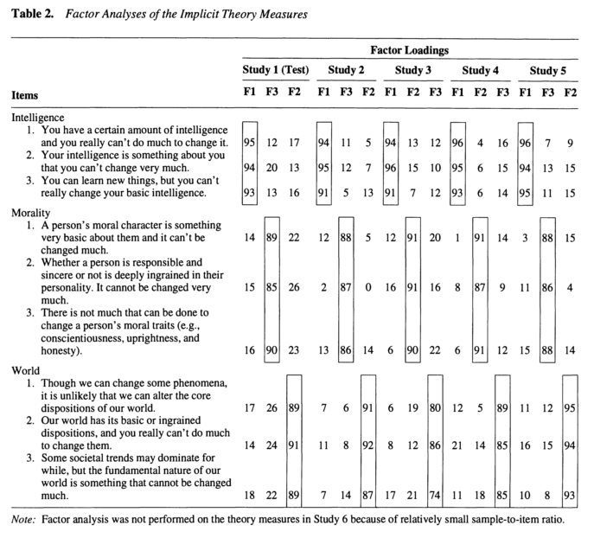

Slide 39
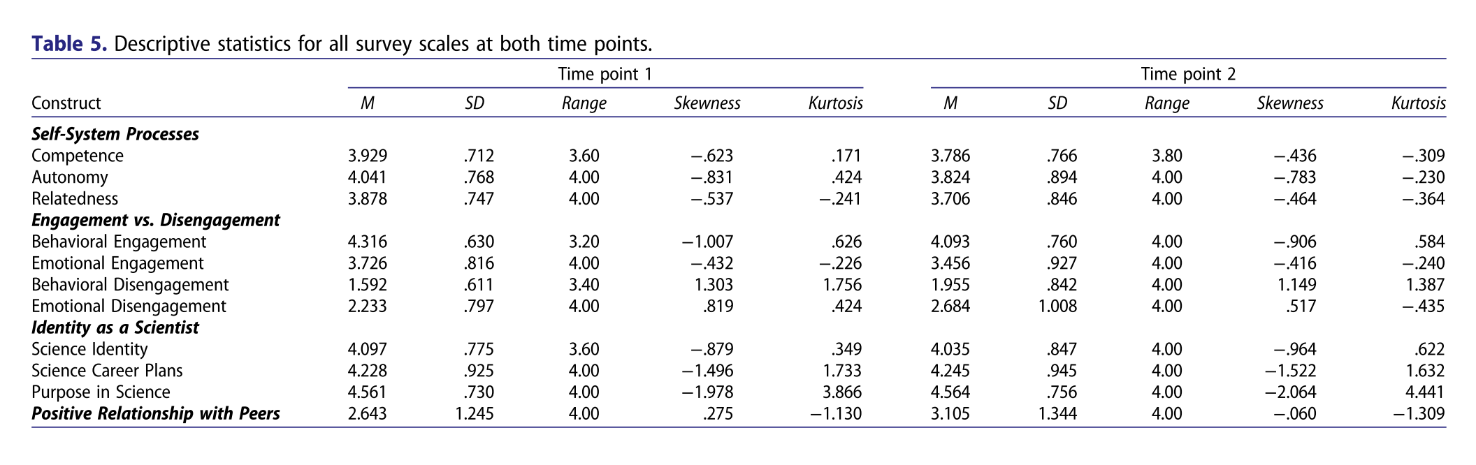

Slide 40
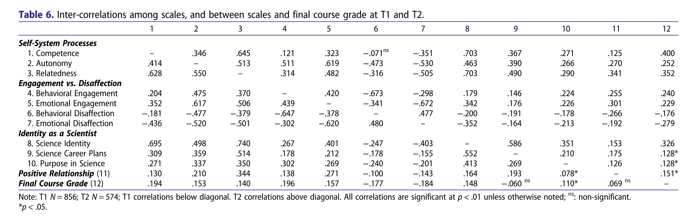

Slide 42
Additional Guidance
Use graphical representation when there are patterns in the data that are difficult to detect otherwise.
The visual should be universally understood without extensive written explanation
Strive for clarity
Never use 3D
Source: Lyons, 2010

Slide 43
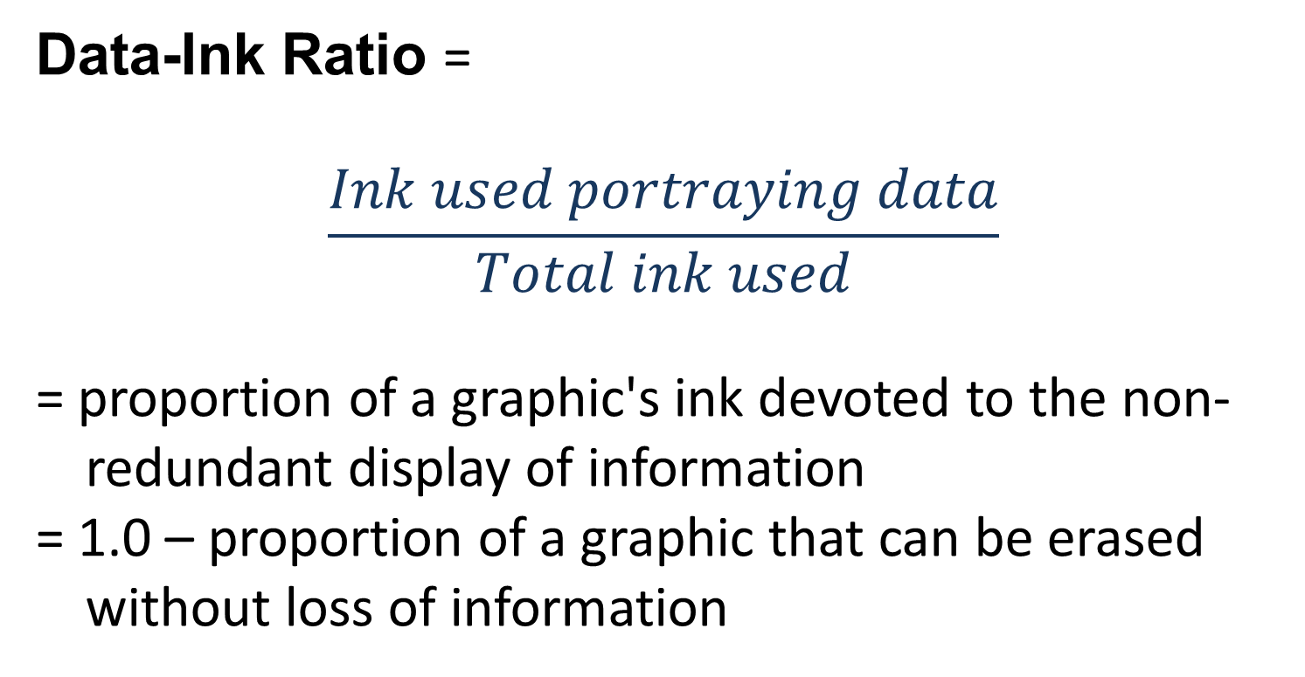
Tufte’s Graphical Efficiency Measure
Data-Ink Ratio =
$$\frac{Ink used portraying data}{Total ink used}$$
= proportion of a graphic's ink devoted to the non-redundant display of information
= 1.0 – proportion of a graphic that can be erased without loss of information
Source: Lyons, 2010

Slide 44
Graphic reprinted in Tufte, 1983
Source: Lyons, 2010

Slide 45
Source: Lyons, 2010

Slide 46
Additional Guidance
Gridlines are usually distracting
Reference line can help draw attention to important thresholds
Always include zero on bar charts
Scale span should encompass all of the data
Order data labels in the legend to match the order of the data
Avoid placing the legend inside the data rectangle
Lines should be thick enough to see without covering other data
Use line charts for time-series data
Place data values above lines when possible
Source: Lyons, 2010

Slide 47
Use color sparingly and smartly
Color to distinguish or emphasize data – not for decorating
Warm colors: red, orange, yellow
Cool colors: blue, violet, neutral gray
Objects rendered in warm colors appear larger than cool colors
Do not use colors from opposite sides of the color wheel together
Source: Lyons, 2010

Slide 48
Source: Lyons, 2010

Slide 49
Source: John B. Horrigan, 2010, Broadband Adoption and Use in America, US Federal Trade Commission
Source: Lyons, 2010

Slide 50
Source: U.S. Bureau of the Census 2004, We the People: Aging in the U.S.
Source: Lyons, 2010

Slide 51
Source: Lyons, 2010

Slide 52
Source: Lyons, 2010
Notes:
Suggests equivalence of gain in 100 thousand and 150 million

Slide 53
Source: Lyons, 2010

Slide 54
Additional Guidance
Don’t use shading/shadows on bar charts
Make bar width about 1 to 2 times the space between bars
Don’t mix colors or patterns
Never use 3D
Start at a zero baseline
Do not angle tick-mark labels – consider using a horizontal bar chart
Limit categories to three – colors don’t help
Source: Lyons, 2010

Slide 55
Wall Street
Journal standard:
gap = ½ bar width
Gap = bar width
seems okay also
Source: Lyons, 2010

