Slide 1


Multivariate Methods
EPSY 5245
Michael C. Rodriguez

Slide 2
Cluster Analysis
Generic name for a variety of procedures.
The procedures form clusters of similar entities (usually persons, but can be variables).
Groups persons based on commonalities on several variables.
Cases within a cluster are more alike than cases between clusters.
Definition of the variables on which to cluster is critical, as this defines the characteristic of each cluster.

Slide 3
Clustering for what?
Development of a classification or typology.
Investigate useful conceptual frameworks for grouping entities.
A method of data reduction to manage large samples.

Slide 4
Statistical Framework
No statistical basis – no ability to draw statistical inferences regarding results.
Exploratory technique.
Solutions are not unique – slight variation in procedures can create different clusters.
The procedure ALWAYS creates clusters, even if they DO NOT really exist in the population.

Slide 5
Methods of Clustering
Hierarchical: cases are joined in a cluster and they remain in that cluster as other clusters are formed.
Non-Hierarchical: cases can switch clusters as the cluster formation proceeds (not discussed further here).

Slide 6
Hierarchical Clustering
This procedure attempts to identify relatively homogeneous groups of cases based on selected characteristics, using an algorithm that starts with each case in a separate cluster and combines clusters until only one is left.
Source: SPSS (Help Menu)

Slide 7
Hierarchical Clustering
The variables can be continuous, dichotomous, or count data.
Scaling of variables is an important issue, as differences in scaling may affect your cluster solution(s).
For example, one variable is measured in dollars and the other is measured in years.
  You should consider standardizing them.
  Can be done automatically by the Hierarchical Cluster Analysis procedure.
Source: SPSS (Help Menu)

Slide 8
Using Cluster Analysis
Identify the important characteristics to define the clusters.
Select the method of clustering.
Check the number of cases in each cluster (very small clusters are not useful).
Assess whether clusters make sense.
Validate the clusters by examining how they relate to other important variables.
Source: SPSS (2003)

Slide 9
Cluster Examples
Archeological Data

Slide 10
Reliability Analysis
Reliability Analysis examines the consistency of the total score and contribution of each item to the total score.
  Coefficient Alpha
  Coefficient Omega
  Generalizability Theory
  Item-Total Correlations

Slide 11
Coefficient Alpha
Coefficient Alpha is an index of score reliability.
Technically speaking, it is the proportion of observed variance that is true (systematic) variance.
It tells us degree to which scores are reliable, consistent, replicable.
This should be above .70 for research purposes (when above .90, scores for individuals can be used).
Alpha is not an index of unidimensionality, but may indicate the presence of a “common factor”.

Slide 12
Item-Total Correlations
Total score is based on the sum of items – but not necessarily a unidimensional measure.
Commonly referred to as item discrimination; does the item discriminate between people high or low on the trait.
Does the item contribute to the total score (total measure)?
Should be positive and relatively high (.30+).

Slide 13
Reliability Statistics
Cronbach's Alpha N of Items
.364 5
 | Corrected Item-Total Correlation
Like mathematics | .502
Enjoy learning math | .543
Math is boring | -.584
Math is an easy subject | .445
Like a job involving math | .459

Slide 14
Reliability Statistics
Cronbach's Alpha N of Items .790 4
 | Corrected Item-Total Correlation
Like mathematics | .690
Enjoy learning math | .706
Math is an easy subject | .468
Like a job involving math | .557

Slide 15
Reliability Examples
TIMSS Data

Slide 16
Factor Analysis
Factor Analysis examines the inter-correlations of items, identifies items that are correlated as sets.
  Factor Loadings
  Variance Explained
Polychoric correlations
  Two ordinal variables

Slide 17
Factor Loadings
A factor is a unidimensional measure of “something”.
A loading is a correlation between the item and factor.
Does the item contribute to the total factor?
Should be positive and relatively high (.50+).

Slide 18
Variance Explained
Each item contributes variance.
The total variance is the sum of the item variances.
As a set, the factor accounts for variance from all the items.
If the factor is an efficient summary of all of the items, it will explain a large percent of the total variance.
% Variance Explained | 47.9

Slide 19
Factor Scores
Factor scores can be used in analysis – based on the factor analysis results.
A factor score is a single score resulting from the weighted combination of item scores.
The weights are based on the factor loadings.
These scores retain the percent of variance accounted for by the factor.

Slide 20
EFA
Exploratory factor analysis allows all items to load on each factor.
Explores the underlying factor structure.
No test for fit or whether the factor structure is the best solution – it is simply one solution.

Slide 21
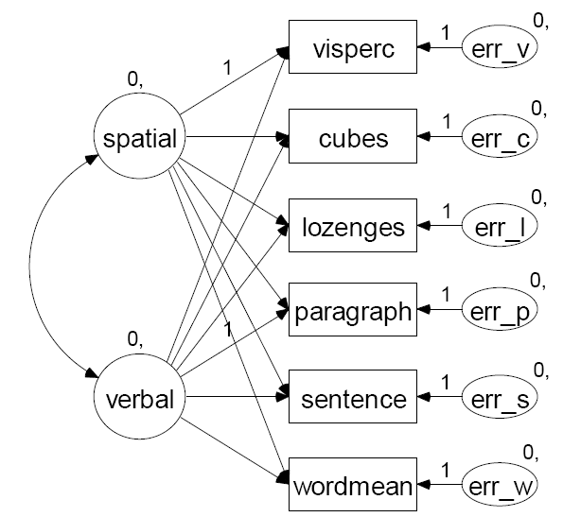

Slide 22
CFA
Confirmatory factor analysis requires a priori specification of factors.
Provides a test of fit between the factor structure and the data.
Allows for comparisons of the factor structure fit across groups.

Slide 23
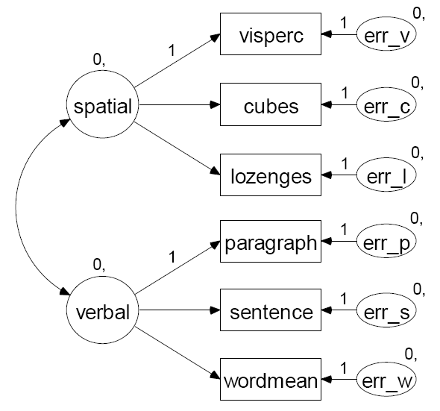

Slide 24
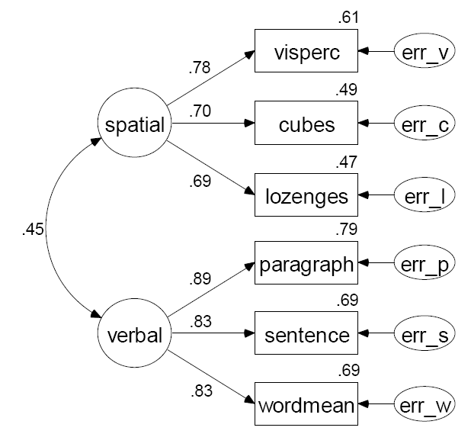
CFI = .996
NFI = .987
RMSEA = .078

Slide 25
Specifying Factors
Variables are standardized (SD = 1, Var = 1).
Total variance is equal to the number of items.
The Eigenvalue is the amount of variance accounted for by each factor.
Eigenvalues > 1.0 are efficient summaries of items; worth more than a single item.
A scree plot helps identify number of efficient factors.

Slide 26
Extraction Method
Principal Components Analysis: Assumes no measurement error and all items are weighted equally – NOT true EFA.
Principal Axis Factoring: Employs communalities (i.e., explained variance) to facilitate the identification of the factor structure – traditional EFA.
With large samples, most methods yield similar results.

Slide 27
Principal Components Analysis
A data reduction technique – reducing a large number of variables into efficient components
Principal components are linear combinations of the measures and contain common and unique variance
EFA decomposes variance into the part due to common factors and that due to unique factors

Slide 28
Rotation
Rotation helps identify the simple structure.
Maximizes differences between the high and low loadings or maximizes the variance between factors.
Orthogonal rotation requires that the resulting factors are uncorrelated.
Oblique rotation allows factors to be correlated.

Slide 29
Practical Issues
Need at least 10 cases per variable or per question in the model.
CFA requires more cases – at least 200 for a standard model.
Should have measurements from at least 3 variables for each factor you hope to include.
In EFA, you should try to write items that span the range of possible items for each potential factor (construct).

Slide 31
Using Factors
A factor is not very useful for research purposes if it is not sensitive to group differences.
Factors should be both theoretically defensible and empirically defensible.

Slide 32
Factor Analysis Examples
Aggression Data

Slide 33
Multivariate Structure
Cluster analysis is primarily concerned with grouping cases (persons).
  Creating subgroups
Factor analysis is primarily concerned with grouping variables.
  Creating measures
Assessing structure is the common characteristic between these two methods.

Slide 34
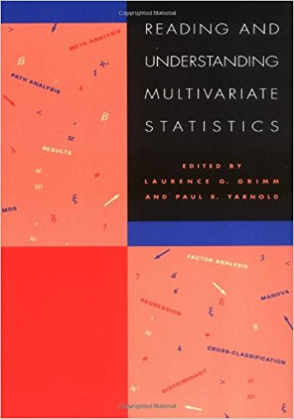
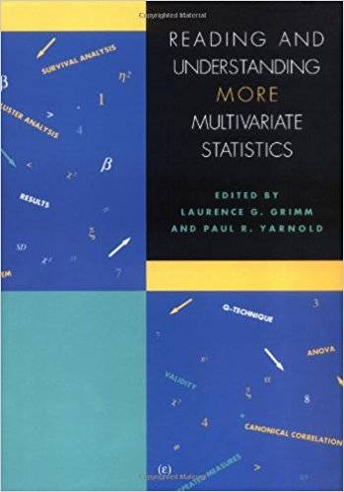
Grimm, L.G. & Yarnold, P.R. (Eds.). (2000). Reading and understanding more multivariate statistics. Washington DC: American Psychological Association.

