Slide 1
Item Response Theory for Survey Data Analysis
EPSY 5245
Michael C. Rodriguez

Slide 2
Wilson, M. (2005). Constructing measures: An item response modeling approach.
Mahwah, NJ: Lawrence Erlbaum.

Slide 3
Reeve, B.B., & Mâsse, L.C. (2004).
Item response theory modeling for questionnaire evaluation.

Slide 4
ADDITIONAL READINGS & ONLINE RESOURCES
IRT Resources Online
Introduction to IRT by Zickar online
Hambleton, R. K., & Jones, R. W. (1993). An NCME instructional module on : Comparison of classical test theory and item response theory and their applications to test development. Educational Measurement: Issues and Practice, 12(3). 38-47.

Slide 5
One Approach – Construct Map
Construct Definition (measuring a trait)
A simple form: More or less, high to low
Item Development
Realizations of the construct
Outcome Space
Aspect of response we value – how to score
Measurement Model
How we relate scores to constructs

Slide 6
From Construct to Item Responses
Causality
Item
Responses
Construct
Measurement
Model
Outcome
Space
Inferences
Source: Mark Wilson, 2005

Slide 7
Background to IRT
IRT is a way of thinking about measurement: a probabilistic model.
We give an item or task to a person and obtain an “item-person” interaction.
This results in a score with a probability, given a person’s ability.

Slide 8
Ability scores are more fundamental because they are test independent.
Examinees come to a test administration with trait levels in relation to the construct being measured – not necessarily in relation to the test being administered.

Slide 9
Each child has a trait score that is defined in relation to the construct at the time of an assessment, and this remains invariant over samples of assessment tasks.
Their trait score is not a function of what tasks they perform – their performance on the tasks is a function of their ability.

Slide 10
Measurement Models: IRT v. Rasch
Most IRT models are based on a paradigm that identifies a model which explains variation in the data – to find a model that best characterizes the data.
Rasch is an approach that is based on the paradigm of constructing a measure which can characterize a construct on a linear scale – such that the total score fully characterizes a person on a given construct.

Slide 11
Rasch Philosophy
Rasch models provide a basis and justification for obtaining person locations on a continuum from total scores on assessments.
Although it is not uncommon to treat total scores directly as measurements, they are actually counts of discrete observations rather than measurements.

Slide 12
Each observation represents the observable outcome of a comparison between a person and item.
Such outcomes are directly analogous to the observation of the rotation of a balance scale in one direction or another.
This observation would indicate that one or other object has a greater mass, but counts of such observations cannot be treated directly as measurements.

Slide 13
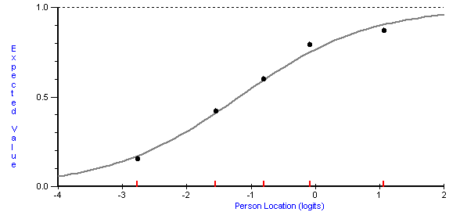
Item Characteristic Curve

Slide 14
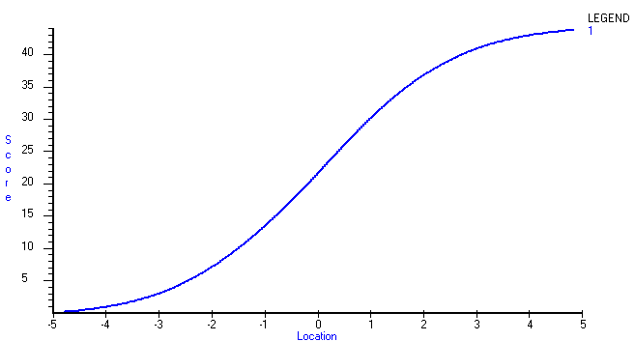
Test Characteristic Curve

Slide 15
Test Characteristic Curve
4 Points on the Raw Score Scale

Slide 16
Test Characteristic Curve
4 Points on the Raw Score Scale
0.5 on the Rasch Scale

Slide 17
Test Characteristic Curve
4 Points on the Raw Score Scale
0.5 on the Rasch Scale
4 Points on the Raw Score Scale

Slide 18
Test Characteristic Curve
4 Points on the Raw Score Scale
0.5 on the Rasch Scale
4 Points on the Raw Score Scale
1.2 Point on the Rasch Scale

Slide 19
From Numbers to Meaning
Numbers themselves do not mean much.
Is 10 meters a short distance? Long distance?
We need context to bring meaning to the measure: 10 meters.
However, 10 meters should always be 10 meters, no matter who takes the measure or how it is taken.

Slide 20
Sample Dependent Statistics
Is an item with a p-value of .90 easy or difficult?
… 90% passed the item
Is a person with a score of 5 out of 50 items low in ability?
… correctly answered 10% of the items

Slide 21
IRT Scaling
Person-free item difficult
Locates the items on the ability continuum
Item-free person ability
Locates the person on the ability continuum
Places items and persons on the same scale – the ITEM MAP

Slide 22
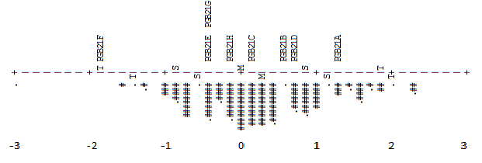
Item Map

Slide 23
Construct MAP
1. Explains the construct; interpretation guide
2. Enables design of items that will lead individuals to give responses that inform important levels of the construct map; identify relevant item features
3. Provides criterion to analyze responses regarding degree of consistency with intended construct
4. Item selection or retention should be based on informed professional judgment

Slide 24
Construct Map Describing Task Characteristics

Slide 25
IRT Assumptions
Local independence
Responses to differing items on the test are independent of one another, conditional on the trait they have in common (i.e., conditional on the latent trait items are uncorrelated).
Unidimensionality
Only one dominant trait is being measured.
Multidimensional models now exist.

Slide 26
Validity
Validity refers to the degree to which evidence and theory support the interpretations of test scores entailed by proposed uses of tests.
Standards for Educational & Psychological Testing
(AERA, APA, NCME, 1999)

Slide 27
Validation
Validation is the process of gathering evidence to achieve these goals, including evidence related to the
construct,
content,
response processes,
internal structure,
relations to other variables, and
the consequential bases of validity.

Slide 28
Evidence
In all cases, the most important sources of validity evidence are those that are most closely related the nature of the inferences we draw regarding scores.
We can begin to secure evidence to support our intended inferences in the design of any test.

Slide 29
OTL: Uses of Assessment
&INST
TITLE = OTL Math Education Assessment Uses
DATA = merged.dat
NAME1 = 1
NAMELEN = 29
ITEM1 = 30
NI = 136
IDFILE =*
+67-68
+73-75
*
CODES = 1234
MODELS = R
GROUPS = 0
&END

Slide 30
Response Data
72 10110101 12122211211222122112112112212211111212343233311223344221113444343434232234344322111111133224223321123344424241323231121399999999999999999
72 10110102 12111212211212121111111112211211111211323321344411432323222234333334434324443442111111144433344443223332234341424444443444413444411334444
72 10110103 12122292211222222112112212212211111221423111312311234413234311244412222433443442121122113334434333123231224241422334224433124443213113334

Slide 31
Run Analysis…

Slide 32
Beliefs: Quality of Instruction
&INST
TITLE = Program as a whole: program effectiveness
DATA = merged2.dat
NAME1 = 1
NAMELEN = 16
ITEM1 = 17
NI = 53
IDFILE =*
+48-53
*
CODES = 123456
MODELS = R
GROUPS = 0
&END

Slide 33
Response Data
72 10110101 155446545352435211223222433444265624342134333344443445
72 10110102 166664646666645214256245555533144654444344444444666666
72 10110103 154665536566452241356211666413414614342134434343244545

Slide 34
Run Analysis…

Slide 35
Evaluate the functioning of scale properties
We can ask questions about the response scale:
Does the 5-point scale work as interpreted?
Do we need 5 points?

Slide 36
Minnesota Student Survey
Mental Distress

Slide 37
Mental Distress Item
During the last 30 days, have you felt you were under any stress or pressure?
Yes, almost more than I could take
Yes, quite a bit of pressure
Yes, more than usual
Yes, a little
No

Slide 38
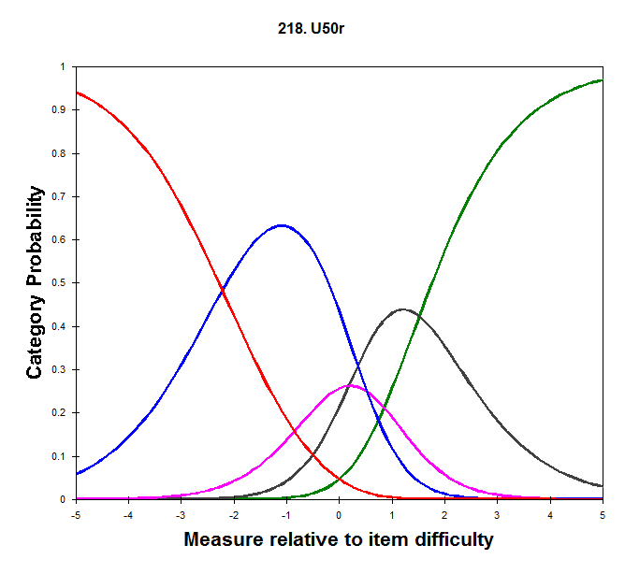

Slide 39
Mental Distress Item
During the last 30 days, have you felt sad?
All the time
Most of the time
Some of the time
A little of the time
None of the time

Slide 40
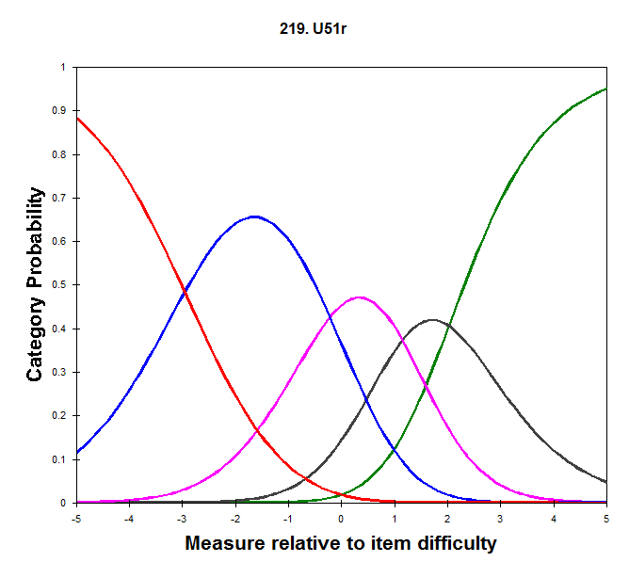

Slide 41
Item Map - Thresholds
Rasch Logit Scale
2 . +
.# | U49hr.45
.# |
. | U49br.45
.## | U50r .45
.# |
.# | U51r .35 U49dr.45
U49fr.45
1 .# + U52r .35
U53r .35
.#### |
.## |
.##### | U49hr.35
.### |
.####### |
.### | U52r .25 U49br.35
U50r .35
0 .######## +M

Slide 42
Other Possible Analysis
Differential Item Functioning
Group difference, conditioned on trait level
Form of measurement invariance; item bias
Equating over time
Constant score scale location over time
Keep item parameters and fix item locations
Examine parameter drift over time

Slide 43
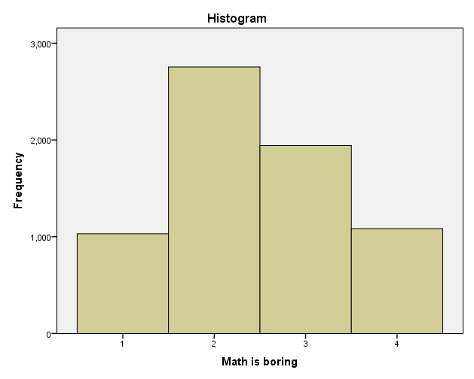
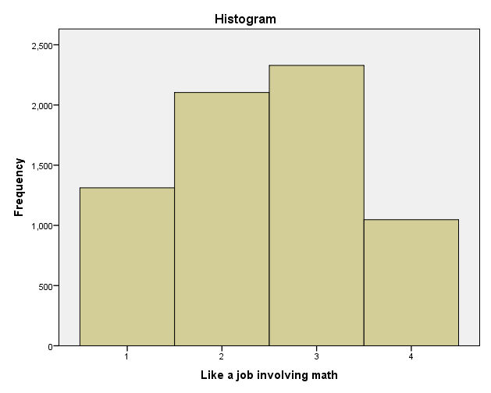
Returning to TIMSS Liking Math…
Mean = 2.45
Rasch = 0.40
Mean = 2.46
Rasch = 0.60

Slide 44
Ordering of Items by…
Item Mean | Rasch location
Math is important | Math is important
Enjoy learning math | Enjoy learning math
Like math | Like math
Math is easy | Math is boring
Like a job involving math | Math is easy
Math is boring | Like a job involving math

Slide 45
| Easy .35
| Boring .35
Job .35
2 . T+
|
.### |
.##### |
S|
.####### |T
1 . +
. |
.######### |
.############ | Boring .25
Easy .25
Job .25
.########## |
0 . +M
.####### |
.##### S|
. |
.### |S
.## |
-1 . +
.# T|T Job .15
. |
| Boring .15
Easy .15
EASY
BORING
JOB
BORING
EASY
JOB
JOB
BORING
EASY

