Slide 1
Equating Error
Kolen & Brennan, 2004 & 2014

Slide 2
Systematic Error
Smoothing technique (successful smoothing reduces random error more than introduction of systematic error)
Administration inconsistency – design isn’t followed
Violating statistical assumptions of the given method
Using IRT with multidimensional tests (over time)
Groups used in the equating differ from those who will obtain scores from equated forms

Slide 3
Random Error
Sampling scores → the equating relationship in the sample differs from the equating relationship in the population
As the sample increases, this source becomes negligible.

Slide 4
Sample Size
Importance of sample size – leads to diminishing random error with no effect on systematic error.

Slide 5
Standard Error of Equating
The SD of equated scores over hypothetical replications of a given equating procedure in samples from a population
The SD of replications at each score point is estimated

Slide 6
To Estimate SE of Equating
Must specify:
Equating design
Definition of equivalents (e.g., equipercentile)
Methods used to estimate equivalents
The population
Sample sizes (across forms)
Score levels for estimating SE (e.g., from 0 to K_{X})

Slide 7
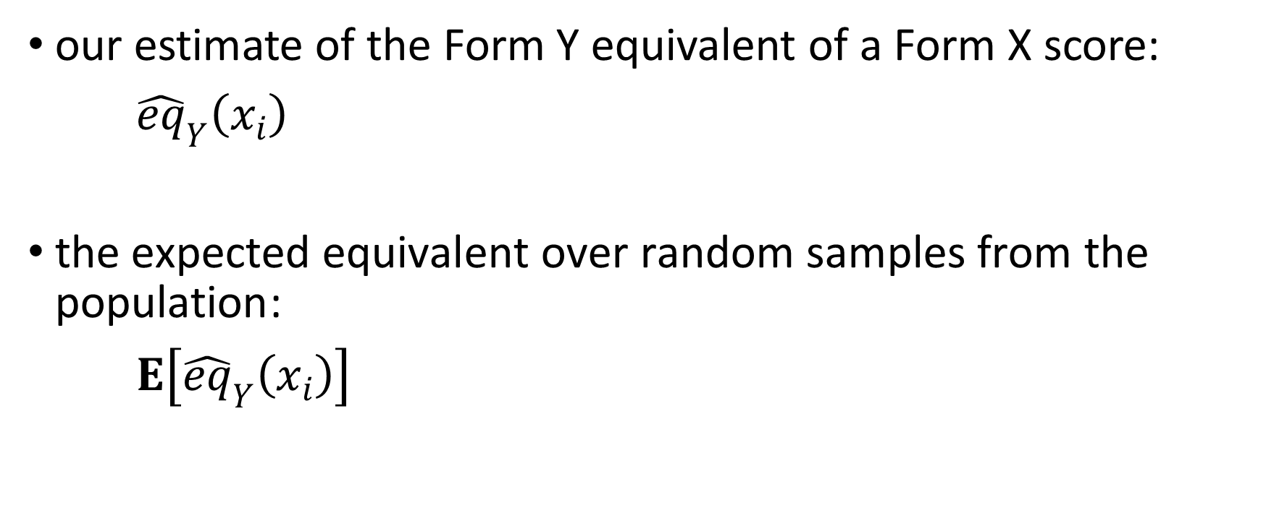
Notation
our estimate of the Form Y equivalent of a Form X score:
${\hat{eq}}_{Y}\left(x_{i}\right)$
$\text{the} \text{expected} \text{equivalent} \text{over} \text{random} \text{samples} \text{from} \text{the} \text{population}$:
$E\left[{\hat{eq}}_{Y}\left(x_{i}\right)\right]$

Slide 8
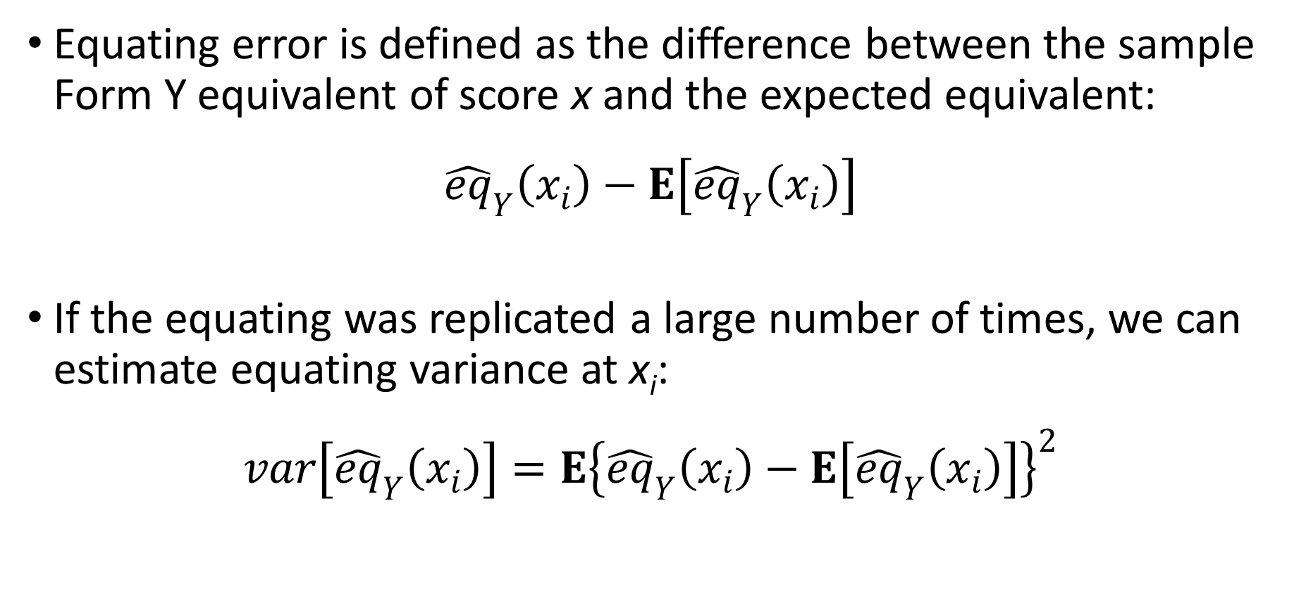
Defining Equating Error
Equating error is defined as the difference between the sample Form Y equivalent of score x and the expected equivalent:
$${\hat{eq}}_{Y}\left(x_{i}\right)−E\left[{\hat{eq}}_{Y}\left(x_{i}\right)\right]$$
If the equating was replicated a large number of times, we can estimate equating variance at x_{i}:
$$var\left[{\hat{eq}}_{Y}\left(x_{i}\right)\right]=E{\left\{{\hat{eq}}_{Y}\left(x_{i}\right)−E\left[{\hat{eq}}_{Y}\left(x_{i}\right)\right]\right\}}^{2}$$

Slide 9

Standard Error of Equating
$$se\left[{\hat{eq}}_{Y}\left(x_{i}\right)\right]=\sqrt{var\left[{\hat{eq}}_{Y}\left(x_{i}\right)\right]}$$
$$=\sqrt{E{\left\{{\hat{eq}}_{Y}\left(x_{i}\right)−E\left[{\hat{eq}}_{Y}\left(x_{i}\right)\right]\right\}}^{2}}$$

Slide 10
Considering the Population
What if we have the “population” or at least, all 8th grade students in the state.
Is there a role for equating error?
Are there other sources of random error beyond sampling individual test takers?

Slide 11
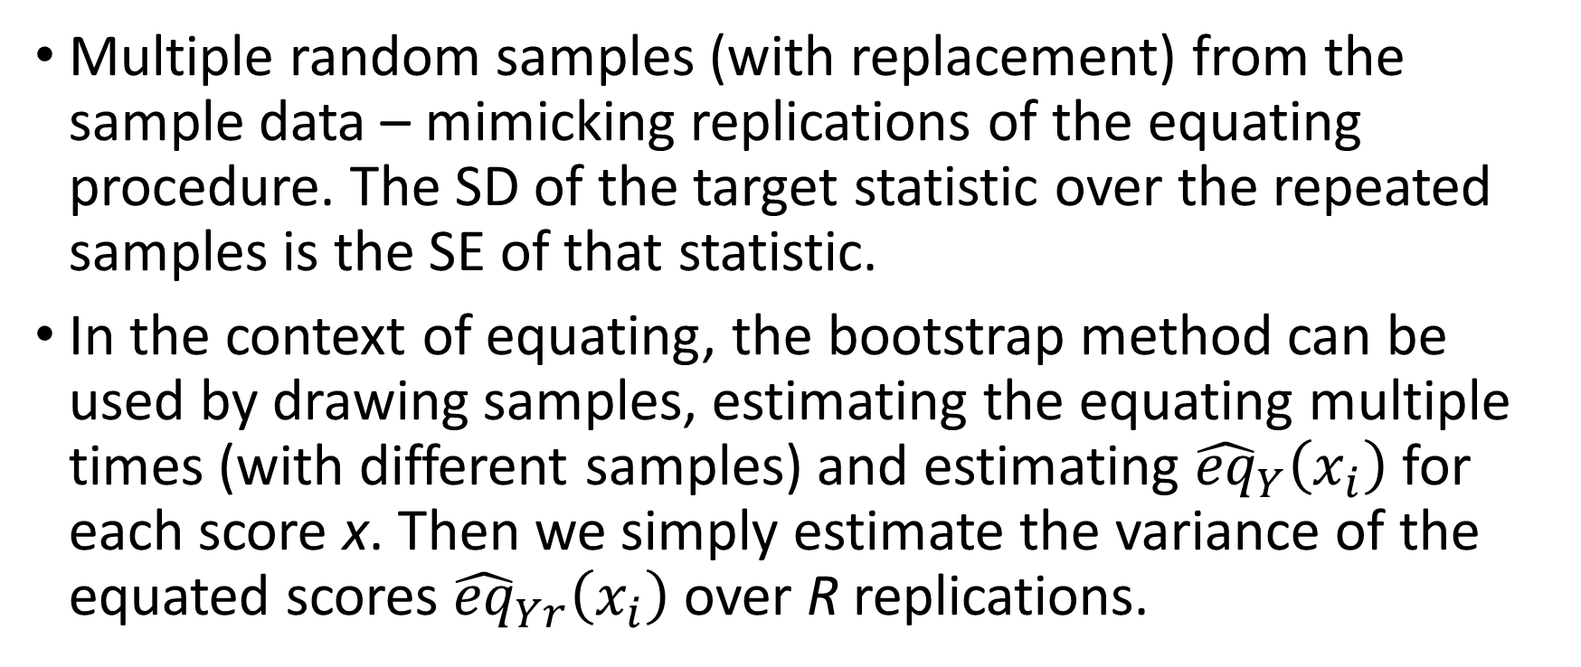
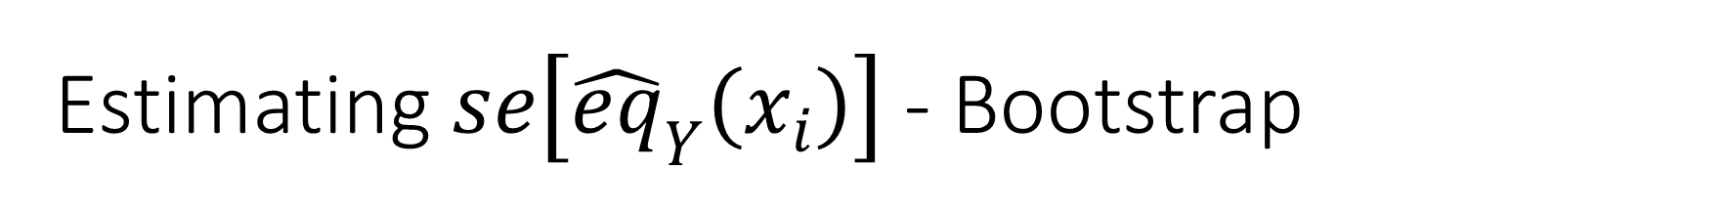
Estimating $se\left[{\hat{eq}}_{Y}\left(x_{i}\right)\right]$ - Bootstrap
Multiple random samples (with replacement) from the sample data – mimicking replications of the equating procedure. The SD of the target statistic over the repeated samples is the SE of that statistic.
In the context of equating, the bootstrap method can be used by drawing samples, estimating the equating multiple times (with different samples) and estimating ${\hat{eq}}_{Y}\left(x_{i}\right)$ for each score x. Then we simply estimate the variance of the equated scores ${\hat{eq}}_{Yr}\left(x_{i}\right)$ over R replications.

Slide 12
Bootstrap Challenges
This method may result in irregular SEs across the score scale for equipercentile equating where we observe score points with small frequencies. (Figure 7.1)
Parametric methods are available to address this limitation, where samples are drawn from fitted distributions (e.g., log-linear), rather than empirical distributions. (Figure 7.2)

Slide 13


Average $se\left[{\hat{eq}}_{Y}\left(x_{i}\right)\right]$
The mean SE of equating can also be estimated, across scores:
$$\sqrt{\sum_{i}{f\left(x_{i}\right){se}^{2}\left[{\hat{eq}}_{Y}\left(x_{i}\right)\right]}}$$

Slide 14
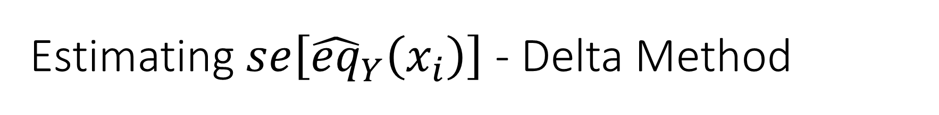
Estimating $se\left[{\hat{eq}}_{Y}\left(x_{i}\right)\right]$ - Delta Method
We have known expressions for standard errors – we can use known statistical relations and extend them to equating. For example, we know well how to estimate the SE(M). Works well for mean, linear, and equipercentile equating methods.
Using the Taylor series expansion – relying on moments of the distributions (Table 7.2)

Slide 15
SE of Equating in Practice
An index of random error due to equating; potentially a significant source of error in scores reported to test takers
Estimate precision of different equating methods – for a given test with a given population
Used to estimate sample size requirements
Delta method has very restrictive assumptions
Bootstrap method is very computer intensive
Computer programs for IRT methods are inaccessible

Slide 16
Quality control in equating
Check that the test administration conditions are followed properly.
The answer keys are correctly specified.
The items appear as intended.
The equating procedures that are specified are followed correctly.
The score distributions and score statistics are consistent with those observed in the past.
The correct conversion table or equation is used with the operational scoring.

Slide 17
Score Scales (Chapter 9)
scaling is the process of associating numbers or other ordered indicators with the performance of examinees
These numbers and ordered indicators are intended to reflect increasing levels of achievement or ability
The process of scaling results in a score scale
The scores that are used to reflect examinee performance are referred to as scale scores
By using an equating process, score scales enable the comparison of individuals who take different forms of a test

Slide 18
Angoff (1971) citing Lord (1950)
The claim for equality of score units can no longer be justified on an external operational basis. Such score scales can be said to have equal units of ability only if we are willing arbitrarily to define the ability in terms of the scale itself. However, such a definition of ability, while not indefensible, cannot hope to be generally accepted since the units of ability would vary with the group tested as well as with the choice of the measuring instrument. (p. 510)

Slide 19
Yen (1986)
It is important for educators and test developers to acknowledge that until the achievement traits are much more adequately defined, it is not possible to develop measurement scales that are linearly related to such traits. In fact, it appears impossible to provide such trait definition. Test users are therefore left to use other criteria to choose the best scale for a particular application; choosing the right scale is not an option. It is important that any choice of scale be made consciously and that the reasons for the choice be carefully considered. (p. 314)

Slide 20
Bock et al. (1997)
Educational measurement, insofar as it refers to measuring the extent to which a student or group of students, has mastered some area of content or skill, does not fit comfortably within the trait concept. Measurement in this context is better conceived of as testing student performance on a sample of tasks from the area for the purposes of predicting the extent of satisfactory performance in the area as a whole. The concept is that of domain mastery, and the domain score, expressed as a percentage, is the index of the proportion of the domain mastered. (p. 197)

Slide 21
Test score terminology
Scoreable unit is the smallest unit that receives a score
Unit score is the score from a scoreable unit
Item score is the score on a test item or task
Raw score is a function of the item scores, often the number correct score or number of points obtained score, the sum of the item scores
The maximum likelihood estimate (MLE) IRT score is a complex function of the item scores, it can be thought of as a raw score

Slide 22
Score Transformations
Raw scores often have serious limitations as primary scale scores for a test; they often depend on the items in a particular form.
The use of these raw scores as primary scale scores can lead to confusion on tests when scores on alternate forms are equated.

Slide 23
Scoring Handout

