Slide 1
The Promise of
Formative Uses of Assessment:
Building a Culture of Assessment
Michael C. Rodriguez
Quantitative Methods in Education
Educational Psychology

Slide 2
`
www.edmeasurement.net/MAG

Slide 4
Leonard P. Ayres, 1918
The importance of the movement lies not only in its past and present achievements, but in the hope of the future. Knowledge is replacing opinion, and evidence is supplanting guess-work in education as in every other field of human activity.

Slide 5
Edward L. Thorndike, 1918
The superintendents, supervisors, principals and teachers directly in charge of educational affairs have been so appreciative of educational measurements and so sincere in their desire to have tests and scales devised which they can themselves apply, that the tendency at present is very strong to provide means of measurement which are concerned somewhat closely with school achievements, and which can be used by teachers and others with little technical training.

Slide 6
M. E. Haggerty, 1918
In preparing this chapter on the specific uses of measurement in the solution of school problems the writer mailed to a selected group of school superintendents, most of whom were known to have used tests and scales, a questionnaire. Chiefly it was sought to learn what changes in school organization and procedure had been made as a result of such measurement. Among 200 replies received there were 62 which reported some conscious alteration in the work of the school following the use of a standardized scale or test. In general, these changes may be grouped under six heads as follows:

Slide 7
Changes in
1. classification of pupils
2. school organization
3. course of study
4. methods of instruction
5. time devoted to subject
6. methods of supervision

Slide 8
Green & Jorgensen, 1929
The use and interpretation of education tests.
Within the past score of years tests and measuring devices in nearly all subject matter fields have been developed. What the future of this movement will be no one can predict. In many ways the rapid development has been unfortunate for it has resulted in confusion on the part of the classroom teacher, the one who should profit the most from the program.

Slide 9
Tiegs, 1931
Tests and Measurements for Teachers
“The principal function of measurement is to contribute directly or indirectly to the effectiveness of teaching and learning.”

Slide 10
Measurement and assessment has been coopted by accountability systems.
Our work is not about the tests.
It’s about teaching and learning.

Slide 11
Standardized assessments provide a narrow glimpse of learning
Globally, curriculum doesn’t appear to matter
Instructional approaches matter
Local assessment is more informative – when tied to instructional practices and designed to reflect what students know and can do – we can strive to connect local objectives to state standards

Slide 12
…thoughts
By simply increasing attention to our decision-making process, there is no guarantee that new ways of solving the problem will miraculously come into awareness.
Because we do DDDM, doesn’t automatically translate into improved outcomes
No amount of increased effort can compensate for limited knowledge and skill about how to solve problems that require special training.

Slide 13
Promising Practices
Student-centered approaches show great promise
Helping students set appropriate goals and supporting them to meet their goals show great promise
Teacher commitment and teacher-powered schools show great promise
The key ingredient in all effective youth-development efforts is developmental relationships

Slide 14
Misconceptions about Formative Uses
Formative assessment is a special kind of test or series of tests that teachers learn to use to find out what their students know.
Formative assessment is a program that teachers adopt and add to what they already do.
Any practice that gathers information for the purpose of improving programs or improving teaching is a part of formative assessment.
Advancing Formative Assessment in Every Classroom
by Connie M. Moss and Susan M. Brookhart

Slide 15
Misconceptions about Learning Targets
Informing students of the learning target by telling them what it is or by writing it on the board is sufficient.
Sharing a rubric with students will ensure they understand the criteria for success.
I will recognize effective sharing of learning targets and criteria for success when I see it.
Advancing Formative Assessment in Every Classroom
by Connie M. Moss and Susan M. Brookhart

Slide 16
Moving Forward
Using learning and motivation theories to coherently link formative assessment, grading practices, and large-scale assessment
Shepard, L.A., Penuel, W.R., & Pellegrino, J.W.
Educational Measurement: Issues and Practice
Spring 2018

Slide 17
Sociocultural Learning Theory
All learning is fundamentally social, involving the student’s use of shared language, tools, norms and practices in interaction with their social context.
One’s cognitive development and social identity are jointly constituted through participation in multiple social worlds of family, community, and school.

Slide 18
Shepard, Penuel, & Pellegrino
To support equitable and ambitious teaching practices, classroom assessment design must be grounded in a research-based theory of learning.
Compared to other theories, sociocultural theory offers a more powerful, integrative account of how motivational aspects of learning—such as self-regulation, self-efficacy, sense of belonging, and identity—are completely entwined with cognitive development.

Slide 19
Curriculum specificity is necessarily abandoned in large-scale test design when a district or state wants to compare the performance of students across jurisdictions using quite different curricula. But such tests then are not of much use for detailed formative feedback.
Curriculum-general tests underestimate learning.

Slide 20
Instead of “scores,” which offer teachers little information about what to do next, it is much more important that formative assessment questions, tasks, and activities provide instructional “insights” about student thinking and about what productive next steps might be taken.

Slide 21
Quantitative data systems frequently provide teachers with results in the form of a grid showing class rosters crossed with item or subtest scores.
Teachers then typically use these data to reteach the standards or objectives missed by the most students, and they identify students who missed the greatest number of items for special tutoring or after-school help.
In these scenarios, reteaching efforts are not adjusted based on information from the assessment.

Slide 22
Given what we know about how such interim assessments are constructed, it is not surprising that identifying standards not-yet-mastered does not give teachers access to student thinking.
To intervene with an individual student, a teacher still needs to follow up with more individualized student conversations, which is generally not possible due to time constraints.
Typical interim tests offer students an impoverished vision of intended learning goals.

Slide 23
Shepard, Penuel, & Pellegrino
Instead of centering assessment within systems that support use of interim and end-of-year standardized tests, we argue for a vision of formative assessment based on discipline-specific tasks and questions that can provide qualitative insights about student experience and thinking, including their identification with disciplinary practices.

Slide 24
Shepard, Penuel, & Pellegrino
At the same time, to be consistent with a productive formative assessment culture, grading policies should avoid using points and grades “to motivate” students but should create opportunities for students to use feedback to improve their work.

Slide 25
Discipline-Specific Models of Learning
Learning progressions in the broader context of sociocognitive models attend to the social nature of learning and to discipline-specific ways that core ideas and practices are developed over time.
Student cognition develops through social interactions, as students solve problems, complete tasks, and devise strategies to pursue learning goals.

Slide 26
Classroom assessment tasks should not simply be designed to “recruit” student interests into disciplinary ways of thinking, but help them recognize those ways of thinking and relate them to their own.

Slide 27
For example, at the beginning of a unit in the Micros and Me curriculum, students take photos of things or activities that they do to prevent disease and stay healthy at home or in their communities. They then share these photos in class as a way to bring personally relevant experiences into the classrooms and draw connections to learning goals for the unit.

Slide 28
Instruction-Assessment Integration
We promote models of curriculum-embedded-in-the-process-of-instruction formative uses of assessment
Which depends on
Usefulness of the “information” provided by assessment activities, and
on the ways that materials and tools support productive, learning-focused “assessment cultural practices.”

Slide 29
Grading
To be coherent with formative assessment, a critical requirement is that grades be based on the same learning goals toward which instructional activities and formative feedback are aimed.
Grading practices are the most consistent with formative assessment cultural practices—and make the most sense to students—when the focus is consistently on student learning.

Slide 30
Point systems in general and electronic systems designed to keep parents continuously informed tend to work against the logic of formative assessment because they assign points as if early steps in learning are “finished” rather than providing a substantive and still changing picture of developing competence. Research on effective feedback argues against grading assessments used for formative purposes because the grade itself becomes the focus of attention rather than attending to the means for improvement.

Slide 31
The motivation literature is quite clear that making prerequisite behaviors (being prepared, making an effort, participating, paying attention) dependent on external rewards harms learning, especially when the rewards are seen as controlling.
The conclusion that “extrinsic rewards drive out intrinsic motivation” is based on a large body of controlled experiments.

Slide 32
Goals to Strive For
formative assessment activities to surface student thinking and further learning within instructional units
summative unit assessments used for grading that explicitly address transfer and extensions from previous instructional activities
district-level assessments designed in parallel to unit summative measures but with particular attention to program-level evaluation

Slide 33
Ecology of Youth Development
COUNTY
STATE
NEIGHBORHOOD - COMMUNITY
SCHOOL
STUDENT
FAMILY
PEERS
SOCIETY

Slide 34
Social Emotional Context for P Y D
Youth have the inherent capacity for positive development
enhanced through multiple meaningful relationships, contexts, and environments
where community is a critical delivery system
and youth are major actors in their own development

Slide 35
Provide an organizational framework for content, knowledge, skills – organize content based on the structure of the assessment.
Confirm “storage” of knowledge by solidifying the connections among different pieces of knowledge.
Shape study behavior.
Enhance academic motivation and effort through provision of feedback.
Formative Uses of Assessment

Slide 36
Explicitly articulate and communicate learning objectives and achievement targets – typically vaguely defined by teachers.
Demonstrate the kinds of thinking and processes valued by the instructor – valued by the field.
Confirm the importance of hard work, time spent studying, and effort.
Formative Uses of Assessment

Slide 37
Using Models of Learning
A model of learning can describe the learning process, development stages of understanding, knowing, and doing
A model of learning can distinguish novice learners from expert learners; identifying the nature of proficiency and prerequisite skills for progression

Slide 38
Using Models of Learning
A model of learning allows the test developer to recognize the variety of ways students come to understand the subject matter.
This connects students with the assessment – the assessment reflects the students’ experiences.

Slide 39
Lessons from Research on Learning
Importance of context
Importance of sequencing tasks and knowledge structures
Importance of using multiple representations of ideas and concepts

Slide 40
Why Interventions to Influence Adolescent Behavior Often Fail but Could Succeed
Yeager, D.S., Dahl, R.E., & Dweck, C.S.
Perspectives on Psychological Science, 2018

Slide 41
Hypothesis (Yeager et al., 2018)
Compared with younger individuals, middle adolescents show a greater sensitivity to status and respect, resulting from pubertal maturation (e.g., changes in hormones), changes in social context (e.g., school transitions), and social-cognitive developments.

Slide 42
Wise Feedback (Yeager et al., 2018)
The teacher justifies critical feedback on student work with an appeal to high standards
  Conveys respect for the student’s competence by setting a high bar
With an assurance of the student’s potential to reach the high standard
  Conveys respect for the student’s competence by suggesting that the student can improve and develop

Slide 43
Sustained Behavior Change (Yeager et al., 2018)
Feelings of respect and status serve as a gateway to the self.
A view that:
  “I am now the kind of person who does this behavior because it makes me feel the way I want to feel.”

Slide 44
Conclusion (Yeager et al., 2018)
Our perspective has been that when adults honor adolescents’ sensitivity to feelings of high status and being respected, we may find that adolescents show far greater self-regulation, ability to think about the future, and capacity to change than we imagined.

Slide 45
Teachers are the ultimate purveyors of assessment

Slide 46
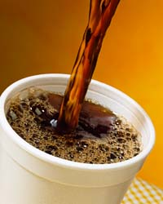

Slide 47
Articulate Student Learning Outcomes (SLOs) and Claims
  “What do we want to say about our students?”
Identify Evidence to Support Claims
  “What can our students do to demonstrate the knowledge, skills, and abilities that are being claimed?”
Develop Assessments to gather Evidence
Evidence Centered Design

Slide 48
Essential: Purpose
Clearly define your purpose
  Progress Monitoring (formative uses)
  Objective/Instructional Feedback
  Grading (summative uses)
  Placement

Slide 49
Essential: Blueprint
Create a test blueprint
  Content to be covered
  Cognitive tasks to be assessed
  Format of items
  Number of items (given time limits)

Slide 50
Quality Items
Content | Knowledge | Comprehension | Application | Total
Central Tendency |  |  |  | 25%
Variability |  |  |  | 50%
Shape of Distribution |  |  |  | 25%
Total | 20% | 30% | 50%

Slide 51
Essential: Item Quality
Design effective items & tasks
  Use accepted principles of item writing
  Tryout new item types
  Review items prior to use – peer and expert review

Slide 52
Writing MC Items
Questions should require students to consider novel contexts
Use reference materials (graphical displays) that are authentic
Options should be plausible – common errors or misconceptions
Use only the number of options you need or can develop (3 is sufficient)

Slide 53
MC item difficulty is determined by the distractors
Distractor proximity and plausibility determine the difficulty of items
The power of distractors

Slide 54
Who was the 7th president of the United States?
Andrew Jackson
John Quincy Adams
Abraham Lincoln
James Madison

Slide 55
Who was the 7th president of the United States?
Andrew Jackson
Davy Crockett
George H. W. Bush
Elvis Presley

Slide 56
A high school graduation test is considered a criterion-referenced test because
it was built with a test blueprint.
it has a cut-score required to pass.
it is based on a clearly defined domain.

Slide 57
A high school graduation test is considered a criterion-referenced test because
it was really difficult.
teachers spent a month on test preparation.
it is based on a clearly defined domain.

Slide 58

Distractors that are written to be plausible should contain common errors or misconceptions
Distractor analysis provides information regarding the kinds of errors or misconceptions held by students
No reason, psychometrically, to have the same number of options for every item
Obtaining Diagnostic Information

Slide 59
For all assessment tasks, regardless of format and response requirements, valid inferences
about student understanding require the following:
The student understands what is being asked by the task, including response requirements.
The scoring system knows how to consistently interpret the student response.
Constructed-Response Items

Slide 60
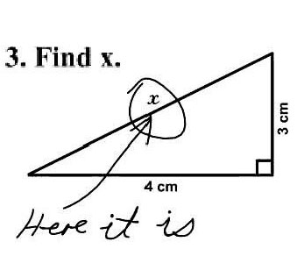
What is the role of necessary assumptions in order to respond in a way that is consistent with the construct being measured?
Be Explicit

Slide 74
Essential: Item Review
4. Item Review – Item Analysis
  Item Difficulty
    Proportion that correctly respond
  Distractor Functioning
    Are the distractors being selected
    Are the distractors “attracting” the right students
    What misconceptions remain

Slide 75
Restrict the use of essay questions to those learning outcomes that cannot be measured satisfactorily by objective items.
Construct questions that will call forth the skills specified in the learning standards.
Phrase the question so that the student’s task is clearly indicated.
Indicate an approximate time limit for each question.
Quality Essay Items

Slide 76
Educational Leadership, Sept. 2012
Feedback is not advice, praise, or evaluation. Feedback is information about how we are doing in our efforts to reach a goal

Slide 77
If students know the classroom is a safe place to make mistakes, they are more likely to use feedback for learning.
The feedback students give teachers can be more powerful than the feedback teachers give students.
When we give a grade as part of our feedback, students routinely read only as far as the grade.

Slide 78
Effective feedback occurs during the learning, while there is still time to act on it.
Most of the feedback that students receive about their classroom work is from other students—and much of that feedback is wrong.
Students need to know their learning target—the specific skill they’re supposed to learn—or else “feedback” is just someone telling them what to do.

Slide 81
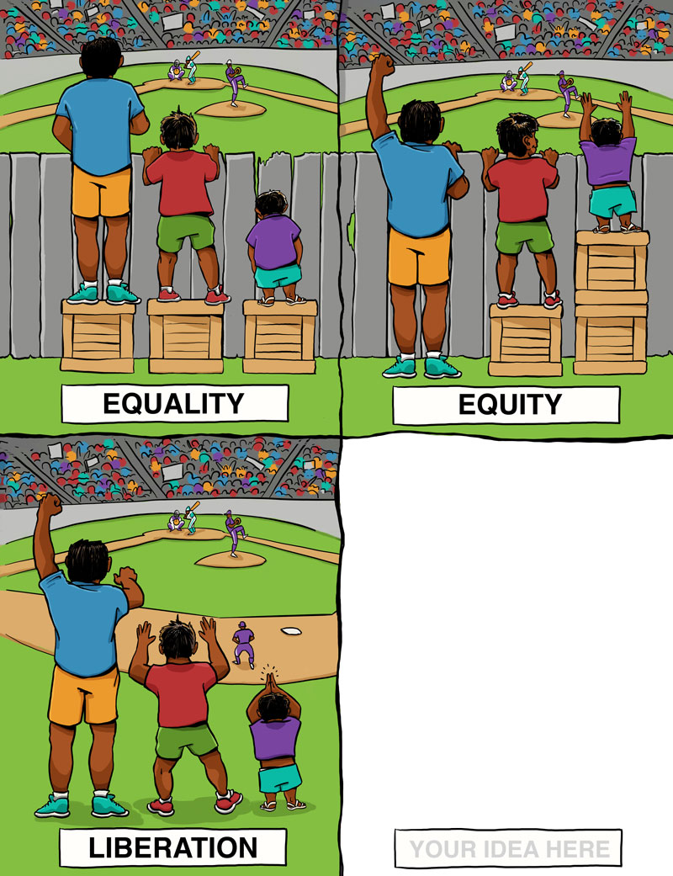
Common Notions of Equity

Slide 82
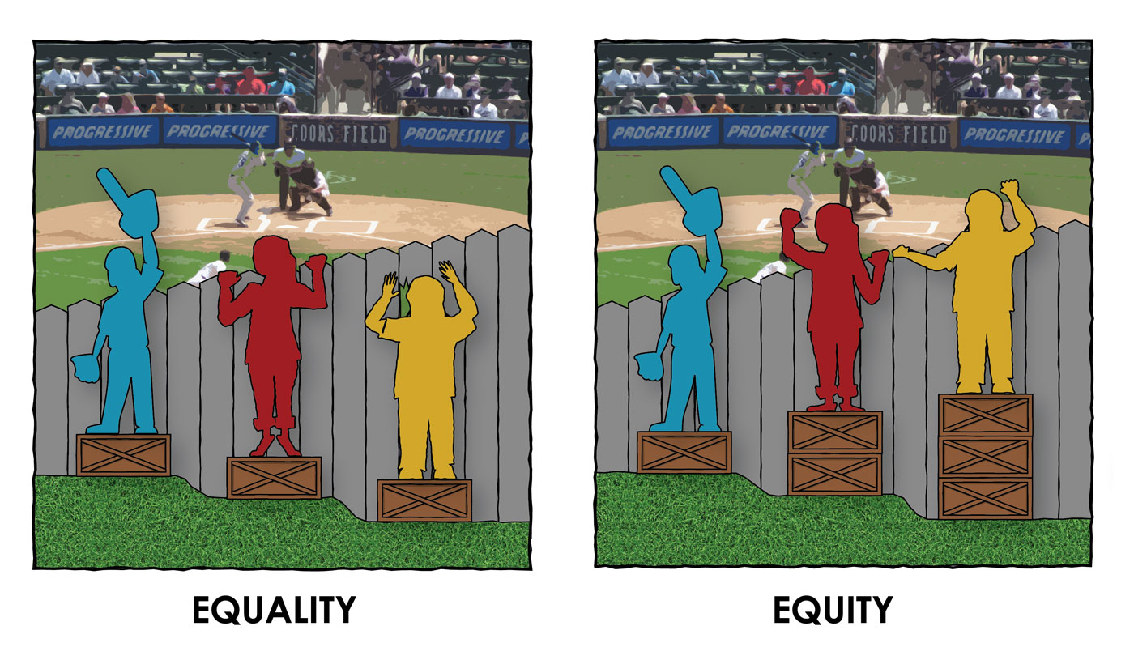
Rethinking Equity
http://culturalorganizing.org

Slide 83
Building a culture of testing
a culture of assessment
a culture of evidence

Slide 84
NCME Statements

Slide 85
Excerpts from C.C. Ross (1941), Measurement in Today’s School, based on hundreds of research studies across four decades:

Slide 89
Phelps, R.P. (2009). Educational achievement testing: Critiques and rebuttals. In R.P. Phelps (Ed.), Correcting fallacies about educational and psychological testing (pp. 89-146). Washington, DC: American Psychological Association.

Slide 97
Phelps, R.P. (2012). The effect of testing on student achievement, 1910-2010. International Journal of Testing, 12, 21-43.

Slide 98
Reviewed several hundred studies published between 1910 and 2010.
The pure testing effect is an increase in achievement that occurs simply because students take a test instead of spending the same amount of time some other way, such as studying.
Taking a test, responding to questions, generating responses – has a more durable effect on memory and understanding than listening/reading.
177 empirical studies with 640 effects

Slide 99
Quantitative results: d = 0.55 to 0.88
Testing with feedback produced strongest positive effects
Adding stakes and testing with greater frequency increased positive effects

Slide 100
Treatment Group Mean Effect Size
is made aware of performance, control group is not. 0.98
receives targeted instruction (e.g., remediation). 0.96
is tested with higher stakes than control group. 0.87
is tested more frequently than control group. 0.85

Slide 101
247 survey studies with 813 effects
Testing improves learning
education provider: d = 1.2
education consumer: d = 1.3
Testing improves instruction
education provider: d = 1.0
education consumer: d = 1.2

Slide 102



