Slide 1

Survey Design & Analysis to support
Valid Interpretation and Use
Michael C. Rodriguez
Campbell Leadership Chair in Education & Human Development
March 15, 2019 Educational Psychology

Slide 2
This presentation can be found at:
http://www.edmeasurement.net/MAG
Available in PowerPoint .pptx format

Slide 3
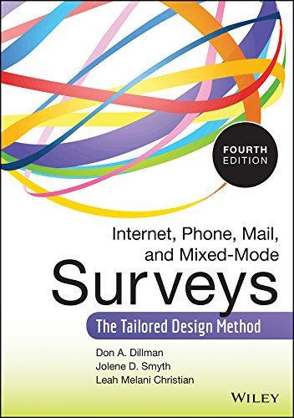
The Tailored Design Method
Dillman, D.A., Smyth, J.D., & Christian, L.M. (2014). Internet, phone, mail, and mixed-mode surveys: The tailored design method (4rd ed.). Hoboken, NJ: John Wiley & Sons, Inc.

Slide 4
Reducing Survey Error
Sampling Error
Coverage Error
Measurement Error
Nonresponse Error

Slide 5
Sampling Error
The result of only including some of the population in the survey – literally because we only have a sample
Example:
  The City Council decided to survey residents in each neighborhood about their satisfaction with the work of their neighborhood council – they surveyed 20% of residents in each neighborhood.

Slide 6
Coverage Error
The result of not giving every member of the population a chance to be included in the sample
Example:
  The City Council decided to survey residents in each neighborhood by sending postcards to all residents with the URL for the online survey – some residents don’t have internet access.

Slide 7
Measurement Error
The result of asking poorly worded questions so that responses are inaccurate or uninterpretable
Example:
  The City Council asked residents “Has the social interaction level changed in the past year” using these choices:
  (1) increased a lot
  (2) increased somewhat
  (3) increased a little
  (4) decreased

Slide 8
Nonresponse Error
The result of people who do not respond to the survey being different from those who do respond – different in a way that produces different response patterns
Example:
  Residents with children were less likely to respond – their responses are different than those without children

Slide 9
Two Critical Points for quality survey design
Responding to a survey requires cognition and motivation
Multiple attempts are required to obtain satisfactory response rates regardless of administration method

Slide 10

How can we motivate participants?
View survey participation as social exchange

Slide 11
Social Exchange
A theory of human behavior that helps us understand how human interaction develops and is maintained
Individual behavior is motivated by the expected returns from others
Three factors are central to predicting behavior in this context: rewards, costs, and trust

Slide 12
Ways of providing REWARDS
Say thank you
  “We appreciate very much your help”
  “Many thanks in advance”
Show positive regard
  “You have been selected in our national sample”
  “Please take a moment…”
  Give a reason for the survey
  Provide a phone number
  Personally address correspondence

Slide 13
Ways of providing REWARDS
Give tangible rewards
  $1 or $2 improves response rates much more than promise of later larger rewards
  Pens or other materials
  Rewards invite a sense of obligation in the respondent
Ask for advice
  here you suggest that the respondent is the important one
  Important decisions need to be made and we need your advice on which route to follow

Slide 14
Ways of providing REWARDS
Give social validation
  You are an important member of the neighborhood
Inform respondents that opportunities to respond are scarce
Make the survey interesting
  Highly salient topics
  Attend to layout & design
  Some people just love surveys
Support group values
  Importance of neighborhood vitality
  Importance of dues paying members

Slide 15
Ways of reducing SOCIAL COSTS
Avoid embarrassment
  Ask people questions to which they should reasonably be expected to know the answers?
  Don’t put folks in a position where they are being judged because of not knowing or doing things on the survey.
Avoid subordinate language
  “In order to address the pressing needs of the neighborhood councils, your input is necessary.”
  “Would you please consider providing us with your advice/ opinions/experiences?”

Slide 16
Ways of reducing SOCIAL COSTS
Minimize requests for personal information
  If needed, place at end of the survey
  If required (the focus of the survey), use clear but respectful language
  Certify anonymity
Avoid inconvenience
  Include an envelope with a real stamp
  The url link should include the password
The survey should appear short and easy
  Respondent friendly
  Easy-to-answer format
  Balance with more questions on a page

Slide 17
Ways of establishing TRUST
Provide an advanced token of appreciation
  Although $1 or $2 is of little value to many, it creates significant trust
  Use of real stamp on return envelop
  Access to tangible resources
Legitimate authority as a sponsor
  Government sponsored surveys have higher response rates than surveys from marketing research firms

Slide 18
Ways of establishing TRUST
Invoke other social exchange relationships
  As an alum of the University …
  As a resident of the neighborhood …
  As a participant in the program …
Make the task appear important
  Personalized cover letters
  Actual letterhead
  Insignia or logo of respected sponsor
  Questionnaire design that makes sense to ordinary folks

Slide 19
Linking Social Exchange Elements
Costs and rewards may contribute to nonresponse
  What rewards are present for not responding?
Repetition of appeals diminishes effectiveness
Extreme designs create the opposite effect
  Very short surveys may be seen as unimportant
People differ in what constitutes rewards/costs
Strategies work as a whole – not in isolation

Slide 20
Planning for the Survey Project
Preparing for Survey Design handout
content coverage
construct maps
knowing your target population
including local wisdom and community leaders

Slide 21
Survey Design

Slide 22
Item Writing
Item writing evidence versus niceties
dos and don'ts
the online survey tool might give you interesting options - doesn't mean you should use them

Slide 23
Assess Every Survey Question
Do you need to ask the question?
Does the question require an answer?
Do survey respondents have an accurate ready-made answer?
Can folks accurately recall past behavior?
Will the individual be willing to reveal information?
Will the individual be motivated to answer each question?

Slide 24
General Guidelines
Professional Looking – clean format
Brief and concise – clear instructions
Use check boxes or circles, rather than blanks to obtain responses
Personal questions at the end
Leave room for comments (and tell folks upfront that there will be room).

Slide 25
Proofing Guidelines
Read questions aloud
Scan items for - and - or - but - with - except
Consider sensitivity review
Pilot items – look for
  - Little variation - too many don’t know
  - Too many other - misinterpretation

Slide 26
Additional Item-Writing Advice
Order scales from low to high or from negative to positive
strongly disagree / disagree / agree / strongly agree
This common scale may be redundant
Better to allow room for uncertainty
disagree / tend to disagree / tend to agree / agree

Slide 27
More Item-Writing Advice
Avoid middle or neutral options
  Neutral responses may indicate
  - Lack of knowledge - Uncooperativeness
  - Reading difficulty - Inapplicability
  - Reluctance to answer
Provide a clearly interpretable alternative
  not applicable - no basis for judgment
  don’t know - prefer not to answer

Slide 28
Cases when the middle option works
less than before / about the same / more than before
too little / about right / too much
less than acceptable / acceptable / more than acceptable
not yet proficient / proficient / exceeds proficient

Slide 29
Even More Item-Writing Advice
Avoid other options
Avoid ranking responses
Avoid loaded questions:
  9 out of 10 dentists recommend Pepsi over Coke. Which do you prefer?
Avoid double-barreled items:
  How satisfied are you with the amount and quality of police patrol and road repair?
Avoid open-ended questions.

Slide 30
Formats and Guidelines
Review Formats from handout
Review Survey Item-Writing Guidelines from handout
Review Social Exchange Evaluation Tool

Slide 31

Race/Ethnicity and Sex/Gender Identity
The Williams Institute is dedicated to conducting rigorous, independent research on sexual orientation and gender identity law and public policy. A think tank at UCLA Law, the Williams Institute produces high-quality research with real-world relevance and disseminates it to judges, legislators, policymakers, media and the public.

Slide 32
https://williamsinstitute.law.ucla.edu/
Best Practices for Asking Questions about Sexual Orientation on Surveys
Gender-Related Measures Overview
Best Practices for Asking Questions to Identify Transgender and Gender Minority Respondents on Population-Based Surveys

Slide 33
Transgender-inclusive measures of sex/gender for population surveys: Mixed-methods evaluation and recommendations
https://journals.plos.org/plosone/article?id=10.1371/journal.pone.0178043

Slide 34
Constructing the Survey

Slide 35
Criteria
Objectives
  Reduce nonresponse
  Reduce measurement error
Focus on Social Exchange Elements
  Improve rewards
  Reduce costs
  Develop trust

Slide 36
Ordering Questions
Most salient to least salient
Does what the cover letter says
Personal or objectionable questions are near the end
Logical order or progression of questions
Group items with the same scale – with similar items within topic area

Slide 37
Choosing the First Question
Applies to everyone
Simple and easy to answer
Interesting
Connect the respondent and the purpose of the survey (as understood by the individual)
Clearly indicates the main topic of the survey

Slide 38
Pretesting
Have knowledgeable colleagues or other experts review the instrument
Conduct a few interviews to understand the cognitive and motivational requirements
Pilot the instrument
Final proofing

Slide 39
Computer Based Administration

Slide 40
Computer Based Issues
Coverage
Device variation
Effects of computer hardware and software
Computer literacy
Computer logic versus survey logic

Slide 41
Positives
Ease of administration
Fast response time
Lower cost
Direct data entry
Increased attractiveness may improve willingness of respondents to complete survey

Slide 42
Negatives
Coverage limited to those with internet access
Time and expense in providing help desk
Security - without password protection anyone may respond

Slide 43
When to go
Online¹
You can use a convenience sample
Your population is self-contained
You have e-mail addresses
Sample size is relatively large
You want to use multimedia elements (opt)

Slide 44
Basic Design Principles^{2,3}

Slide 45
Web Survey Design Principles
Provide a password to limit access to those in the sample
Introduce the web survey with a motivational welcome screen
  Emphasize ease of responding
  Informs respondents how to proceed

Slide 46
Web Survey Design Principles
The first question should fit entirely on the screen at the top of the questionnaire.
Present questions like they would appear on paper surveys (conventional appearance)
Consider variations that may appear due to differences in software, browsers, smaller screens

Slide 47
Web Survey Design Principles
Provide very specific directions how to take each computer-related action at the point it is needed
Limit the line length of each question so that questions don’t extent the full width of the screen
Restrain the use of color – maintain readability and measurement properties

Slide 48
Web Survey Design Principles
Use drop-down boxes sparingly & limit matrix-type questions
Do not require individuals to respond to a given question before they can answer the questions that follow
Provide skip directions while encouraging individuals to answer each question

Slide 49
Web Survey Design Principles
Construct the web survey so that respondents can scroll from question to question
Provide some indicator of survey completion progress
Keep graphics to a minimum – they increase loading time
Automate skips & inform respondents; may consider validating input

Slide 50

Defending Survey Quality

Slide 51
Validity
The degree to which theory and evidence supports the intended interpretations and uses of scores
  We validate score interpretations and uses.
Interpretation and Use Argument
Validity Argument

Slide 52
Building a Validity Argument
There are many forms of validity evidence, not different forms of validity. Validity is not an either/or, it is a continuum.
Here we explore possible interpretations and uses of survey data. Once an interpretation/use is articulated, we can identify appropriate evidence to collect to support and defend that interpretation/use. This is validation (the collection of evidence to support the intended interpretations and uses).

Slide 53
Are the responses plausible?
Internal agreement checks (internal consistency in responses)
Do responses across similar questions agree
Identifying faking, extreme responses, lying
Pattern responding
Minimum number of items with responses

Slide 54
Measuring person attributes or characteristics
What is the attribute we are measuring? [accuracy]
  Content evidence required
  Theory, literature, prior measures
  Individuals from the target population agree with our definition and operationalization of this attribute
Is the score consistent or reliable? [precision]
  Score reliability
  Item discrimination
Are scores associated with other relevant variables?
  Criterion-related evidence (correlations with other variables)

Slide 55
Accurately summarizing true intent of the population
Did respondents interpret questions as you intended?
  Think alouds
  Piloting results
  Key-informant reviews of the survey
  Followed evidence-based item-writing guidelines
Are respondents consistent in their answers?
  Internal agreement across items
  Score consistency or reliability

Slide 56
Help inform decision making (policy) to promote community responsiveness and preparedness
Representativeness and coverage of the population.
  Sampling design (stratification) – special attention to the sampling frame
  Set the sample size to achieve certain level of precision
Minimized multiple sources of survey error
  Nonresponse error – report missingness (non-respondent study)
  Measurement error

Slide 57
Help inform decision making… (cont.)
Generalizability of the topic – extent to which responses are context specific
  Theory about the context-specific variables (validity generalization)
  Expert review or endorsement
  Local review and endorsement
  Look for availability of base-rates in new communities
  Examine regional variation within your own sample

Slide 58
To inform program design or curriculum design (program staff)
Responses are accurate and plausible
  Minimized measurement error
  Etc. (as above)
Content-related evidence, domain coverage
Program theory of action
Program main goals and objectives are included in the survey
Participants are the right participants (sample demographics)

Slide 59
Response Rates⁴
Response Rates based on review of published survey results
Previous research suggests average response rates at 55-65% for paper-pencil surveys.
With careful attention to design, 70% can be achieved consistently.
Others suggest that returns less than 40-50% are common on mail surveys

Slide 60
Web Return Rates⁴
A meta-analysis of web survey reports (N=68)
Mean response rate was 40% (SD=20%)
Survey response rate was improved by
  # of contacts
  personalized contact
  prenotification letter, message
  issue salience
No relationship found between survey length or password requirements and response rates

Slide 61

Item Review & Practice

Slide 62

Analysis of Ordinal & Categorical Data

Slide 63
Survey Data
Quantitative Data (not typical for surveys)
  Age, income, height, weight
  Counts of things (children, books, credits earned)
Qualitative Data
  Nominal Categories (gender, race, political affiliation, state of residence)
  Ordered Categories (level of satisfaction or agreement, frequency of behaviors)
  Descriptive Comments (open-ended responses)

Slide 64
Quantitative Analysis of Qualitative Data
There is a tendency to use numeric labels as category labels or as option labels. These are labels, not numeric values.
On a scale of 1 to 4, please indicate your level of satisfaction with these services, where 1 is dissatisfied and 4 is satisfied.
Dissatisfied | Somewhat Dissatisfied | Somewhat Satisfied | Satisfied
1 | 2 | 3 | 4
 |  | ● | ❍

Slide 65
Measuring Attributes
Continuity is a property of an attribute, not the measurements of that attribute.
  e.g., Length is a continuous variable but measured in inches it is discrete.
Ordinal variables can have two meanings:
  Attribute is continuous, but measurement is discrete and ordinal denoting order along the continuum (e.g., rating scales).
  Discrete variable that denotes rank.

Slide 66
Hypothesis Tests for Nominal/Ordinal Variables
Chi-square test
Measures of strength of association
    Phi coefficient (2x2 tables)
    Cramer’s phi (larger than 2x2 tables)

Slide 67
Chi-square test
Actually two-tests
  Goodness-of-fit test (one variable)
    Equal or predetermined expected frequencies.
    Answers the question: Do our observed frequencies fit the expected frequencies? Or previous frequencies?
  Test of independence (two variables)
    Evaluates the similarity of frequencies across groups.
    Answers the question: Are these two variables independent (i.e., are they related)?

Slide 68
Associations among Items
Assumption 1: Observations are independent.
  This is generally met when each person in the table is only in the table once – they are not counted twice or more.
Assumption 2: The test statistic is approximately distributed Chi-Square for relatively large samples.
  This is generally met when expected frequencies in each cell of the contingency table are greater than or equal to 5 (there has to be the potential to observe 5 cases in each cell).

Slide 69
χ² Effect Sizes
Phi, Φ, is a special case of the Pearson product-moment correlation coefficient for dichotomous items (0/1) – or can be thought of as a correlation in a 2 × 2 table.
There is an adjustment made to Φ for contingency tables larger than 2×3 or 3×2 called Cramér’s Phi (SPSS calls this Cramer’s V).

Slide 70
Crosstab: Sex × Support
 |  |  | Support building a football stadium |  | Total
Sex |  |  | No | Yes
 | Male | Count | 22 | 58 | 80
 |  | % within Gender | 27.5% | 72.5% | 100.0%
 | Female | Count | 71 | 59 | 130
 |  | % within Gender | 54.6% | 45.4% | 100.0%
Total |  | Count | 93 | 117 | 210
 |  | % within Gender | 44.3% | 55.7% | 100.0%

Slide 71
χ² Results
 | Value | df | Asymp. Sig. (2-sided)
Pearson Chi-Square | 14.758 | 1 | .000
N of Valid Cases | 210
 |  | Value | Approx. Sig.
Nominal by Nominal | Phi | -.265 | .000
 | Cramer's V | .265 | .000

Slide 72
Summary Statement
Based on the results, 73% of Males and 45% of Females (± 5%) support building a stadium. There is a statistically significant difference in level of support between males and females, where χ²(1, n=210)=14.8, p<.001. This is a small, but statistically significant association where Phi=.264.

Slide 73
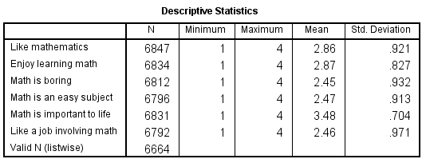
TIMSS 1994
SPSS analysis of 6 TIMSS middle school questions. 1=Strongly Disagree to 4=Strongly Agree

Slide 74
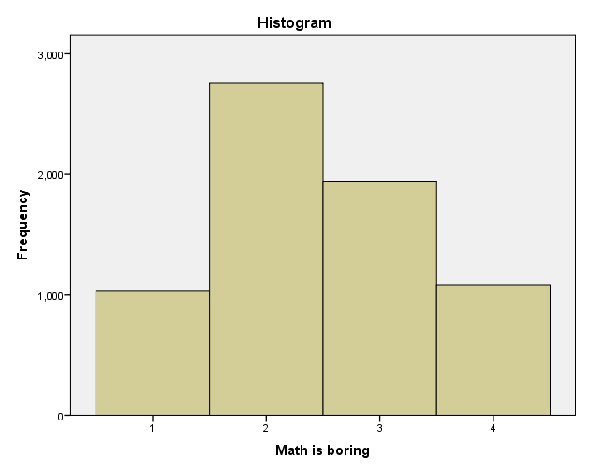
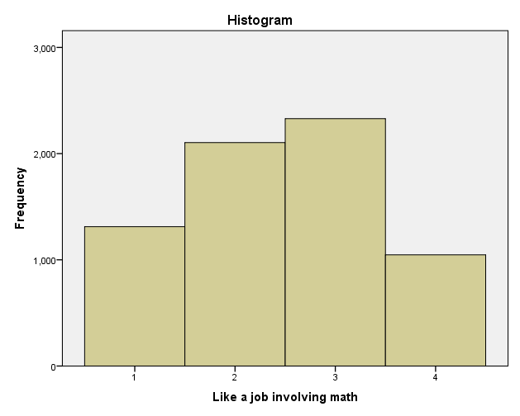
Mean = 2.45
Mean = 2.46

Slide 75
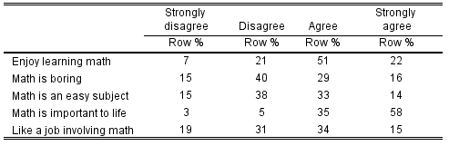
Table of Response %

Slide 76
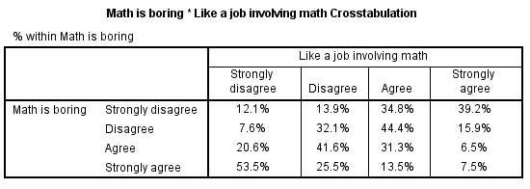
Crosstab of Boring/Job

Slide 77
Crosstab of Boring/Job
χ²(9, n=6759) = 1794, p<.001.
Cramér’s phi magnitude of association = .29

Slide 78

Item Response Theory for Survey Data Analysis

Slide 79
Wilson, M. (2005). Constructing measures: An item response modeling approach.
Mahwah, NJ: Lawrence Erlbaum.

Slide 80

Reeve, B.B., & Mâsse, L.C. (2004).
Item response theory modeling for questionnaire evaluation.

Slide 81
One Approach – Construct Map
Construct Definition (measuring a trait)
  A simple form: More or less, high to low
Item Development
  Realizations of the construct
Outcome Space
  Aspect of response we value – how to score
Measurement Model
  How we relate scores to constructs

Slide 82
From Construct to Item Responses
Causality
Item
Responses
Construct
Measurement
Model
Outcome
Space
Inferences
Source: Mark Wilson, 2005

Slide 83
Background to IRT
IRT is a way of thinking about measurement: a probabilistic model.
We give an item or task to a person and obtain an item-person interaction.
This results in a score with a probability, given a person’s ability.

Slide 84
Rasch Philosophy
Rasch models provide a basis and justification for obtaining person locations on a continuum from total scores on assessments.
Although it is not uncommon to treat total scores directly as measurements, they are actually counts of discrete observations rather than measurements.

Slide 85
Each observation represents the observable outcome of a comparison between a person and item.
Such outcomes are directly analogous to the observation of the rotation of a balance scale in one direction or another.
This observation would indicate that one or other object has a greater mass, but counts of such observations cannot be treated directly as measurements.

Slide 86
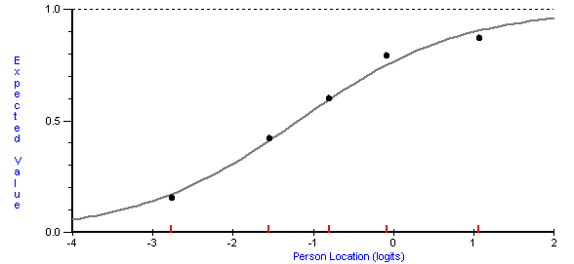
Item Characteristic Curve

Slide 87
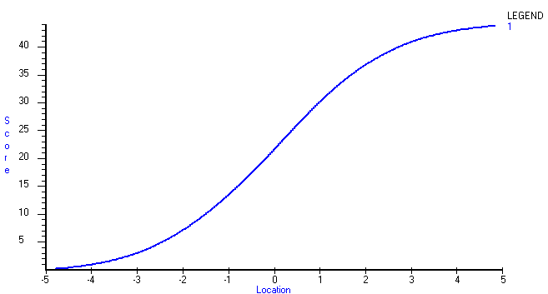
Test Characteristic Curve

Slide 88
Test Characteristic Curve
4 Points on the Raw Score Scale

Slide 89
Test Characteristic Curve
4 Points on the Raw Score Scale
0.5 on the Rasch Scale

Slide 90
Test Characteristic Curve
4 Points on the Raw Score Scale
0.5 on the Rasch Scale
4 Points on the Raw Score Scale

Slide 91
Test Characteristic Curve
4 Points on the Raw Score Scale
0.5 on the Rasch Scale
4 Points on the Raw Score Scale
1.2 Point on the Rasch Scale

Slide 92
From Numbers to Meaning
Numbers themselves do not mean much.
  Is 10 meters a short distance? Long distance?
  We need context to bring meaning to the measure: 10 meters.
  However, 10 meters should always be 10 meters, no matter who takes the measure or how it is taken.

Slide 93
Sample Dependent Statistics
Is an item with a p-value of .90 easy or difficult?
  … 90% passed the item
Is a person with a score of 5 out of 50 items low in ability?
  … correctly answered 10% of the items

Slide 94
IRT Scaling
Person-free item difficult
  Locates the items on the ability continuum
Item-free person ability
  Locates the person on the ability continuum
Places items and persons on the same scale – the ITEM MAP

Slide 95
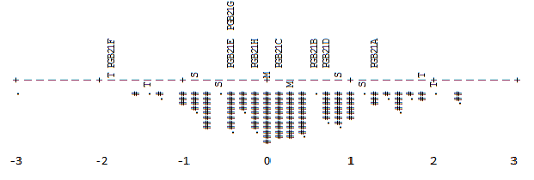
Item Map

Slide 96
Construct MAP
1. Explains the construct; interpretation guide
2. Enables design of items that will lead individuals to give responses that inform important levels of the construct map; identify relevant item features
3. Provides criterion to analyze responses regarding degree of consistency with intended construct
4. Item selection or retention should be based on informed professional judgment

Slide 97
Construct Map
Describing Task Characteristics

Slide 98
IRT Assumptions
Local independence
  Responses to differing items on the test are independent of one another, conditional on the trait they have in common (i.e., conditional on the latent trait items are uncorrelated).
Unidimensionality
  Only one dominant trait is being measured.
  Multidimensional models now exist.

Slide 99
Evaluate the functioning of scale properties
We can ask questions about the response scale:
Does the 5-point scale work as interpreted?
Do we need 5 points?

Slide 100
Minnesota Student Survey
Consider:
Mental Distress

Slide 101
Mental Distress Item
During the last 30 days, have you felt you were under any stress or pressure?
Yes, almost more than I could take
Yes, quite a bit of pressure
Yes, more than usual
Yes, a little
No

Slide 102
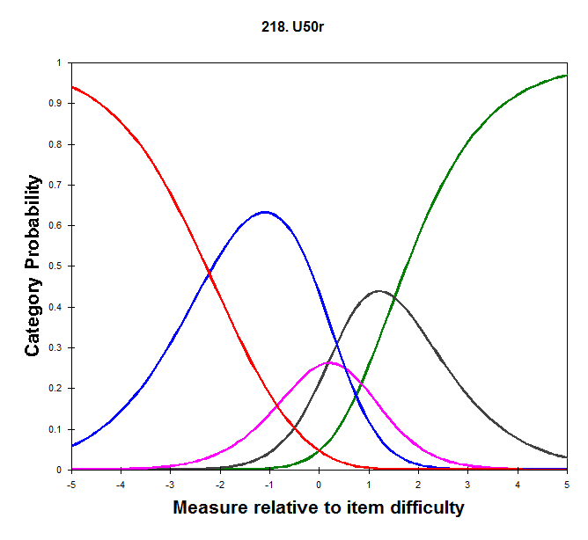

Slide 103
Mental Distress Item
During the last 30 days, have you felt sad?
All the time
Most of the time
Some of the time
A little of the time
None of the time

Slide 104
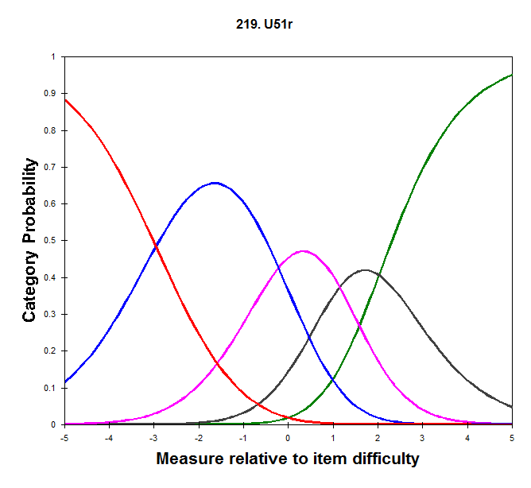

Slide 105
Other Possible Analysis
Differential Item Functioning
  Group difference, conditioned on trait level
  Form of measurement invariance; item bias
Equating over time
  Constant score scale location over time
  Keep item parameters and fix item locations
  Examine parameter drift over time

Slide 106
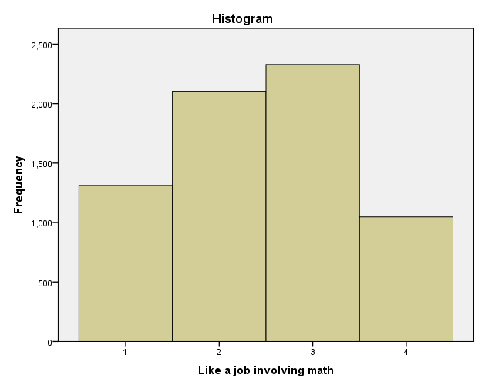
Returning to TIMSS Liking Math…
Mean = 2.45
Rasch = 0.40
Mean = 2.46
Rasch = 0.60

Slide 107
Ordering of Items by…
Item Mean | Rasch location
Math is important | Math is important
Enjoy learning math | Enjoy learning math
Like math | Like math
Math is easy | Math is boring
Like a job involving math | Math is easy
Math is boring | Like a job involving math

Slide 108
| Easy .35
| Boring .35
Job .35
2 . T+
|
.### |
.##### |
S|
.####### |T
1 . +
. |
.######### |
.############ | Boring .25
Easy .25
Job .25
.########## |
0 . +M
.####### |
.##### S|
. |
.### |S
.## |
-1 . +
.# T|T Job .15
. |
| Boring .15
Easy .15
EASY
BORING
JOB
BORING
EASY
JOB
JOB
BORING
EASY

Slide 109
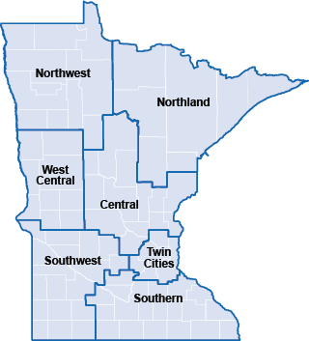

Survey Data Analysis examples from the
Minnesota Student Survey
3.5% (3.2)
4.9% (5.0)
4.7% (4.0)
15.4% (14.2)
52.9% (55.4)
4.7% (5.2)
13.9% (13.1)

Slide 110
Minnesota Student Survey
Population survey of students in grade 5, 8, 9, 11
160,000+ students
Optional for schools
Administered every 3 years (currently being administered)
336 questions on the longer forms
Administered online

Slide 111
Minnesota Student Survey - Intro
You can help your community and school learn more about the lives and feelings of young people like you. The questions on this survey cover many areas. Some questions might make you feel uncomfortable. You do not have to answer any question you don’t want to. You can choose not to complete the survey.
Do NOT write your name on this survey. No one will know how you answered these questions. Your answers will be kept private. Thank you for filling out this survey honestly and carefully.

Slide 112
MSS - Topics
Background
School
Out of School Activities
Health
Behavior

Slide 113
MSS Scaling
Developmental Skills | Developmental Supports | Developmental Challenges
1. Commitment to Learning | 1. Empowerment | 1. Bullying
2. Positive Identity and Outlook | 2. Supported | 2. Bullied
3. Social Competence | 3. Teacher/School Support | 3. Mental Distress
 |  | 4. Family Violence

Slide 114
Measurement Model - CFA
Model fit is indicated by:
RMSEA < .05 is Good Fit; RMSEA < .08 is Adequate Fit
CFI > .95 is Good Fit; CFI > .90 is Adequate Fit
TLI > .95 is Good Fit; TLI > .90 is Adequate Fit

Slide 115
MSS – Commitment to Learning CFA
MODEL FIT INFORMATION
RMSEA (Root Mean Square Error Of Approximation)
Estimate 0.081
90 Percent C.I. 0.080 0.082
Probability RMSEA <= .05 0.000
CFI/TLI
CFI 0.943
TLI 0.921

Slide 116
MSS – Commitment to Learning CFA

Slide 117
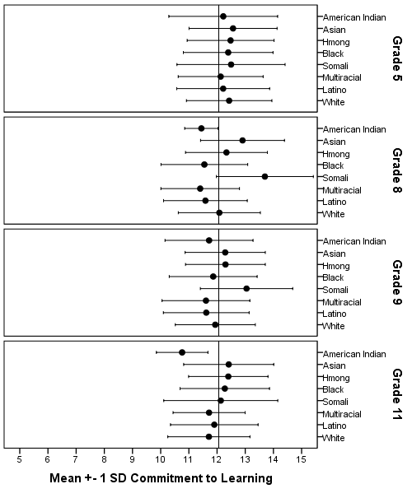
Commitment to Learning: Race Profiles

Slide 119
Disparities: Commitment to Learning

Slide 120
8th Grade MCA & CtL Disparities

Slide 122
Disparities in OST Participation v Non-Participation

Slide 123
% Equipped: Social Competence

Slide 124
Equipped & After-School Participation
 | % in at least one activity by grade level
# of skills equipped | 5 | 8 | 9 | 11
0 | 70% | 67% | 66% | 61%
1 | 77% | 77% | 77% | 74%
2 | 81% | 84% | 84% | 82%
3 | 87% | 89% | 90% | 88%

Slide 125
Equipped and Grades
 | GPA by grade level
# of skills equipped | 5 | 8 | 9 | 11
0 | 2.7 | 2.4 | 2.4 | 2.5
1 | 3.1 | 3.0 | 3.0 | 3.0
2 | 3.3 | 3.3 | 3.2 | 3.2
3 | 3.5 | 3.5 | 3.5 | 3.5

Slide 126
Does working affect after-school participation?
In one anonymous school district: Not by much.
Of the students in grades 8-11 (the work question was not given to 5th graders), about 31% report to work at least 1 hour a week (of these, 22% work more than 10 hours per week).
Of those working, 77% participate in after-school activities.
Of those not working, 70% participate in after-school activities.

Slide 127
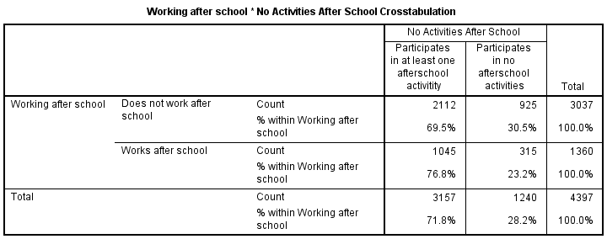

Slide 128
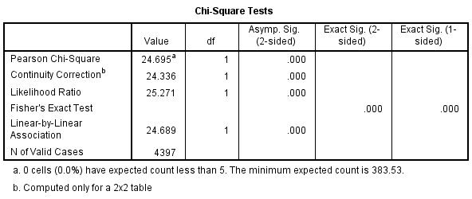
Chi-Square Test of Independence

Slide 129
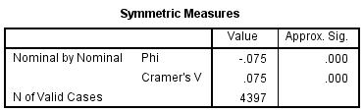
Effect Size – Magnitude of Effect

Slide 131

https://sites.google.com/view/mnydrg
Minnesota Youth Development Research Group

Slide 132
Reporting & Ethical Standards

Slide 133
Limitations
Know the limitations of your methodology.
Be sensitive to the limitations when interpreting results and making conclusions.
We can never prove anything, only rule out alternative explanations (i.e., hypotheses).

Slide 134
Generalizing Findings
Cannot make conclusions about populations (or subgroups) that were not sampled appropriately or sampled at all.
Describe your sampling method clearly.
Describe your sample completely.

Slide 135
The Ethics of Reporting
Ethics is not just human-subjects protection.
Data analysis and interpretation require ethical decision-making.
Reporting findings with major repercussions?
Reporting some findings but not others?
Results that run counter to prevailing beliefs?
Results that run counter to the interests or mission of your funding source?

Slide 136
Interpretations and Conclusions
Interpretations should be…
  informed, intelligent, creative, data-based, and ethical.
Interpretations should not be…
  speculative, selective, biased, or dishonest.
Conclusions should follow from research questions, methodology, and analysis.
Conclusions demonstrate a familiarity with subject material, theories, and prior research.

Slide 137
AERA Reporting Standards
AERA, 2006. Standards for reporting on empirical social science research in AERA publications. Educational Researcher, 35, 33-40.
Covers quantitative and qualitative methods.
Does not cover research reviews; theoretical, conceptual, or methodological essays; critiques of traditions and practices; or scholarship more grounded in the humanities.

Slide 138
AERA Reporting Standards
Intended to provide a framework of expectations about what should be included in an empirical report.
Not intended to define the conduct of empirical work.
Not intended to define the format of a empirical report.
Not a checklist.

Slide 139
Two Principles
Sufficiency of warrants
  Empirical reports should be warranted (reasonable, defensible, acceptable).
  Adequate evidence should be provided to justify results and conclusions.
Transparency of report
  Reporting should make explicit the logic of inquiry and activities that led from the development of a research question, through definition, collection, and analysis of data to presenting findings.

Slide 140
1: Problem Formulation
1.1 Provide a clear statement of purpose and scope of study.
1.2 Make clear how the study is a contribution to knowledge.
1.3 Include a review of the relevant scholarship.
1.4 Rationale for conceptual, methodological, or theoretical orientations of study should be described.
1.5 Rationale for problem formulation as it relates to the groups studied should be described.

Slide 141
2: Design and Logic
Design and logic flow directly from problem formulation.
2.1 Reporting should follow a clear logic of inquiry that allows readers to trace the path from problem formulation to interpretations and conclusions.
2.2 An unambiguous and specific description of the design should be reported.

Slide 142
3: Sources of Evidence
3.1 The units of study (sites, groups, participants, events, etc) and means of selection should be adequately described.
3.2 The data and empirical materials should be clearly described, including how and when they were gathered, by whom, and for what purpose.

Slide 143
4: Measurement & Classification
4.1 The development of measurements and classifications should be clearly described and show how important characteristics of the phenomenon of study are preserved.
4.2 Any classification scheme should be described and illustrated with concrete examples that represent the range of the phenomenon.
4.3 Measurement reporting should describe data elements and organization in a specific and unambiguous way.

Slide 144
4: Measurement & Classification
4.4 When transcriptions are included all coding conventions should be clearly described.
4.5 A rationale for the relevance of a measurement or classification should be described.

Slide 145
5: Analysis and Interpretation
5.1 Procedures used for analysis should be clearly described.
5.2 Analytic technique should be clearly described.
5.3 Analysis and presentation of findings should make clear how they support conclusions.
5.4 Include information on any intended or unintended circumstances that may affect interpretations.

Slide 146
5: Analysis and Interpretation
5.5 When presenting conclusions describe:
  (a) how interpretations address the research question,
  (b) how conclusions relate to literature, and
  emphasize the implications of study.
5.6 Clearly state statistical analyses and appropriateness of statistical tests.
5.7 Provide descriptive and inferential statistics that are relevant to each analysis.

Slide 147
5: Analysis and Interpretation
5.8 Any issues in data collection that might compromise the validity of statistical analyses should be reported (e.g., missing data).
5.9 Any issues in data analysis that might compromise the validity of statistical analyses should be reported (e.g., assumption violations).
5.10 For each statistical results include: (a) an index of the quantitative relation between variables; (b) the standard error for given index; (c) the hypothesis test, test statistic, and significance level; (d) qualitative interpretation (i.e., practical significant).

Slide 148
6: Generalization
6.1 Whether generalization is intentional or not, make clear the specifics of the participants, contexts, activities, data collections, and manipulations.
6.2 When generalization is intentional make intended scope of generalization clear.
6.3 When generalization is intentional make logic by which the findings of the study should apply within the intended scope of generalization clear.

Slide 149
7: Ethics in Reporting
7.1 Ethical considerations involved in data collection, analysis, and reporting should be explicitly addressed.
7.2 Reporting should be presented in a way that honors consent and other agreements.
7.3 Describe conflicts of interest or biases.
7.4 Care should be taken to ensure accuracy of reporting.
7.5 Data and relevant materials should be stored appropriately to allow for potential replication of results.
7.6 Funding support should be acknowledged.

Slide 150
8: Title, Abstract, and Headings
8.1 Title should clearly convey what article is about.
8.2 The abstract should provide a summary of the article that is self-contained, concise, and accurate.
8.3 Headings and subheadings should make clear the logic of inquiry underlying the report.

Slide 151
References
Schonlau, M., Fricker, Jr., R.D., & Elliott, M. N. (2002). Conducting research surveys via e-mail and the web. Santa Monica, CA: Rand.
Dillman, D. A. (2000). Mail and internet surveys: The tailored design method. New York: John Wiley & Sons, Inc.
Dillman, D. A., Tortora, R. D., & Bowker, D. 1998. Principles for Constructing Web Surveys. SESRC Technical Report 98-50, Washington State University. Available online at: http://survey.sesrc.wsu.edu/dillman/papers/websurveyppr.pdf
Cook, C., Heath, F., & Thompson, R. L. (2000). A meta-analysis of response rates in web-or internet-based surveys. Educational and Psychological Measurement, 60(6), 821-836.

Slide 152


