Slide 1



Toward Balanced
Assessment Systems
Michael C. Rodriguez
Campbell Leadership Chair in Education and Human Development
University of Minnesota

Slide 2
Do you have a coherent and effective district and school assessment system to complements and enhances instruction? Does it serve student, teacher, administrator, and policymaker needs, and with good balance?
Was the system designed so that teachers, principals, and administrators share power in service of providing students the best possible education? Or does the collection of tests feel more like a collection of bricks than a well-designed house?

Slide 3
Does each test have a clear and appropriate purpose? Are these purposes clearly understood? Agreed to by all parties?
Are current uses appropriate to the test purposes? Is it clear what uses are appropriate, and which are not for data from each test?
Does it feel like some tests will crumble under the weight of use?

Slide 4
Are some tests given by tradition without a clear understanding of why?
Are test data actually used when they become available?
Are tests used for new purposes without explicit attention to whether the new uses are appropriate?

Slide 5
Are the tests (taken as a set) coherent, or do tests prescribed by the state, district, school, or the classroom teacher conflict with each other in timing, content standards, or results?
Does it feel like, overall, testing disrupts rather than facilitates instruction?

Slide 7
Developers

Slide 8
Toolkit Guidance
Create a Design Team
Professional development and learning regarding assessment
Design documents to facilitate three 3-hour workshops resulting in:
A summary of the existing assessments used in the district
A document describing the Design Team’s proposed district assessment system design
A report describing how the team created the final design
A document describing potential barriers to implementation with associated strategies to address them.

Slide 9
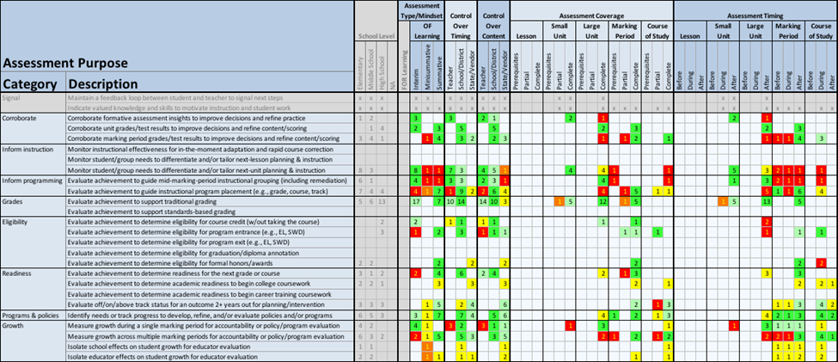
District Assessment Audit

Slide 10
Toolkit
Also contains Primers on
Assessment vocabulary
Purposes of assessments
Types of assessment
Focus on formative assessment

Slide 11

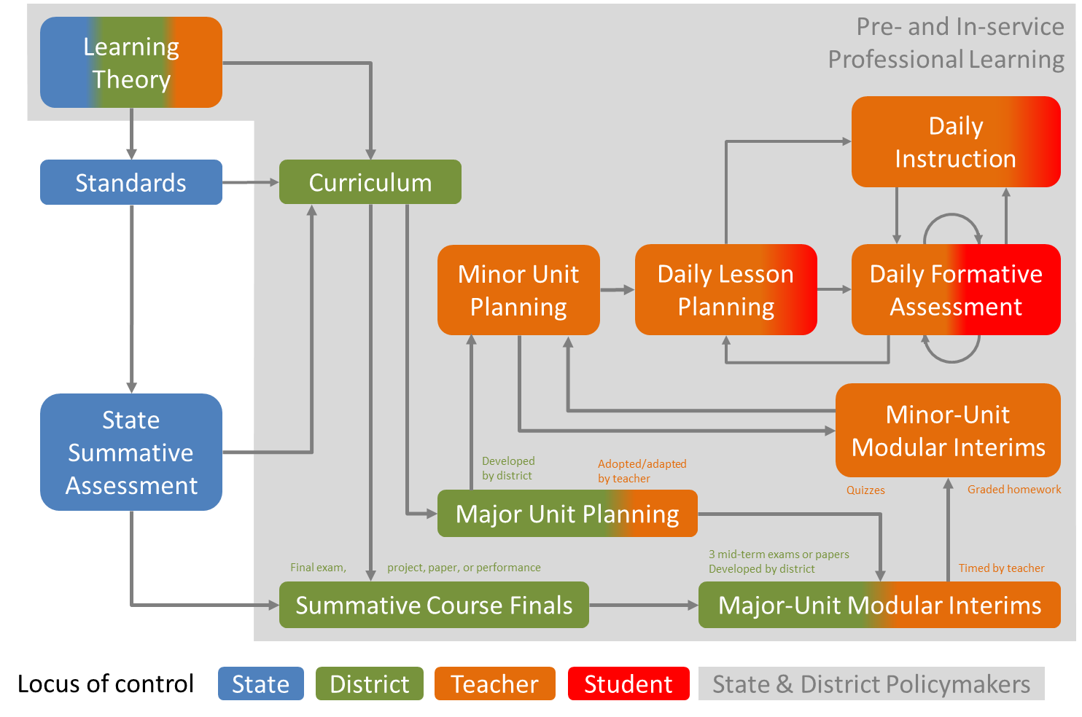
What does the system look like?

