Slide 1



Classroom Assessment in Balanced Assessment Systems
Michael C. Rodriguez
Campbell Leadership Chair in Education and Human Development
University of Minnesota

Slide 2
Today’s Topics
District Assessment System Design Toolkit
Balanced Assessment Systems
District and Classroom Assessment Audits & Maps
Assessment Essentials – a few basics
Classroom Assessment Modules (Center for Assessment)
Focus on Formative Assessment & Feedback
Classroom Assessment in Remote Contexts
Working with Teachers & Getting the Work Done

Slide 3
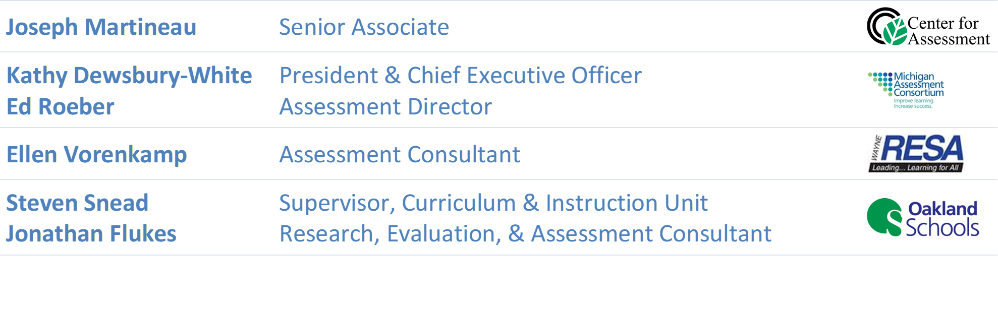

Slide 4
Toolkit Guidance
Create a Design Team
Professional development and learning regarding assessment
Design documents to facilitate three 3-hour workshops resulting in:
A summary of the existing assessments used in the district
A document describing the Design Team’s proposed district assessment system design
A report describing how the team created the final design
A document describing potential barriers to implementation with associated strategies to address them.

Slide 5
Toolkit
Also contains Primers on
Assessment vocabulary
Purposes of assessments
Types of assessment
Focus on formative assessment

Slide 6
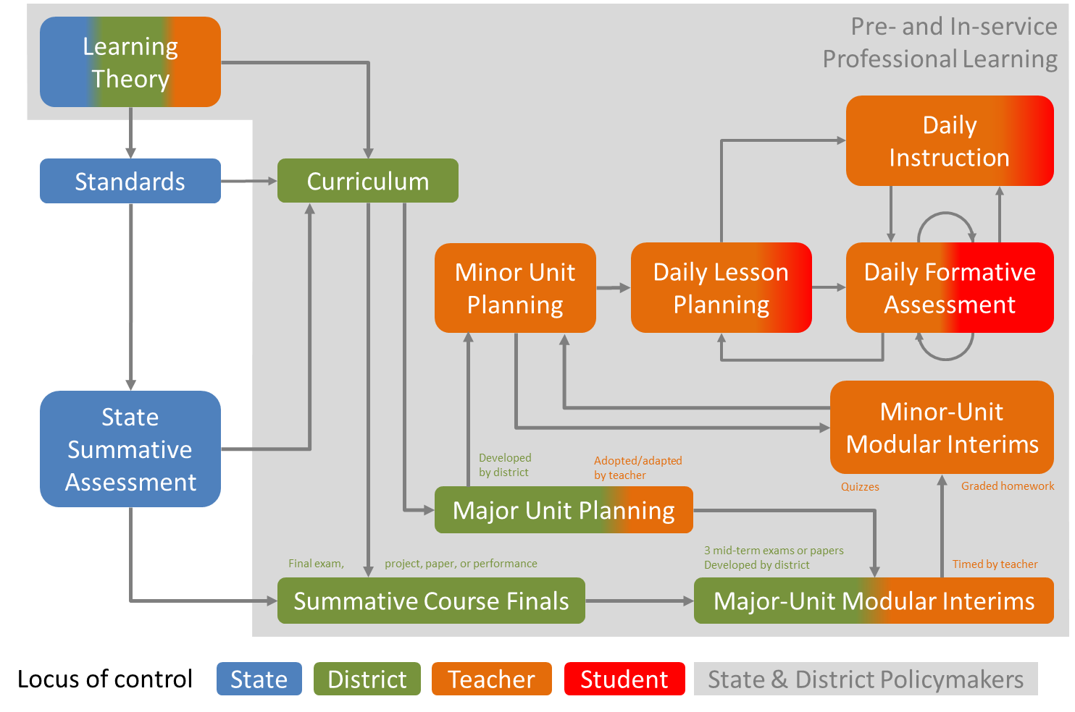


Slide 7
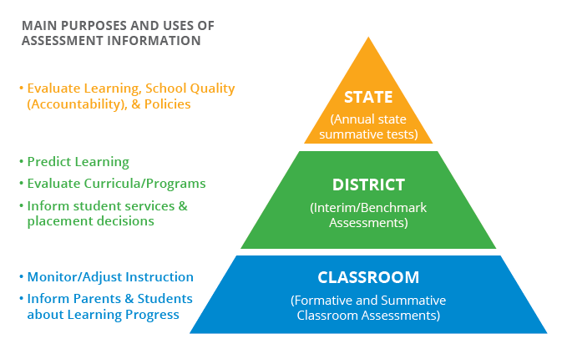
What are Balanced Assessment Systems?
There are multiple layers of an assessment system.
The purposes and uses of assessment information differ at each layer.
It is important to guard against practices that might have a negative impact on classroom instruction (e.g., teaching to the test, over-testing, narrowing of the curriculum, etc.).
Notes:
We start first with asking the question: What are BAS? As stated on the previous slide, a balanced assessment system is one in which the assessments from the state house to the classroom do not work at cross purposes with each other, and the assessment within any given layer provide the necessary information to support better decision-making for specific purposes and uses at that layer.
However, If you google “balanced assessment systems” you will notice that many define balanced assessment systems in a different way. For example, many define BAS based upon the types of assessments that make up the system--whether those be formative, interim, or summative. The problem in our opinion with that approach is that these assessment types (formative, interim, summative) are just tools like a hammer, screwdriver, or drill--they are agnostic to what you are building or fixing. So we have to talk about purpose and use for assessment information, as well as the multiple layers of the system that supply assessment information.
The triangle graphic on the slide shows the three layers of an assessment system (state, district, and classroom). The main purposes and uses of assessment information at each level (or layer) are to the left --color coded in terms of correspondence with the layer. You’ll notice that the purposes and uses of assessment information differ at each layer. The state layer serves primarily an accountability and equity function. The district layer supplies an aggregate look at students across classrooms or schools within a district (which would include interim/benchmark and common assessments), and the classroom layer provides the most fine-grained information for teachers.

Slide 8
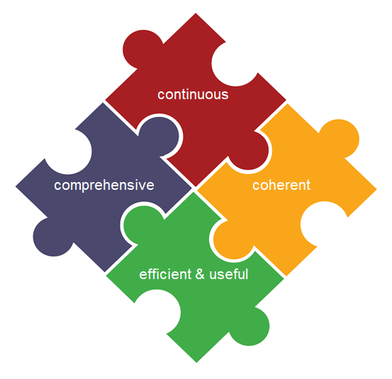
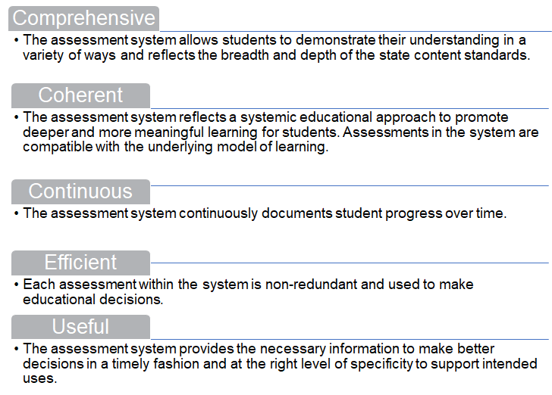

What Makes an Assessment System Balanced?
See paper: “Not as Easy as It Sounds: Designing Balanced Assessment Systems”
Notes:
The second building block details the features of balanced assessment systems. Balanced assessment systems have specific features that, if present, support turning a collection of assessments with multiple layers into a system that documents student achievement towards meaningful learning targets for a specific purpose or purposes.
These five features are listed on the screen and I want to take a minute to explain each one:
-Comprehensive means that the assessment system allows students to demonstrate their understanding in a variety of ways. So, for example, a student may be asked to reproduce factual knowledge and apply skills, as well as transfer their learning to new or novel situations. Students may be asked to communicate their conceptual understanding in writing, or through an oral presentation. Students may be provided the opportunity to choose how they want to demonstrate their knowledge and skills within a certain menu of options. Students may create or produce something. There are numerous ways students can demonstrate their understanding and a balanced assessment system is one in which the full range of opportunities are present to students—rather than always having to demonstrate their understanding through a 100-question paper and pencil test.
Comprehensiveness also means that the system reflects the breadth and depth of the state content standards. One way to ensure all standards are taught is to ensure that all standards are assessed—and assessed at the depth of the proficiency expectations detailed in the language of the standard. [maybe leave out…] For example, if the standard says: Write informative/explanatory texts to examine a topic and convey ideas, concepts, and information through the selection, organization, and analysis of relevant content. CC.7.W.2 –then a student must be asked to write an informative/explanatory text that elicits this assessment evidence.
-The second feature of BAS is coherence. Because assessment is the process of reasoning from evidence, the assessment system should align with modern conceptions of how students learn and deeper learning goals. Deeper learning is defined by the 2012 NRC report Education for Work and Life as transfer of knowledge and skills from one context to another.

Slide 9
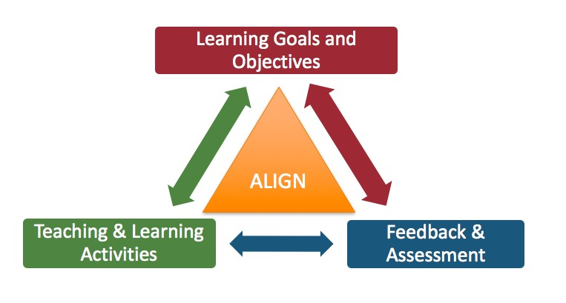
Coherence: A Deeper Dive
A model of learning serves “as a unifying element—a nucleus that brings cohesion to curriculum, instruction, and assessment.”
National Research Council. (2001). Knowing what students know: The science and design of educational assessment. Washington, DC: The National Academies Press, p. 54.
Notes:
Transfer, or deeper learning, is facilitated when there is alignment among the learning goals and objectives, teaching and learning activities ,and the feedback and assessment mechanisms used to inform the curriculum and instruction.

Slide 10
Comprehensive and Balanced Assessment Systems (LSI, 2019)
Most district assessment systems are neither comprehensive nor balanced.
A balanced assessment system offers more detailed information to individual learners and their teachers in the classroom, where the learning takes place, and proportionally less (more general, and more aggregated) information available as the distance from the learning increases.
Learning outcomes are the foundation of a comprehensive, balanced assessment system and the reference against which assessment information should be interpreted.

Slide 11
Comprehensive and Balanced Assessment Systems (LSI, 2019)
In fact, when benchmark assessments are used to monitor students’ progress toward state accountability test performance, they are functioning summatively.
As currently practiced, interim and benchmark assessment is the component of an assessment system with the least research support. It may be that, with enhanced short- and medium-cycle formative assessment and improved grading practices, this component can be eliminated or at least have its use radically transformed.
One of the goals of a balanced system weighted heavily on the side of classroom short-cycle and medium-cycle formative assessment is to strengthen core instruction and eliminate over-reliance on interventions.

Slide 12
Comprehensive and Balanced Assessment Systems (LSI, 2019)
The last best hope for improving assessment systems and increasing the assessment literacy of the responsible parties resides at the district level. That is where the main responsibility for the parts of the system lie, and where the benefits and consequences—and thus, presumably, the motivation—accrue.

Slide 13
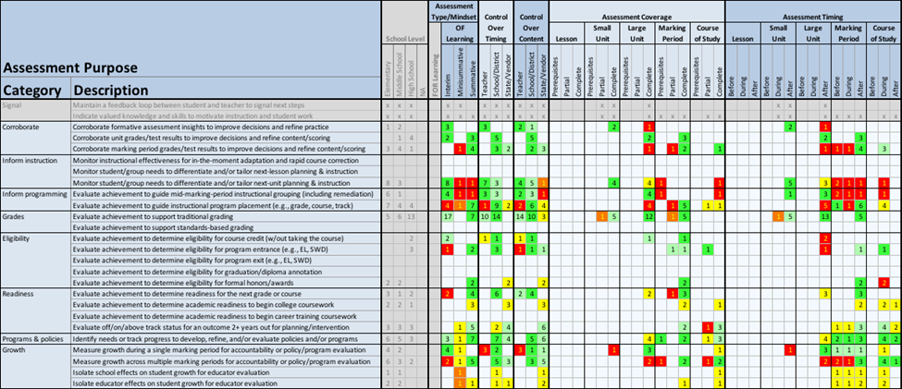
District Assessment Audit

Slide 14
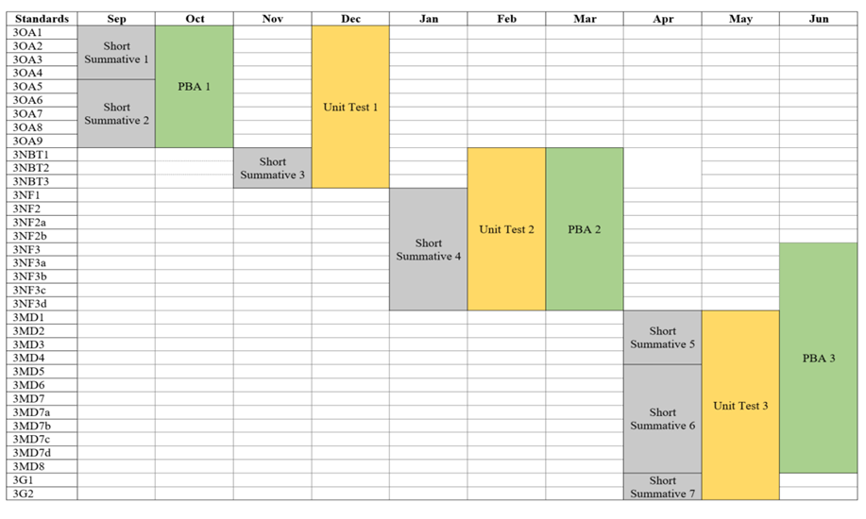
Classroom Assessment System Audit
Examine the extent to which what is actually taking place in classrooms is consistent with the features of balanced assessment systems.
Reflect on the system as a whole (across grades and subject areas) and devise a plan for improving the quality going forward.
Notes:
This slide shows one type of classroom assessment system audit—a classroom assessment map, in this case for Gr 3 math. Teams of grade level teachers can create these assessment maps which are analogous to curriculum maps. Assessment maps list only the summative classroom assessments. You’ll notice that all the gr 3 math state content standards are listed down the left hand column. Months of the year are across the top. Time could also be demarcated based on trimesters, quarters, or another way. The summative classroom assessments are color coded to indicate the type of classroom assessment design. Short summatives in grey; performance based assessments in green; and unit tests in yellow. These three types of assessment design are just examples.
School/district leaders can use the maps alongside teachers to evaluate the quality of their classroom assessment systems using the same five criterion used to evaluate the quality of the district assessments. For example, teachers and school/district leaders can look at each map independently, but also examine vertical and horizontal coherence. Vertical means across grade levels such as K-12 and horizontally means within their grade level/grade band but across content areas to see what they notice.
Are students assessed with assessments that probe deeper learning such as performance assessments (depth of the state content standards)? Are there clusters of standards that are not assessed at all over the course of the year in a particular grade/subject area (breath of the state content standards)? Depth and breadth just discussed relate to comprehensive criterion. How would a student experience the assessment system from K-12? Are teachers approaching their classroom assessment systems in fundamentally different ways or with similar philosophies? What model of learning undergirds these philosophies and approaches (coherence criterion). re students provided multiple opportunities to demonstrate mastery which represents the continuous criterion)? How are the teachers using the information gleaned from these summative assessments? In other words, is the information useful? If not, are there assessments that can be eliminated to make the system more efficient?
Just as with the district assessment system audit, not every one of the five features of BAS can be answered in depth by just analyzing the classroom assessment map. One could also take a deeper dive into the summative classroom assessments listed on the map and evaluate each for quality. We discuss quality criterion such as alignment, fairness, and technical qualiities that could be used in a subsequent learning module.
**
One final note in closing: If you did an overleigh of the district assessment system map with the classroom maps, the goal is to visually see how the information collected at multiple levels promotes efficiency and the collection of critical information used to inform decisions. Incoherence, overtesting, and/or redundancies are eliminated.

Slide 15
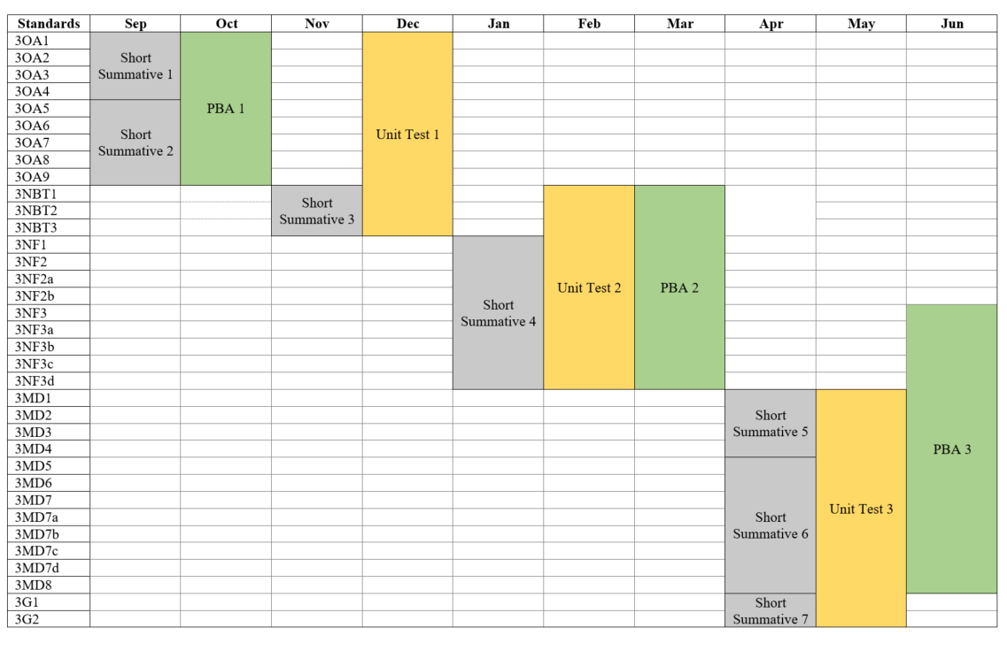
One Example of a Gr 3 Math Assessment Map
Short Summative = shorter classroom summative assessment
PBA =
performance-based assessment
Unit Test =
longer classroom summative assessment
PBA 4
Notes:
Here’s an example of a Gr 3 Math Assessment Map. This is only one way it can be designed. What do you notice about how it is designed? What questions do you have? For example, consider: [read]. Turn and discuss or jot down some thoughts about these questions.

Slide 16
Some Unit of Time
(Semesters, Months, Quarters, Etc.)
State Content Standards
Assessment maps are meant to be a flexible tool!
Adapt as needed!
Notes:
In terms of what do you notice, you see that all of the state content standard for Gr 3 math are listed down the left hand column. There is also some unit of time demarcated at the top. Here you see months of the year, a school/district could decide to choose trimesters, semesters, quarters, etc. Different types of assessment are color coded and named. I often recommend that teachers add in the specific name of the assessment rather than just Short Summative 1, for example, as this can serve as a resource to new teachers and assessment names are often more helpful for that purpose. You do not need to include these three assessment designs--short summative, unit test, or PBA necessarily. We do recommend however that you do not list formative assessments (as those are inseparable from instruction and would be too numerous to include) and you also do not include district level assessments or state level assessments. The key thing to note is that assessment maps are meant to be a flexible tool. Adapt as needed, but strive for consistency across classrooms in a school or district if you want to be able to evaluate quality across classrooms, schools, content areas, and/or grade levels.

Slide 17
How do you Create Classroom Assessment Maps?
Use the summative classroom assessments for a grade/subject and backward map those assessments to the standards they measure by...
  Using curricular resources to align each assessment with one or more standards.
  Adding the assessments to the map in based on when it is administered. Use the actual name of the assessment, if possible.
  Color coding each assessment by type (e.g., Unit Test, Performance Assessment, Short Unit Quiz). Define the meaning of each and use similar color coding scheme across classrooms can help with interpretation.
  Merging boxes (or repeat assessment name) across standards to show alignment to the standards measured by the assessment.
Notes:
So how do you create classroom assessment maps? [read]

Slide 18
Reflecting on the Quality of the System
Is this collection of assessments coherent, comprehensive, continuous, efficient and useful?
  What are the strengths and weaknesses of your classroom assessment system given a desire to elicit evidence of higher-order thinking and deeper learning?
  Are the assessments aligned to how you believe people learn?
  Do assessment probe the depth and breadth of the content standards?
  Are students provided multiple and varied assessment experiences over the course of the year?
  How many summative assessments are administered over the course of the year?
  Are there redundant assessments or assessment that can be removed because the information is not used?
What about across classrooms within a school or district?
  Is there coherence across grade levels or content areas?
  How would a student experience the assessment system from K to 12?
Notes:
In order to reflect on the quality of the system, which is the purpose for doing classroom assessment maps, by the way, you can use the following italicized questions to help you evaluate the extent to which your classroom assessment system adequately meets the criteria for balanced assessment systems. Some of these questions you will only be able to answer in part from the 30,000 foot view--which is the classroom assessment map--without taking a deep dive into each individual assessment. It is important to note that these questions are not the only ones you can ask, but they are a good start.
If you have assessment maps across classrooms within a school or district, you can also ask:

Slide 19
Assessment Essentials
Control over timing
Control over content
Small unit, large unit
Marking period, course grading
Assessment for learning, for formative purposes
Assessment of learning, for summative purposes

Slide 20
 | Teacher-Made | Standardized
Specificity of Objectives | Objectives are specific to the needs of students in a given classroom | Objectives are general to the needs of students in most classrooms
Content | May come from any area of the curriculum. Items may be added, eliminated, or modified as desired | Items are fixed and are not modifiable; only the most common areas of the curriculum are surveyed
Rules for administration and scoring | Determined by the teacher. Should be uniform within the class and can be adapted to the particular needs of students. | Determined by the test publisher. Must be followed exactly as stated in the test manual.
Norms | No norms are provided, although teachers may generate their own. | Norms are provided by the publisher to compare class or student performance to similar or different age and grade groups.
Evaluation of tests | Test quality is assessed by the teacher | Data on the quality of instruments are provided by the publisher.

Slide 21
Score Reference Systems
Norm-referenced score interpretation
Criterion-referenced score interpretation

Slide 22
Classroom Assessment Learning Modules
The modules provide educational leaders and teachers with the materials, resources, and tools they need to support re-entry with students in fall 2020 and beyond.
The learning modules can be used as stand-alone professional learning or sequenced together over time--even when COVID-19 is a distant memory as the content is applicable beyond the current educational context.

Slide 23
ASSESSMENT is the process of gathering evidence of student learning for the purpose of informing educational decisions
Notes:
Multifaceted enterprise – used for formative and summative purposes

Slide 24
Describing the Two Assessment Mindsets
Key Features | Assessment OF Learning |  | Assessment FOR Learning
 | Summative | Interim | Formative
Key Question | Did the students learn what they should have? | Is the class/student on track for proficiency? | What comes next in the student’s learning?
When Asked | End of unit/ term/year | Multiple times per year | Ongoing in the classroom
Use of Results | After instruction ends (curriculum & instructional leaders) | Between instructional cycles (instructional leaders & teachers) | During Instruction (teachers & students)
Notes:
ALECIA

Slide 25

Assessment Users and Purposes
Students
Assessment for Learning
  What am I supposed to learn?
  What should I do next?
  What help do I need?
Assessment of Learning
  How much did I learn? Did I get a good grade?
  Is learning worth the effort?
Notes:
Students may ask several questions of themselves or their teacher during learning
For example, what am I supposed to learn? Or, am I learning enough.
[Pause]
Students may have other questions after learning opportunities have concluded.
For example, how much did I learn? Will I get a good grade? Or, is learning worth the effort?
[Pause]

Slide 26

Assessment Users and Purposes
Teachers
Assessment for Learning
  What does each student need?
  What strengths can I build on?
  How should I group my students?
  Am I going too fast? Too slow?
Assessment of Learning
  What grades do I give each student?
  What do I tell parents?
  Do any students need to be referred for special services?
  Will each student be ready for the next unit, course, grade?
Notes:
Teachers may ask several questions of themselves during instruction.
For example, what does each student need to continue learning? Or, am I going to fast or too slow?
[Pause]
Teachers may have other questions questions after learning opportunities have concluded..
For example, what grades should I assign to each student?
[Pause]

Slide 27
Teachers Who Are…
Expert in Formative Assessment | Not Expert in Formative Assessment
Collect evidence of student thinking (quality of thinking) Interpret student responses in terms of what students were thinking Consider what feedback or immediate next step in instruction will address the specific needs | Collect evidence of student performance (quantity of thinking) Evaluate the correctness of responses Re-teach topics based on percent correct
Minstrell, Anderson, & Li (2009); Hattie (2009); Hattie & Timperley (2007); Kroog, Ruiz-Primo, & Sands (2014).

Slide 28
When FA Doesn’t Quite Work….
If formative assessment strategies don’t inform further instruction (and students’ further work), the issue is usually one of depth.
Surface application of strategies (e.g., using exit tickets), without deep mindset change, has been called the “letter” but not the “spirit” of FA (Marshall & Drummond, 2006).

Slide 29
Formative Assessment Guiding Questions
Where am I going?
  Provide a clear and understandable vision of the learning target
  Use examples and models of strong and weak work
Where am I now?
  Offer regular descriptive feedback
  Teach students to self-assess and set goals
How do I close the gap?
  Design lessons to focus on one aspect of quality
  Teach students focused revision
  Engage students in self-reflection, and let them keep track of and share their learning
Adapted from Sadler 1989, J. Myron, P. Black, & J Coffey, 2001

Slide 30
Component 1: Planning
Instructional Planning
  Planning is essential to effectively implementing the formative assessment process
  When planning, keep the following in mind:
    What am I teaching? (Standard)
    How do I make this transparent to the student? (Learning Target)
    How will I/they know they have mastered the concept, content, skill? (Criteria for Success)
    When will I collect evidence of student learning?
    How will I collect evidence of student learning?
    Based on my analysis of collect evidence…How will I…
      Give feedback to students?
      Modify my instruction if students are not on target?
      Help students’ modify their learning tactics is they are not on target?

Slide 31
Component 2: Learning Targets
Learning Targets
  Are written in student friendly language
  Are posted somewhere in the classroom
  Are aligned with the day’s activities
  Identify for students the knowledge and skills needed to accomplish the lesson’s learning
  Are embedded in the instructional process

Slide 32
Component 4: Formative Feedback
Feedback from the Teacher
  Feedback must be descriptive and actionable
  It must be related to the learning target and criteria of success
  Feedback must focus on both the outcome and the process of learning
  Students must have the opportunity to use and learn from the feedback
  Teachers monitor the student’s understanding of the feedback and scaffold their revisions.

Slide 33
Educational Leadership, Sept. 2012
Feedback is not advice, praise, or evaluation. Feedback is information about how we are doing in our efforts to reach a goal

Slide 34
If students know the classroom is a safe place to make mistakes, they are more likely to use feedback for learning.
The feedback students give teachers can be more powerful than the feedback teachers give students.
When we give a grade as part of our feedback, students routinely read only as far as the grade.

Slide 35
Effective feedback occurs during the learning, while there is still time to act on it.
Most of the feedback that students receive about their classroom work is from other students—and much of that feedback is wrong.
Students need to know their learning target—the specific skill they’re supposed to learn—or else “feedback” is just someone telling them what to do.

Slide 36
Classroom Assessment Principles to Support Teaching & Learning
Classroom assessment includes both formative assessment practices focused on moving learning forward and summative assessment used for grading, reporting, and competency determinations. The vision of classroom assessment advanced here is based on sociocultural learning theory, which holds that students’ mental capabilities and ways of being are jointly developed through interaction in their social and cultural context. Importantly, sociocultural theory attends to student identity and sense of belonging as part of learning as well as to the cognitive processes that enhance academic achievement.

Slide 37
Classroom Assessment Principles to Support Teaching & Learning
The assessment principles that follow from this theory are closely connected to ideas about asset-based pedagogies and responsive teaching. In contrast to deficit perspectives, asset-based approaches seek to engage the rich experiences that students bring with them to the classroom by adapting instruction and “responding” to those language and cultural resources. Our assessment principles address equity by fostering student agency and attending to identity and cultural practices from their communities. Although formal instruments and tests are a part of assessment, especially for summative purposes, formative assessment need not rely on formal instruments and is more often effective when embedded in ongoing instructional activity.

Slide 38
2019 NCME Classroom Assessment Conference
Lorrie Shepard Keynote Address
Ongoing challenges in improving teaching and learning uniformly at scale:
The vision of learning cannot be shaped by the external test.
Standardized tests and typical multiple-choice formats distort representations of learning goals.
High stakes pressures misdirect instructional time and learning activities, especially in low performing schools.
Children come to believe that the purpose for learning is to perform well on tests; they internalize the message that they are not capable learners.
Teachers perceive low-scoring students as deficient.
When data-driven-decision-making is done in high stakes environments, educators tend to engage in blaming, identifying who is at blame; accomplishing the opposite intent of professional learning communities. For example, data walls become forms of public shaming.

Slide 39
Classroom Assessment in a Remote Learning Environment
This module is part of a Classroom Assessment series developed by the National Center for the Improvement of Educational Assessment.
This work is licensed under a Creative Commons Attribution 4.0 International License. Educators and others may use or adapt. If modified, please attribute and re-title.
Version 1.0 | Updated September 28, 2020| Developed By:
Carla Evans & Jeri Thompson
Notes:
Hello and welcome to the classroom assessment learning module entitled: [read]. This module is part of a Classroom Assessment series developed by the Center for Assessment.

Slide 40
Warm-Up
What do you think is CONCEPTUALLY different or the same about classroom assessment in a remote learning environment as compared to an in-person context?
Notes:
As a warm-up reflection, we ask you to consider: what do you think is conceptually different or the same about classroom assessment in a remote learning environment as compared to an in-person context? Take a few minutes, pause the video, discuss with colleagues or write out your reflections, and then hit play again.

Slide 41
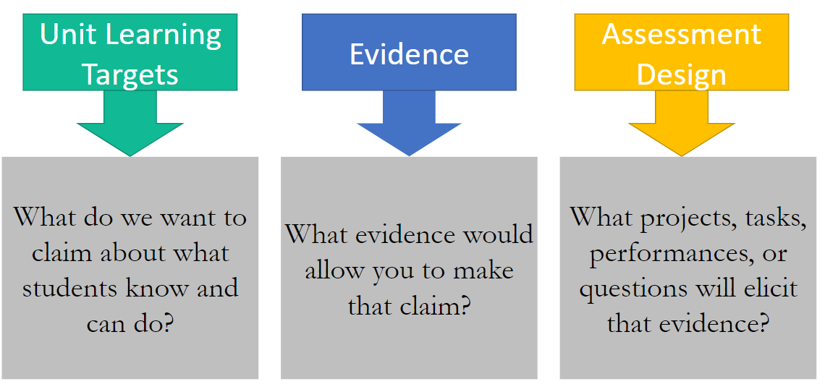
Conceptually, It Is the Same...
Assessment in a remote learning environment is still the process of reasoning from evidence.
See module on “Summative Classroom Assessment” for more information.
Notes:
Now that you’ve taken some time to reflect on what is conceptually different about classroom assessment in a remote learning environment as compared to in-person, let’s see if we came to the same conclusions. Conceptually, we believe it is the same. Assessment in a remote learning environment is still the process of reasoning from evidence. This means assessment is a process of gathering evidence about what a student knows and can do. And because we can’t figure out what a student knows and can do by just looking at a student, we have to gather evidence in relation to what we are teaching and what students are learning (the unit learning targets), and then reason from that evidence about what students know and can do with respect to what proficiency or mastery would look like in relation to the unit learning goals. We then use this brainstorm about acceptable evidence to make decisions about the assessment design--the projects, tasks, performance, and/or questions that will elicit that evidence. This process of assessment design is referred to as evidence-centered design because evidence is in the center. You can see the learning modules on summative classroom assessment for a more in-depth explanation of evidence-centered assessment design--particularly in relation to performance assessments.

Slide 42
Learning Theory Still Unifies Curriculum, Instruction & Assessment
A model of learning serves “as a unifying element—a nucleus that brings cohesion to curriculum, instruction, and assessment.”
National Research Council. (2001). Knowing what students know: The science and design of educational assessment. Washington, DC: The National Academies Press, p. 54.
Notes:
We also believe that learning theory still unifies curriculum, instruction, and assessment regardless of where that CIA takes place--whether in-person or remote. In other words, a model of learning such as constructivism or socio-cultural learning theory (for example) will bring coherence and alignment to the learning goals and objectives, teaching and learning activities, and feedback and assessment mechanisms if all are based in the same model of learning.

Slide 43
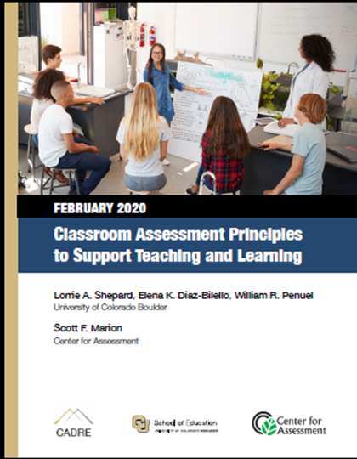

The Foundation of Classroom Assessment Still Remains the Same!
The Classroom assessment principles to support teaching and learning are important for in-person, hybrid, and remote learning environments.
For more information, read the blog: A Principled Approach to Classroom Assessment During Remote Learning.
Notes:
Additionally, the foundation of classroom assessment still remains the same. This slide links to a recent, Feb 2020 resource with high-level principles that guide classroom assessment. These classroom assessment principles are equally important for in-person, hybrid, and remote learning environments though some may be easier or harder to implement in practice depending on the learning environment. See the blog hyperlinked on the bottom of the screen for more information.

Slide 44
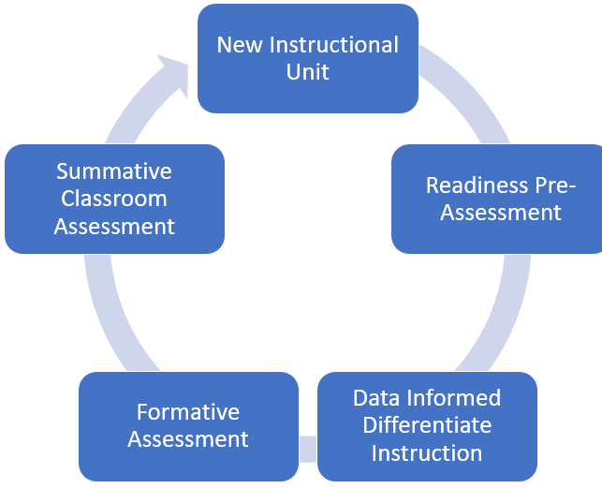
It’s Still About the System!
See module on “Putting the Pieces Together: High-Quality Classroom Assessment Systems” for more information.
Teach to the student’s zone of proximal development
Notes:
And finally, all assessments operate within a system. Formative and summative classroom assessments reside within a classroom assessment system that includes all the evidence gathered over the course of a unit of instruction--and indeed over the course of the year--to chart student progress towards grade level proficiency expectations and important learning targets. You can see in the graphic a typical instructional cycle, which begins with setting the learning intentions and success criteria of the new instructional unit, collecting readiness pre-assessment evidence (as applicable), and then using on-going formative assessment processes before, during and after instruction to differentiate, adjust, and target instruction and provide feedback to students based on learning needs and strengths within a student’s zone of proximal development. Each unit’s cycle wraps up by collecting evidence of student achievement at the end of a period of instruction for grading and reporting purposes.
See the module putting the pieces together for more information on the features of high-quality classroom assessment systems.

Slide 45
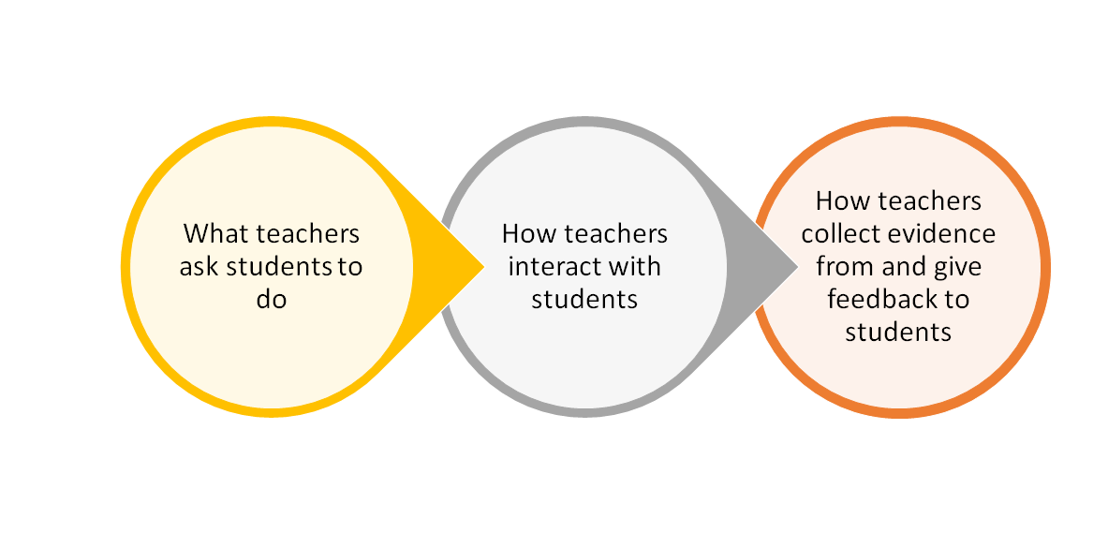
But Practically, It Is Different!
Notes:
But practically, classroom assessment is different in a remote learning environment. Specifically, as it relates to teachers, what teachers ask students to do, how teachers interact with students, and/or how teachers collect evidence from and give feedback to students will likely differ in a remote context as compared to in-person learning.

Slide 46
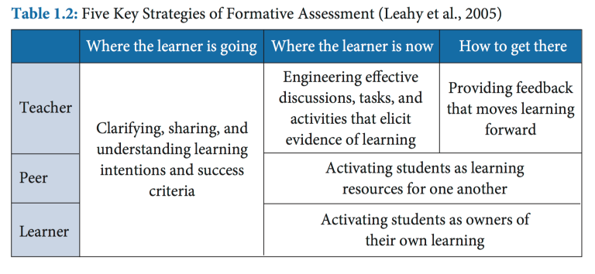
Embedded Formative Assessment Strategies
Wiliam, D. (2018). Embedded formative assessment, 2nd ed. Bloomington, IN: Solution Tree Press.
Notes:
Dylan Wiliam’s five strategies that support the implementation of effective formative assessment listed here are the same whether in-person or remote. However, the application of formative assessment strategies is different in a remote learning environment.

Slide 47
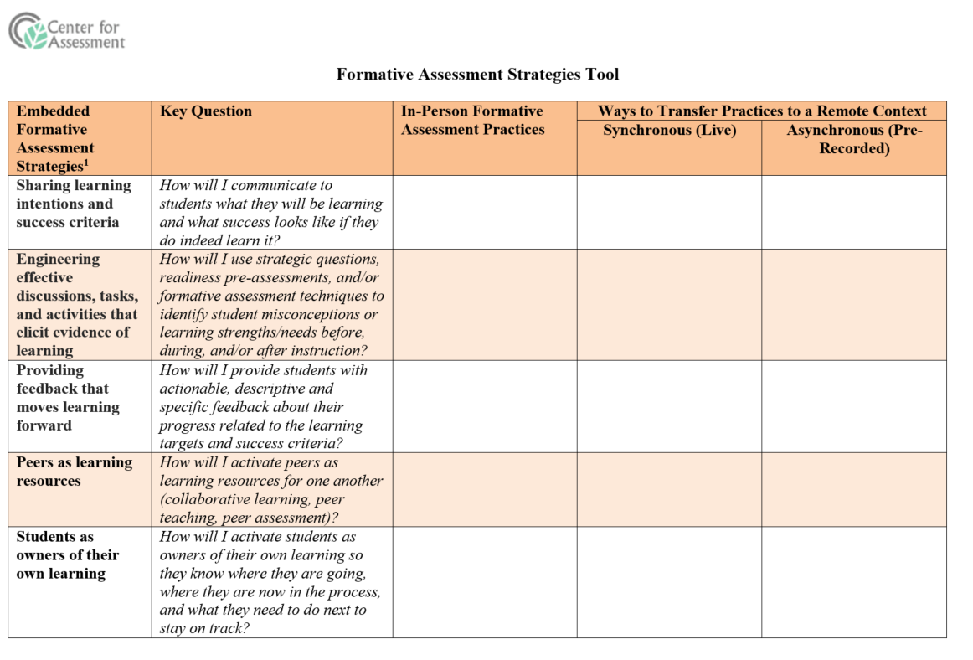
Formative Assessment Strategies Tool
Pedagogy first; technology second.
Technologies are tools to be applied mindfully and appropriately!
Click here to access blank formative assessment strategies tool.
Notes:
We think that starting with best practices with respect to in-person formative assessment practices and then thinking about ways to transfer those practices to a remote context (whether that is synchronous (live) or asynchronous (pre-recorded) remote) will help teachers transfer what they know about in-person formative assessment practices to a remote context. It’s important to remember that technology (online tools or apps; computers; etc.) are never the driver of reform as technology is pedagogically vapid. Good pedagogy is a driver, technology is only a supporting tool that must be mindfully and appropriately applied. To illustrate how to start with good pedagogy and transfer that to a remote context, we created a formative assessment strategy tool that takes Dylan Wiliam’s five strategies that support the implementation of high-quality formative assessment processes with aligned key questions to define what the strategies mean and then leaves blank boxes for classroom teachers to brainstorm and plan ways to embed formative assessment strategies in a remote context. This will make more sense as we apply our understanding in the context of the two classroom profiles discussed earlier.

Slide 48
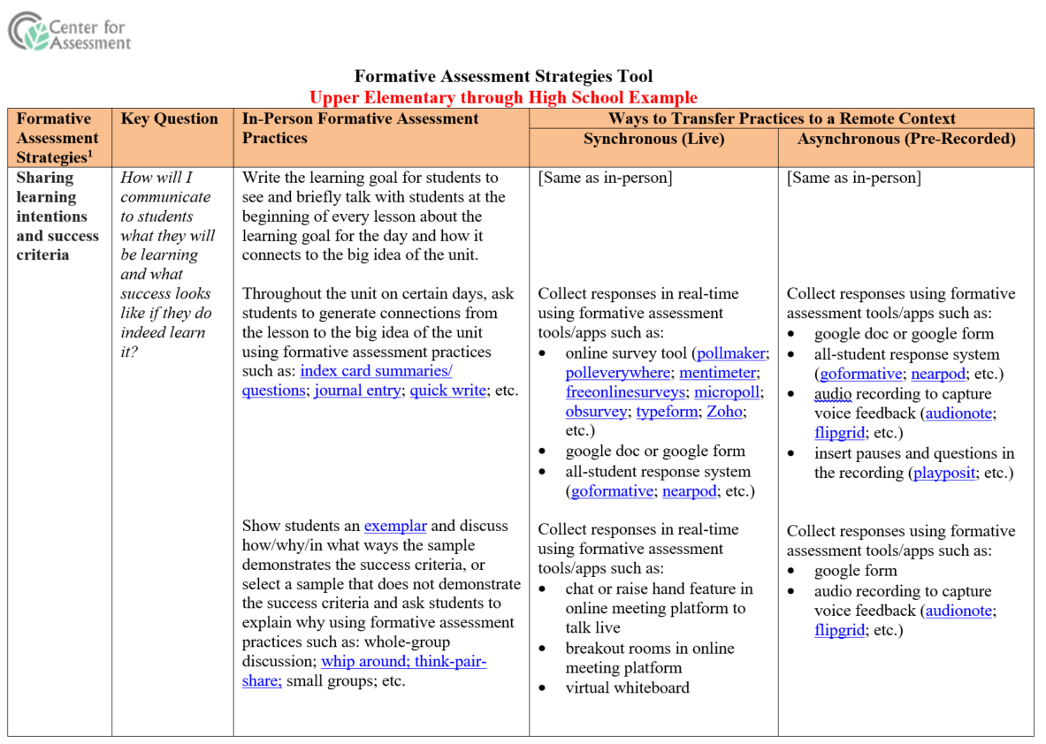
Profile 1: Older Students, Asynchronous
Click here to access upper elementary through high school example
Notes:
The image on the screen is the first part of the upper elementary through high school example as we couldn’t get all five strategies to fit on the screen at once. We think talking about the first formative assessment strategy will help you understand how high-quality pedagogy can be transferred to a remote context using tools and apps that enable teachers to collect/gather/provide feedback on student thinking and understanding before, during and after instruction. So let’s dive in. You’ll see that this first of the five strategies is sharing learning intentions and success criteria. The key question is: How will I (as a classroom teacher) communicate to students what they will be learning and what success looks like if they do indeed learn it? Selected in-person formative assessment practices could include: (1) writing the learning goals for students to see and briefly talking with students at the beginning of every lesson about the learning goal for the day and how it connects to the big idea of a unit. This practice can be transferred very easily to a remote context, whether that be synchronous (live) or asynchronous (pre-recorded) remote learning because it doesn’t require any exchange of information. It is simply the teacher making sure students understand the learning targets and how they will know if they hit a bullseye. The second in-person practice, however, illustrates how a teacher with older students in an asychronous remote environment could ask students at certain points in the unit to generate connections from the lesson to the big idea of the unit using formative assessment practices such as those hyperlinked: index card summaries/questions; journal entries; quick writes; etc. Given the asycnhronous environment the teacher would need to collect responses from students using some type of tool or app. There are several listed here: google doc or google form; all student response system such as [read]; audio recording through audionote or flipgrid; or some system that embeds questions in the pre-recording and collects responses so teachers can view later. These are just examples of tools/apps--it is not meant to be exhaustive, but illustrative. Similarly, if a teacher wants to make the success criteria clear to students, oftentimes in classrooms teachers may show students exemplars and discuss how, why, and in what ways the sample demonstrates the success criteria. In some cases a teacher may even select an sample that is not an exemplar--or does not demonstrate the success criteria--and ask students to explain why using formative assessment practices such as whole-group discussion; whip around; think-pair-share; small group discussions; etc. In a remote asynchronous environment the teacher could do something similar through a google form or audio recording to capture student thinking. Click the hyperlink on the right to download the complete example.

Slide 49
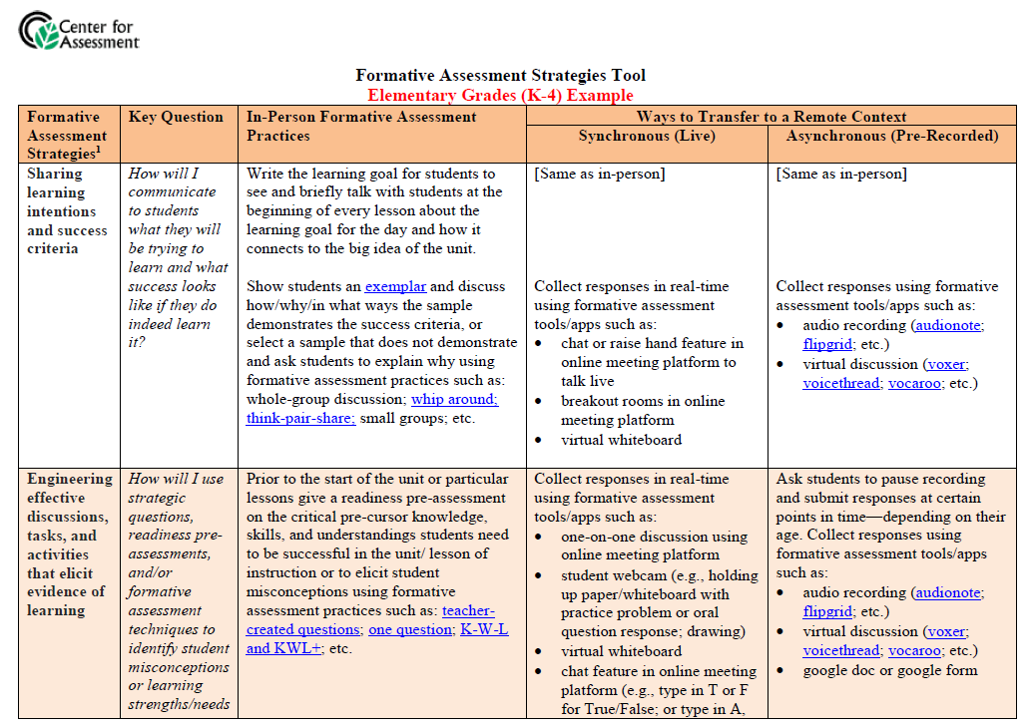
Profile 2: Younger Students, Synchronous
Click here to access elementary grades (K-4) example
Notes:
Again, applying formative assessment strategies in this context will need to be appropriate to the age of students and the remote context. So, for example, let’s look at the second formative assessment strategy--engineering effective discussions, tasks, and activities that elicit evidence of learning. The key question is: How will I (as a classroom teacher) use strategic questions, readiness pre-assessments, and/or formative assessment techniques to identify student misconceptions or learning strengths/needs. During typical classroom instruction the teacher may have administering a readiness pre-assessment on the critical pre-cursor knowledge, skills, and understandings students need to be successful in the unit or a particular lesson in a unit of instruction or elicit student misconceptions using formative assessment practices such as: teacher created questions; one question prompts; KWL charts; etc. In a synchronous environment, the teacher will want to collect responses in real-time as much as possible and could do so through: [read off slide]. Click the hyperlink on the right to download the complete example.

Slide 50
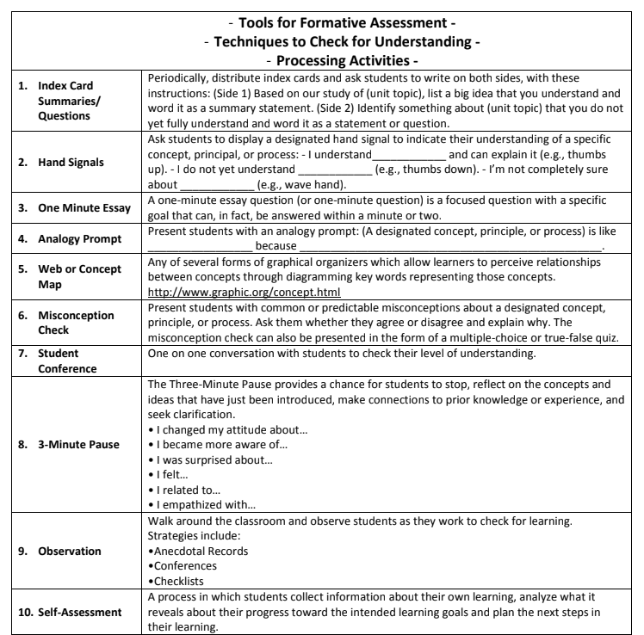
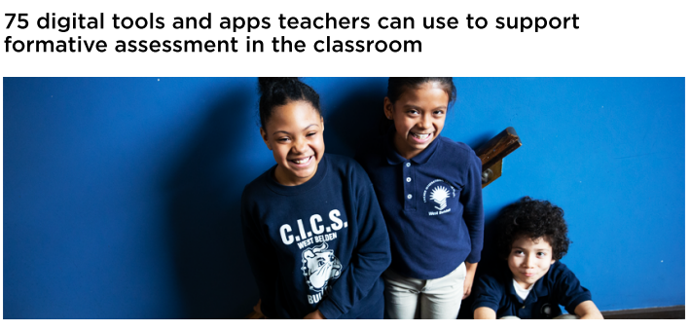
Selected Formative Assessment Resources
Make sure the tools or apps you use fit your purpose.
Don’t overwhelm students with too many tools: focus on a few
Use the information you collect!
60 Formative Assessment Techniques: choose the ones most applicable to remote learning environments
75 digital tools and apps teachers can use to support formative assessment in the classroom
Notes:
Before we wrap up the section on considerations for formative assessment processes in a remote learning environment, we want to say a few words about tools and apps. First, make sure the tools or apps you select fit your pedagogical purpose. Second, don’t overwhelm students with too many tools--focus on a few--explain/teach students how to use them so they become second nature over time. And finally, use the information you collect--or don’t collect it.
The two hyperlinks on this slide contain 75 digital tools and apps (bottom left) and 60 formative assessment techniques on the right, many of which were used in the examples just discussed. Depending on your time and interest, you could pause the video right now and take a look at these two documents. Which digital tools have you used in the past with success for formative assessment purposes? What formative assessment technique do you think could work really well for your grade level and content area?

Slide 51
Caution!!!!
“…We must keep in mind, however, that educators will not achieve the benefits of formative assessment for learning simply by implementing a string of promising techniques [tools] or by using them mechanistically.”
— Lorrie Shepard, 2005
Notes:
See citation in the User’s Guide.
“Please take a moment to read Shepard’s quote to yourself, then turn to a partner and share what this quote means to you.”

Slide 52
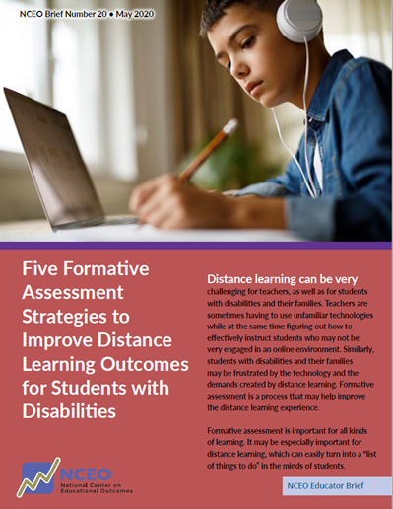
Special Student Populations
Establish and communicate clear learning targets.
Establish and communicate clear criteria for success.
Build in opportunities for students to self-assess or ask questions, based on criteria.
Give brief, clear, actionable feedback based on the criteria.
Give students opportunities to revise assignments or re-do similar assignments.
See: Five Formative Assessment Strategies to Improve Distance Learning Outcomes for Students with Disabilities
See: Formative Assessment for Students with Disabilities
Notes:
And finally we want to say a few words about special student populations and formative assessment in a remote context. This May 2020 brief from the National Center on Educational Outcomes and written by Sue Brookhart provides five formative assessment strategies to improve distance learning outcomes for students with disabilities. You’ll notice pretty quickly that these five criteria do not differ from five embedded strategies we used to structure our tool. Good teaching for students with disabilities or English language learners is good teaching for all. You can click on the hyperlinks for more information.

Slide 53
Defining Summative Classroom Assessment
The gathering of evidence, typically at the end of a unit of study, to broadly signal what students learned as a result of instruction.
Summative classroom assessments are used for grading, reporting, and competency determinations.
Notes:
As with formative, we want to make sure we are clear about what we mean by summative classroom assessment. Summative classroom assessment is the gathering of evidence, typically at the end of a unit of study, to broadly signal what students learned as a result of instruction. Summative classroom assessments are used for grading, reporting, and competency determinations. As stated in early learning modules, assessments are not formative or summative based on design, but based on use. The same assessment or series of questions or tasks can be used to provide feedback on instruction and student progress towards learning targets, or it can be used to make a judgment about student achievement on learning targets at certain markers in time.

Slide 54
Essential Features of Summative Assessment
Formative assessment is inseparable from instruction
Formative assessment is inseparable from instruction
1
The assessment measures what is being taught and what students should be learning.
2
The assessment reflects an appropriate degree of rigor.
3
Questions are fair, unbiased, and accessible so that scores can be interpreted and used in the same way for all students and student groups.
4
Performance or success criteria are transparent to students.
See summative classroom assessment learning module.
See blog: Deep Dive into Summative Classroom Assessment in a Remote Learning Environment.
Notes:
The essential features of summative assessment include at least the following four characteristics: [read]
alignment
cognitive complexity
fairness
clear success criteria

Slide 55
What’s Different in a Remote Context?
Gathering evidence of student achievement no longer seems so straightforward because of...
Cheating and academic honesty issues:
Whose work is it?
Identifying how the content should be assessed:
What assessment evidence can be gathered?
Notes:
So what’s different practically in a remote context about summative classroom assessment in comparison to in-person? Gathering evidence of student achievement no longer seems so straightforward because of at least these two things: (1) cheating and academic honest issues--whose work is it? and (2) identifying how the content should be assessed--what assessment evidence can be gathered? We will discuss each in turn.

Slide 56

Whose Work Is It?
Google-able: Is that a problem?
  It depends!
  What claims about student performance do you want to be able to support? What evidence are you trying to collect?
  In most cases, assessment of students’ deeper learning (or transfer to new/novel contexts) will not be Google-able.
Notes:
Google-able is now a more frequent word in a teacher’s lexicon--especially upper elementary to high school teachers. Meaning, if students are accessing instruction remotely then they have access to all the resources and search capabilities of the internet. Every summative classroom assessment is a de facto open book assessment on steroids! So, is it a problem that students can Google answers? And now for the response people hate the most--it depends! It depends on what claims about student performance you want to be able to support. It depends on what evidence you are trying to collect that would allow you to make a specific claim about what students know and can do. As you can see to the left, we cut/pasted an image of evidence-centered design which we discussed all the way back on slide 12.
If what you want to measure is student application of basic skills or recall/reproduction and you don’t want them to be able to Google the right answer, you may face difficulties with classroom summative assessments in a remote environment.
If, however, you are trying to collect evidence of student application, synthesis, evaluation or other higher-order thinking skills or 21st century skills such as cooperation than I’m not sure Google-able assessments are problemmatic. In most cases, assessment of students’ deeper learning (or ability to transfer what they know and can do to a new or novel context) and application of 21st century skills whether those be cogntive, intrapersonal, or interpersonal will not be Google-able.

Slide 57
Selected Summative Classroom Assessment Designs
Multiple-choice tests
Performance tasks
Portfolios and Student Exhibitions/ Demonstrations of Learning
More Google-able
Less authentic assessments
Less
Google-able
More authentic assessments
Multiple-choice tests with some open-ended questions
Project-based learning culminating experiences
See blog: How Much Is Enough?: Sufficiency Considerations for Competency-Based Assessments
Notes:
For example, we put selected summative classroom assessment designs on a continuum from more Google-able to Less-Googleable which is the inverse of authenticity. More Google-able assessments such as multiple choice or other selected response tests are less authentic, and less Google-able assessments such as portfolio defenses or demonstrations of student learning are more authentic. Remote learning may provide the impetus for many teachers to re-consider what claims about students they want to be able to make, what evidence would count as acceptable, and how that influences the type of classroom assessment design used during both formative and summative classroom assessment experiences. This is not to say, however, that this is an all-or-nothing endeavor. Meaning, we are not saying that teachers should now make every summative classroom assessment a performance task, project-based learning experience, etc. Just as with in-person learning experiences, teachers will want to think about their classroom assessment system as a system and meaningfully and thoughtfully consider the evidence that would make the case that a student does indeed know and can do the pre-specified learning targets. And also how they may need to gather more evidence from some students who show variable performance and less evidence from others that demonstrate mastery. See the hyperlinked blog on sufficiency considerations for more information.

Slide 58

Whose Work Is It?
What about parent, friend, or sibling ‘help’ on summative classroom assessments?
First, we need to educate students and parents about academic honesty.
Second, we cannot totally eliminate the possibility of support/scaffolding in a remote context, especially when grades are involved or when younger students need help.
Some things that can help: communicating with students and parents about expectations; viewing drafts of work; mixing in oral exams, conversations, or discussion-based assessments; etc.
Notes:
We discussed initially the Google-able problem. But what about parent or friend ‘help’ on summative classroom assessments? Doesn’t that change the claims we want to make about what students know and can do. Again, it depends. And in this case, I think it depends especially on the age of students. Younger students may need help reading the directions, clarifying what they are being asked to do, organizing their thinking or work, etc. There is a difference between what is productive struggle and what is not productive struggle. So, we argue that first, we need to educate students AND parents about academic honesty issues with respect to classroom summative assessments and other classroom work--including formatives. We will never be able to totally eliminate the possibility of parent, friend, or sibling support/scaffolding in a remote context, especially when grades are involved for older students...and to be honest, depending on the age of the student, the teacher may not want to eliminate the support of parents, friends, or siblings. Here are some things we think can help: communicate often and directly with students and parents about expectations. Do you want parents to give help on this summative classroom assessment, or not? Do you want to know what help was given? Additionally, viewing drafts of student work along the way, mixing in oral exams, conversations, or discussion-based assessments can help you as a teacher get a better sense of what a student knows and can do independently.

Slide 59
What Assessment Evidence Can Be Gathered?
Just because a summative classroom assessment can be re-created online doesn’t meant it should.
Seems to have a broader impact on classroom summative assessments for:
Younger Students
Certain Disciplines (e.g., Science)
Google-able Assessments
-Next Generation Science Assessment
-PhET Interactive Simulations
-JLab Science Education
-Ward’s Science (YouTube)
-Molecular Workbench
Notes:
Let’s unpack that statement a little bit. Just because a summative classroom assessment from last school year can be re-created online doesn’t mean it should. Seems to have a broader impact on classroom summative assessments for younger students, certain disciplines, and Google-able assessments. We’ve already talked about the Google-able problem and to a certain extent the issue with younger students--that they may not be able to complete the assessment independently. Certain things can help, such as embedding in audio files that read directions to students (if reading is not being measured) and allowing students to submit images of their work and audio files describing their learning. Additionally, certain disciplines such as science that require students to demonstrate their knowledge and skill through a scientific investigation grounded in phenomena where part of what is being measured is the students knowledge and ability to, for example, plan and carry out an investigation, analyze and interpret data, engage in argument from evidence, etc. all of which become more difficult to do in a remote environment as students do not have lab access. One way to approach this situation is to use simulations or record labs for students and provide data that then they must analyze, interpret, and construct explanations for. Hyperlinked on the screen are selected simulation based tasks and activities that can be used formatively or summatively in science classrooms.

Slide 60
A Few Other Thoughts….
We recommend putting more emphasis on formative processes rather than summative classroom assessment (this applies to in-person and remote).
Consider mixing in more authentic assessments, but they don’t have to be one big event.
  e.g., Split performance or project-based assessments into a series of smaller events that can be completed over time.
Notes:
A few final thoughts about summative classroom assessment. First, we recommend putting more emphasis on formative processes rather than summative classroom assessment. This applies to both in-person and remote learning environments, but is important to reiterate. Grading can have pernicious effects on student motivation and engagement--and in a remote environment with other factors students are facing in their environment--it is important to give parents and students accurate information on student achievement relative to grade level performance expectations but not spend an inordinate amount of instructional time to do so. What summative information do you really need and when do you need to collect it for reporting purposes?
Second, consider mixing in more authentic assessments, but they don’t have to be one big event. Depending on what is being assessed, teachers may be able to take longer performance tasks or project-based learning experiences and split them into a series of smaller events that can be completed over time or shorter tasks in general.

Slide 61
Working with Teachers in our Districts: Practice Exercises
Take an upcoming unit of instruction and use the formative assessment strategy tool to map out ways to transfer high-quality formative assessment processes to a remote context.
Create an authentic summative classroom assessment that supports the claims you want to make about student learning.
Notes:
There are at least two ways you can apply the learning in this module. First, [read]. Second, [read].

Slide 62



