Slide 1
using test & assessment data to support teaching and learning
Kate Beattie, Data and Reporting, Statewide Assessments

Slide 2
Minnesota Assessment System
Minnesota Assessments
Standards-Based Accountability Assessments
English Language Proficiency Accountability Assessments
MCA
MTAS
ACCESS for ELLs
Alternate ACCESS for ELLs
Leading for educational excellence and equity, every day for every one. | education.state.mn.us

Slide 3
Minnesota Assessments: Aligned to Standards
Test Names | Standards | Year Adopted
MCA and MTAS | Minnesota K–12 Academic Standards in English Language Arts | 2010
MCA and MTAS | Minnesota K–12 Academic Standards in Mathematics | 2007
MCA and MTAS | Minnesota K–12 Academic Standards in Science | 2009
ACCESS and Alternate ACCESS for ELLS | WIDA English Language Development Standards | 2011
Leading for educational excellence and equity, every day for every one. | education.state.mn.us

Slide 4
Purposes of Minnesota Assessments
To measure achievement
To measure academic progress
To provide career and college readiness information

Slide 5
Minnesota Assessments Data: One Component
Data from the state
Data from the district
Data from the school
Making educational decisions

Slide 6
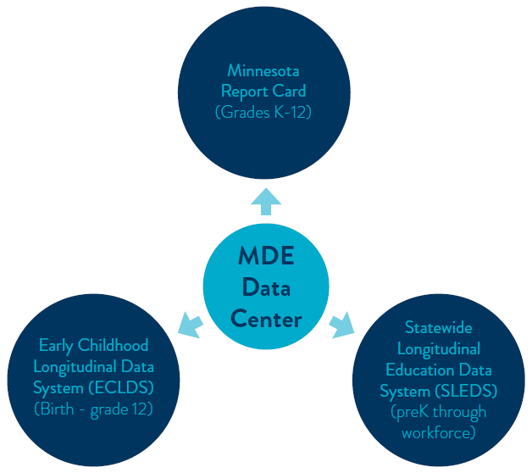
MDE Data Center: Mobile Analytics

Slide 7
Data Sources on MDE

Slide 8
MN Report Card Updates

Slide 9
Report Card Changes
Change from the “i” bubble to the “?”
Language Assistance
7 Federal race/ethnicity codes
North Star data
Graduation Rates
ACCESS for ELLS / MCA & MTAS
State Assessments

Slide 10
Upcoming – Report Card Changes
Secondary Suppression
My School
Demographics
Graduation
Staffing Profile
Preschool Report
Rigorous Coursework
Discipline Report
Fiscal Transparency

Slide 11
Data Reports and Analytics

Slide 12
Data Reports and Analytics
Accountability and Assessment – assessment, growth, North Star, subscore, WBWF
District Information – number of instructional days, consolidations, general information
Early Learning – early childhood screening and school readiness information
Food and Nutrition Programs
Minnesota Common Course Catalog (MCCC) Reports
Financial data
Special Education
Staffing Reports
Student Data – ACT, counts, MN student survey, student level – enrollment, attendance, etc

Slide 13
Secure Reports

Slide 14
Data Reports and Analytics
Accountability Secure Reports Questions: mde.analytics@state.mn.us
Academic Roster – academic achievement and progress indicators
Consistent Attendance Roster
Graduation Rate Roster
North Star Report
Progress Toward English Language Proficiency
Assessment Secure Reports Questions: mde.testing@state.mn.us
District and School Student Results (DSR, SSR)
Student Assessment History Report
Test Results Summary

Slide 15
Benchmark Report Redesign Update

Slide 16
Future of Benchmark Reports
‘New’ in 2019
Vendor driven – psychometrician approved
Scope of work, calculations, simulations
Focus groups this past summer
Include the benchmark wording
Include school’s summary data (achievement levels, strand data)
Easy to read and understand
Still in draft stage

Slide 18
Resources

Slide 19
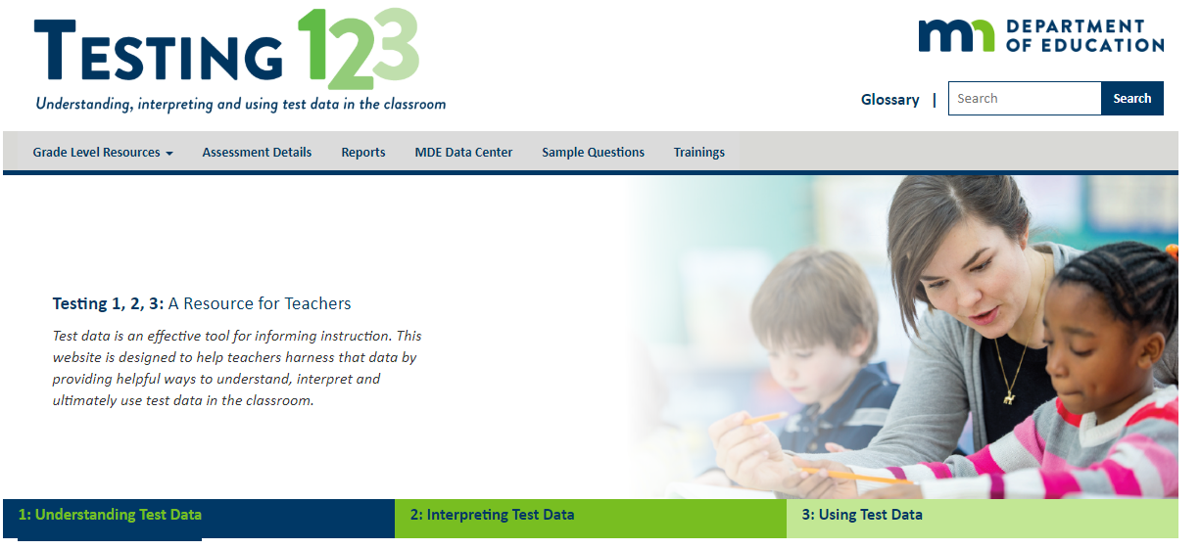
Testing 1, 2, 3 Website
https://testing123.education.mn.gov

Slide 20
Teacher Newsletter (1)

Slide 21
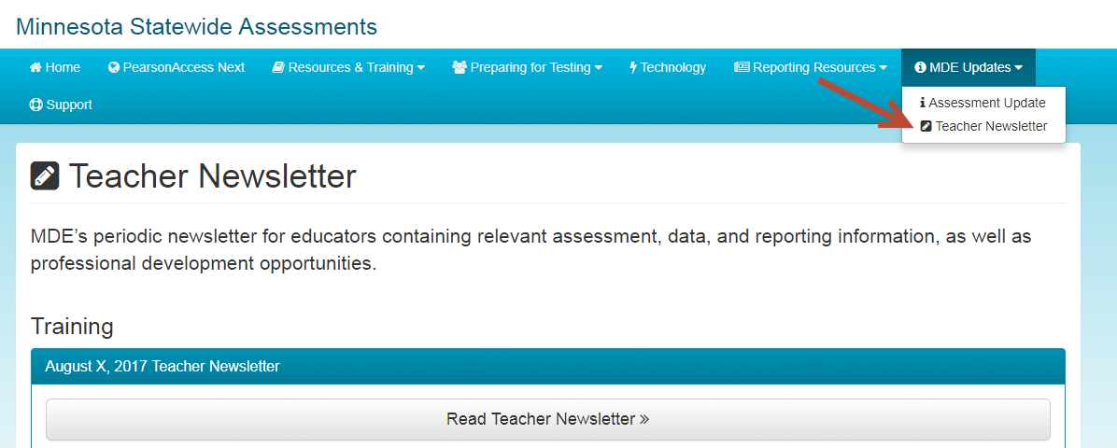
Teacher Newsletter (2)
(PearsonAccess Next > MDE Updates > Teacher Newsletter)

Slide 22
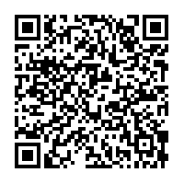
MCA Teacher Review Panel
Here is your chance to see new MCA items and give your input. Or participate in a review of data from newly field-tested items. Sign up in the MDE Advisory Panel database.
Benefits:
YOU will see items on the upcoming MCA.
MN students benefit from having your expertise shape the MCA.
It’s in the summer so no sub plans needed!
It is paid (if you don’t have a sub).
You will receive CEUs.
Link to access the QR Code (or scan the QR code)
(or Google: MDE Advisory Panels – it’s near the top of the list) --When you open the website go to the bottom of the page and click on “Submit your name to the Advisory Panel Register.”

Slide 23
Thank you!
If you have any questions, please email:
Mde.testing@state.mn.us

