Slide 1


Sharing Insights,
Informing Practice:
Hearing Students in MSS
Michael C. Rodriguez
Dean & Campbell Leadership Chair
January 19, 2024

Slide 2
http://www.edmeasurement.net/MAG/MSS2022.pptx
http://www.edmeasurement.net/MSS2022.pdf
Minnesota Youth Development Research Group
http://www.mnydrg.com

Slide 3
Minnesota Student Survey – Participation
All 87 counties were represented each year
 | 2013 | 2016 | 2019 | 2022
School Districts | 84% | 85% | 81% | 70%
Students | 67% | 68% | 64% | 51%

Slide 4
Race & Ethnicity
 | 2013 | 2016 | 2019 | 2022
Missing Race | 1.7% | 1.3% | 2.0% | 2.2%
American Indian | 5.0% | 5.1% | 3.9% | 4.0%
Asian Pacific Islander | 3.2% | 3.5% | 4.6% | 4.6%
Black | 4.8% | 5.2% | 6.1% | 6.6%
White | 71.3% | 67.2% | 66.9% | 64.1%
Multiple Races | 3.0% | 3.6% | 3.0% | 3.9%
Latino | 7.2% | 9.3% | 9.0% | 10.1%
Somali | 1.2% | 2.1% | 2.2% | 2.6%
Hmong | 2.6% | 2.8% | 2.3% | 1.9%

Slide 5

Our Process

Slide 6
Scaling Process
Using a positive youth development framework and ecological models of development, we identified questions related to research-based constructs
No change in scale properties over time was found from 2013 to 2022

Slide 7
Our Current Efforts

Slide 8
Achieving educational equity and positive youth development requires us to explore context, to identify the many ways youth develop, to acknowledge and support youth where they are and what they bring with them. This will be relevant to
success in school
success in families and communities
positive youth programming
equitable policy development

Slide 9
Ecology of Youth Development
SOCIETY
NEIGHBORHOOD - COMMUNITY
COUNTY
SCHOOL
STUDENT
FAMILY
PEERS
STATE

Slide 10
Positive Youth Development
Youth have an inherent capacity for positive development
that is enabled and enhanced through multiple meaningful relationships, contexts, and environments
where community is a critical delivery system
and youth are major actors in their own development

Slide 11
A Role for Social & Emotional Learning
Learning is a social activity
Cognitive development and identity development co-occur:
They are intertwined
We cannot be successful with one if we ignore the other
The evidence regarding the importance of SEL is substantial, acknowledge by
National Research Council
National Academy of Medicine
Aspen Institute
Minnesota Department of Education

Slide 12
Developmental Measures in MSS
Skills | Supports | Challenges
1. Commitment to Learning | Empowerment* | Bullied
2. Positive Identity* | 2. Family/ Community Support | 2. Bullying
3. Social Competence* | 3. Teacher/School Support | 3. Mental Distress
*DAP | > Sense of Belonging > Positive Experience in Out-of-school-time

Slide 13

Used by Education Partnerships Coalition MN
Equipped for Learning

Slide 14
Equipped for Learning
To be equipped means that, on average, the student
recognizes characteristics associated with the developmental skill as being very much or extremely like them;
agrees or strongly agrees with values, behaviors, and characteristics defining each skill;
engages in relevant skill-based behaviors most or all of the time.

Slide 15
Commitment to Learning
Percent Equipped for Learning

Slide 16
Positive Identity
Percent Equipped for Learning

Slide 17
Social Competence
Percent Equipped for Learning

Slide 18
Empowerment
Percent Equipped for Learning

Slide 19
Family/Community Support
Percent Equipped for Learning

Slide 20
Teacher/School Support
Percent Equipped for Learning

Slide 21
Positive Experience in OST
Percent Equipped for Learning

Slide 22
Sense of Belonging
Percent Equipped for Learning

Slide 23
Being Bullied (Victim, in some way, last 30 days)

Slide 24
Bullying (Perpetrator, in some way, last 30 days)

Slide 25
Mental Distress – at least some

Slide 26
Change in Developmental Skills
2013 2016 2019 2022

Slide 27
Change in Developmental Supports
2013 2016 2019 2022

Slide 28
Including All PFSS Schools - 2022
Following Cohorts over Time

Slide 36
Total Sample Results
Are students equipped for learning?

Slide 37
# of Developmental Skills and Supports
Number | Skills
 | 2013 | 2016 | 2019 | 2022
0 | 12.6% | 12.9% | 17.2% | 23.8%
1 | 21.4% | 21.9% | 24.2% | 27.7%
2 | 23.7% | 23.1% | 25.1% | 24.3%
3 | 42.2% | 42.1% | 33.5% | 24.1%
Number | Supports
 | 2013 | 2016 | 2019 | 2022
0 | 14.2% | 14.4% | 16.8% | 21.7%
1 | 17.3% | 16.1% | 17.3% | 19.6%
2 | 25.6% | 24.5% | 25.7% | 24.8%
3 | 42.9% | 44.9% | 40.1% | 33.8%

Slide 38
Does being equipped matter?

Slide 41
Sense of Belonging
feeling cared for by parents, adults in the community, and friends; feeling in control of one’s life and having influence in one’s future; ability to build relationships; feeling valued and appreciated, and accepting others who are different.

Slide 44
79%
44%

Slide 46
Alcohol, marijuana, other drugs (last 12 months)

Slide 47
Alcohol, marijuana, other drugs (last 12 months)

Slide 48
Last 6 months, year, or ever
19%

Slide 49
Last 6 months, year, or ever

Slide 50
Ever experienced trauma (10 items)

Slide 51
Ever experienced trauma (10 items)

Slide 52
After-school activities

Slide 56
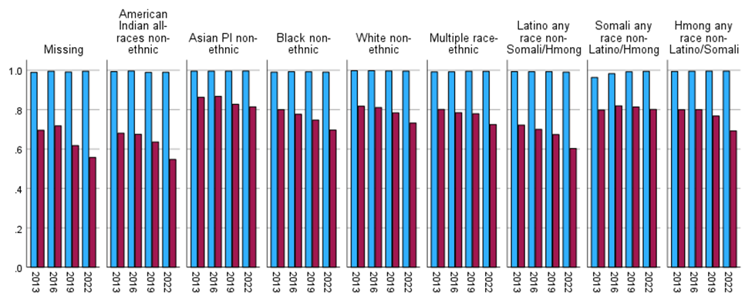
High School Graduation & College Plans

Slide 57
Elevate Student Voice
Consider designing a Student-Led Data Summit
We elevate student voice when students become
Thought partners – idea generators
Decision makers
Implementers
Examples: Northfield Promise & Washoe County Schools

Slide 58



