Slide 1
Classroom Assessment Essentials to Support Teaching and Learning
Michael C. Rodriguez
Quantitative Methods in Education
Educational Psychology

Slide 2
www.edmeasurement.net/MAG

Slide 3
Tests and Measurements for Teachers
(Tiegs, 1931)
“The principal function of measurement is to contribute directly or indirectly to the effectiveness of teaching and learning.”
Notes:
Learning does not always parallel teaching; in fact, at many points and in many different ways, there are learning difficulties. Particular measurement devices which will reveal the exact location and the nature of these difficulties will aid the teacher in directing further learning. Test scores may be utilized to advantage in helping pupils visualize their objectives and goals in meaningful terms.

Slide 4


Slide 5
p. 8
CORE IDEA
Assessments are not the end of the teaching and learning process; they’re the starting point.
… we should not teach and then write an assessment to match; instead, we should create a rigorous and demanding test and then teach to meet its standards

Slide 6
p. 13
CORE IDEAS: Interim Assessments
Start from the end-goal exam.
Align the interim assessments to the end-goal test.
…

Slide 7
p. 28
Analyze the Interim Assessment or End-Goal Test
Acquire the closest version that you can find of your state test, interim assessment, or other year-end assessment by which your students’ learning will be measured.
…

Slide 8
Misconceptions about Formative Uses
Formative assessment is a special kind of test or series of tests that teachers learn to use to find out what their students know.
Formative assessment is a program that teachers adopt and add to what they already do.
Any practice that gathers information for the purpose of improving programs or improving teaching is a part of formative assessment.
Advancing Formative Assessment in Every Classroom
by Connie M. Moss and Susan M. Brookhart

Slide 9
Misconceptions about Learning Targets
Informing students of the learning target by telling them what it is or by writing it on the board is sufficient.
Sharing a rubric with students will ensure they understand the criteria for success.
I will recognize effective sharing of learning targets and criteria for success when I see it.
Advancing Formative Assessment in Every Classroom
by Connie M. Moss and Susan M. Brookhart

Slide 10
Measurement and assessment has been coopted by accountability systems.
Our work is not about the tests.
It’s about teaching and learning.

Slide 11
Role of standards-based assessment, instructional approaches/curriculum
Narrow glimpse of learning
Globally, curriculum doesn’t appear to matter
Instructional approaches matter
Local assessment is more informative – when tied to instructional practices and designed to reflect what students know and can do – we can strive to connect local objectives to state standards

Slide 12
…thoughts
Accountability systems are designed to maximize effort, innovation, self-correction;
to produce optimal outcomes
In many cases, they lead to maximizing self-justification, motivating options and decision paths that are easy to justify

Slide 13
…thoughts
By simply increasing attention to our decision-making process, there is no guarantee that new ways of solving the problem will miraculously come into awareness.
Because we do DDDM, doesn’t automatically translate into improved outcomes

Slide 14
…thoughts
No amount of increased effort can compensate for limited knowledge and skill about how to solve problems that require special training. The only examples of accountability improving judgments and decisions requiring formal training are those where participants received training in the relevant decision rules for problem solving.

Slide 15
Moving Forward
Using learning and motivation theories to coherently link formative assessment, grading practices, and large-scale assessment
Shepard, L.A., Penuel, W.R., & Pellegrino, J.W.
Educational Measurement: Issues and Practice
Spring 2018

Slide 16
Shepard, Penuel, & Pellegrino
To support equitable and ambitious teaching practices, classroom assessment design must be grounded in a research-based theory of learning.
Compared to other theories, sociocultural theory offers a more powerful, integrative account of how motivational aspects of learning—such as self-regulation, self-efficacy, sense of belonging, and identity—are completely entwined with cognitive development.

Slide 17
Shepard, Penuel, & Pellegrino
Instead of centering assessment within systems that support use of interim and end-of-year standardized tests, we argue for a vision of formative assessment based on discipline-specific tasks and questions that can provide qualitative insights about student experience and thinking, including their identification with disciplinary practices.

Slide 18
Shepard, Penuel, & Pellegrino
At the same time, to be consistent with a productive formative assessment culture, grading policies should avoid using points and grades “to motivate” students but should create opportunities for students to use feedback to improve their work.

Slide 19
Sociocultural Learning Theory
All learning is fundamentally social, involving the student’s use of shared language, tools, norms and practices in interaction with their social context.
One’s cognitive development and social identity are jointly constituted through participation in multiple social worlds of family, community, and school.

Slide 20
Discipline-Specific Models of Learning
Learning progressions in the broader context of sociocognitive models attend to the social nature of learning and to discipline-specific ways that core ideas and practices are developed over time.
Student cognition develops through social interactions, as students solve problems, complete tasks, and devise strategies to pursue learning goals.

Slide 21
Classroom assessment tasks should not simply be designed to “recruit” student interests into disciplinary ways of thinking, but help them recognize those ways of thinking and relate them to their own.

Slide 22
For example, at the beginning of a unit in the Micros and Me curriculum, students take photos of things or activities that they do to prevent disease and stay healthy at home or in their communities. They then share these photos in class as a way to bring personally relevant experiences into the classrooms and draw connections to learning goals for the unit.

Slide 23
Curriculum specificity is necessarily abandoned in large-scale test design when a district or state wants to compare the performance of students across jurisdictions using quite different curricula. But such tests then are not of much use for detailed formative feedback.
Curriculum-general tests underestimate learning.

Slide 24
Instruction-Assessment Integration
We promote models of curriculum-embedded-in-the-process-of-instruction formative uses of assessment
Which depends on
Usefulness of the “information” provided by assessment activities, and
on the ways that materials and tools support productive, learning-focused “assessment cultural practices.”

Slide 25
Instead of “scores,” which offer teachers little information about what to do next, it is much more important that formative assessment questions, tasks, and activities provide instructional “insights” about student thinking and about what productive next steps might be taken.

Slide 26
Quantitative data systems frequently provide teachers with results in the form of a grid showing class rosters crossed with item or subtest scores.
Teachers then typically use these data to reteach the standards or objectives missed by the most students, and they identify students who missed the greatest number of items for special tutoring or after-school help.
In these scenarios, reteaching efforts are not adjusted based on information from the assessment.

Slide 27
Given what we know about how such interim assessments are constructed, it is not surprising that identifying standards not-yet-mastered does not give teachers access to student thinking.
To intervene with an individual student, a teacher still needs to follow up with more individualized student conversations, which is generally not possible due to time constraints.
Typical interim tests offer students an impoverished vision of intended learning goals.

Slide 28
Grading
To be coherent with formative assessment, a critical requirement is that grades be based on the same learning goals toward which instructional activities and formative feedback are aimed.
Grading practices are the most consistent with formative assessment cultural practices—and make the most sense to students—when the focus is consistently on student learning.

Slide 29
Point systems in general and electronic systems designed to keep parents continuously informed tend to work against the logic of formative assessment because they assign points as if early steps in learning are “finished” rather than providing a substantive and still changing picture of developing competence. Research on effective feedback argues against grading assessments used for formative purposes because the grade itself becomes the focus of attention rather than attending to the means for improvement.

Slide 30
The motivation literature is quite clear that making prerequisite behaviors (being prepared, making an effort, participating, paying attention) dependent on external rewards harms learning, especially when the rewards are seen as controlling.
The conclusion that “extrinsic rewards drive out intrinsic motivation” is based on a large body of controlled experiments.

Slide 31
Goals to Strive For
formative assessment activities to surface student thinking and further learning within instructional units
summative unit assessments used for grading that explicitly address transfer and extensions from previous instructional activities
district-level assessments designed in parallel to unit summative measures but with particular attention to program-level evaluation

Slide 32
Ecology of Youth Development
COUNTY
STATE
NEIGHBORHOOD - COMMUNITY
SCHOOL
STUDENT
FAMILY
PEERS
SOCIETY

Slide 33
Social Emotional Context for P Y D
Youth have the inherent capacity for positive development
enhanced through multiple meaningful relationships, contexts, and environments
where community is a critical delivery system
and youth are major actors in their own development
Notes:
youth have the inherent capacity for positive development;
positive development is enabled through relationships, contexts, and environments that nurture development;
positive development is enhanced when youth participate in multiple meaningful relationships, contexts, and environments;

Slide 34
Provide an organizational framework for content, knowledge, skills – organize content based on the structure of the assessment.
Confirm “storage” of knowledge by solidifying the connections among different pieces of knowledge.
Shape study behavior.
Enhance academic motivation and effort through provision of feedback.
Formative Uses of Assessment

Slide 35
Enhance the quality and strength of skills by providing unique opportunities to display knowledge and skills.
Explicitly articulate and communicate learning objectives and achievement targets – typically vaguely defined by teachers.
Confirm the importance of hard work, time spent studying, and effort.
Formative Uses of Assessment

Slide 36
Demonstrate the kinds of thinking and processes valued by the instructor – valued by the field.
Allow students to communicate their thinking about the content and process, convey understanding and misunderstanding.
Confirm one’s own level of understanding and ability to respond on demand.
Provide opportunities for students to identify their own strengths and weaknesses.
Formative Uses of Assessment

Slide 37
Using Models of Learning
A model of learning can describe the learning process, development stages of understanding, knowing, and doing
A model of learning can distinguish novice learners from expert learners; identifying the nature of proficiency and prerequisite skills for progression

Slide 38
Using Models of Learning
A model of learning allows the test developer to recognize the variety of ways students come to understand the subject matter.
This connects students with the assessment – the assessment reflects the students’ experiences.

Slide 39
Lessons from Research on Learning
Importance of context
Importance of sequencing tasks and knowledge structures
Importance of using multiple representations of ideas and concepts

Slide 40
Teachers are the ultimate purveyors of assessment

Slide 41
Time to split up
Teachers on my side first

Slide 42
How do you assess student’s knowledge, skills, and abilities?
How do you evaluate your teaching success?

Slide 43
Teacher Assessment Activities
Create tests with various formats
Evaluate student projects
Assign homework
Ask questions
Watch and listen as students work
Pose questions to individuals and groups
Review results of standardized tests
…
Notes:
To one extent or another teachers communicate their findings and evaluations to students, and in doing so, impact the learning process.

Slide 44
Essential: Purpose
Clearly define your purpose
  Progress Monitoring (formative uses)
  Objective/Instructional Feedback
  Grading (summative uses)
  Placement

Slide 45
Essential: Blueprint
Create a test blueprint
  Content to be covered
  Cognitive tasks to be assessed
  Format of items
  Number of items (given time limits)

Slide 46
Quality Items
Content | Knowledge | Comprehension | Application | Total
Central Tendency |  |  |  | 25%
Variability |  |  |  | 50%
Shape of Distribution |  |  |  | 25%
Total | 20% | 30% | 50%

Slide 47
Essential: Item Quality
Design effective items & tasks
  Use accepted principles of item writing
  Tryout new item types
  Review items prior to use – peer and expert review

Slide 48
Writing MC Items
Questions should require students to consider novel contexts
Use reference materials (graphical displays) that are authentic
Options should be plausible – common errors or misconceptions
Use only the number of options you need or can develop (3 is sufficient)

Slide 49
Articulate Student Learning Outcomes (SLOs) and Claims
  “What do we want to say about our students?”
Identify Evidence to Support Claims
  “What can our students do to demonstrate the knowledge, skills, and abilities that are being claimed?”
Develop Assessments to gather Evidence
Evidence Centered Design

Slide 50
SLOs
Are the Student Learning Objectives written in measurable terms?
Each SLO can be decomposed in measurable terms, so that they indicate the behavior associated with the objective, the conditions of performance, and the criteria for performance.
This literally means that as much as possible, the educator should specify the kinds of behavior associated with each objective.

Slide 51
Researchers surveyed 1,000 randomly selected adults in the U.S. A statistically significant, strong positive correlation was found between income level and the number of containers of recycling they typically collect in a week. Please select the best interpretation of this result.
a. We can not conclude whether earning more money causes more recycling among U.S. adults because this type of design does not allow us to infer causation.
b. This sample is too small to draw any conclusions about the relationship between income level and amount of recycling for adults in the U.S.
c. This result indicates that earning more money influences people to recycle more than people who earn less money.
Assessment of learning

Slide 52
Researchers surveyed 1,000,000 randomly selected adults in the United States. A statistically significant, strong positive correlation was found between income level and the weekly number of containers of recycling collected. Please select the best interpretation of this result.
A. The researchers can conclude that earning more money influences adults in the United States to recycle more.
B. The researchers cannot conclude that earning more money influences adults in the United States to recycle more.
Explain. (3pts)
MC-Explanation Item

Slide 53
Researchers surveyed 1,000,000 randomly selected adults in the United States. A statistically significant, strong positive correlation was found between income level and the weekly number of containers of recycling collected.
Why is it NOT appropriate for the researchers to conclude that income level causes recycling behavior?
Assessment for learning

Slide 54
MC item difficulty is determined by the distractors
Distractor proximity and plausibility determine the difficulty of items
The power of distractors

Slide 55
Who was the 7th president of the United States?
Andrew Jackson
John Quincy Adams
Abraham Lincoln
James Madison

Slide 56
Who was the 7th president of the United States?
Andrew Jackson
Davy Crockett
George H. W. Bush
Elvis Presley

Slide 57
A high school graduation test is considered a criterion-referenced test because
it was built with a test blueprint.
it has a cut-score required to pass.
it is based on a clearly defined domain.

Slide 58
A high school graduation test is considered a criterion-referenced test because
it was really difficult.
teachers spent a month on test preparation.
it is based on a clearly defined domain.

Slide 59
Distractors that are written to be plausible should contain common errors or misconceptions
Distractor analysis provides information regarding the kinds of errors or misconceptions held by students
No reason, psychometrically, to have the same number of options for every item
Obtaining Diagnostic Information

Slide 60
For all assessment tasks, regardless of format and response requirements, valid inferences
about student understanding require the following:
The student understands what is being asked by the task, including response requirements.
The scoring system knows how to consistently interpret the student response.
Constructed-Response Items

Slide 61
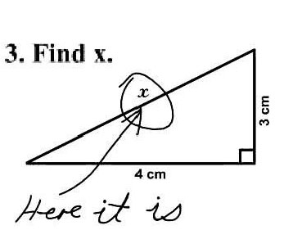
What is the role of necessary assumptions in order to respond in a way that is consistent with the construct being measured?
Be Explicit

Slide 62
Restrict the use of essay questions to those learning outcomes that cannot be measured satisfactorily by objective items.
Construct questions that will call forth the skills specified in the learning standards.
Phrase the question so that the student’s task is clearly indicated.
Indicate an approximate time limit for each question.
Quality Essay Items

Slide 70
Essential: Item Review
4. Item Review – Item Analysis
  Item Difficulty
    Proportion that correctly respond
  Distractor Functioning
    Are the distractors being selected
    Are the distractors “attracting” the right students
    What misconceptions remain

Slide 71
Results of Focus Groups
with students with disabilities
who were eligible for the
modified state assessments

Slide 72
Focus Group Comments (7th Grade)
How do you prepare for the state test?
  Sleep well, eat good, and stay awake
  We get snacks during the test
  To study, I read a lot and do practice questions
  I don’t like to review my notes, it’s pretty boring
  When I get bored I get the temptation for guessing, but I’m not doing that any more
  We do extra writing in class, teachers take the time to help us practice so we don’t forget
Focus Groups cont.

Slide 73
Focus Groups cont.
What do you think about the modified version?
  It has a complete question
  “perplexed”? I have no idea what that means
  There’s always one dumb answer – you don’t have to waste your time on that one
  Just give us the problem straight up, you don’t need all of this other information
  You get the question right at the part of the story where you need to answer it

Slide 74
Focus Groups cont.
  They tell us they are trying to prepare us for college, but they are showing us questions that we never get to in class
  We shouldn’t be completely isolated from all students. If we could use devices to hear music, we wouldn’t be distracted.
  Sometimes the story is so long and you don’t have time to read and they only have one or two questions for that story anyway.

Slide 75
Focus Groups cont.
You should make two kinds of tests. One is the regular old test and then the new and improved test. Then you give it to some kids with disabilities and some without so you can compare. But it has to be random so you know what matters.

Slide 76
Educational Leadership, Sept. 2012
Feedback is not advice, praise, or evaluation. Feedback is information about how we are doing in our efforts to reach a goal

Slide 77
If students know the classroom is a safe place to make mistakes, they are more likely to use feedback for learning.
The feedback students give teachers can be more powerful than the feedback teachers give students.
When we give a grade as part of our feedback, students routinely read only as far as the grade.

Slide 78
Effective feedback occurs during the learning, while there is still time to act on it.
Most of the feedback that students receive about their classroom work is from other students—and much of that feedback is wrong.
Students need to know their learning target—the specific skill they’re supposed to learn—or else “feedback” is just someone telling them what to do.

Slide 81
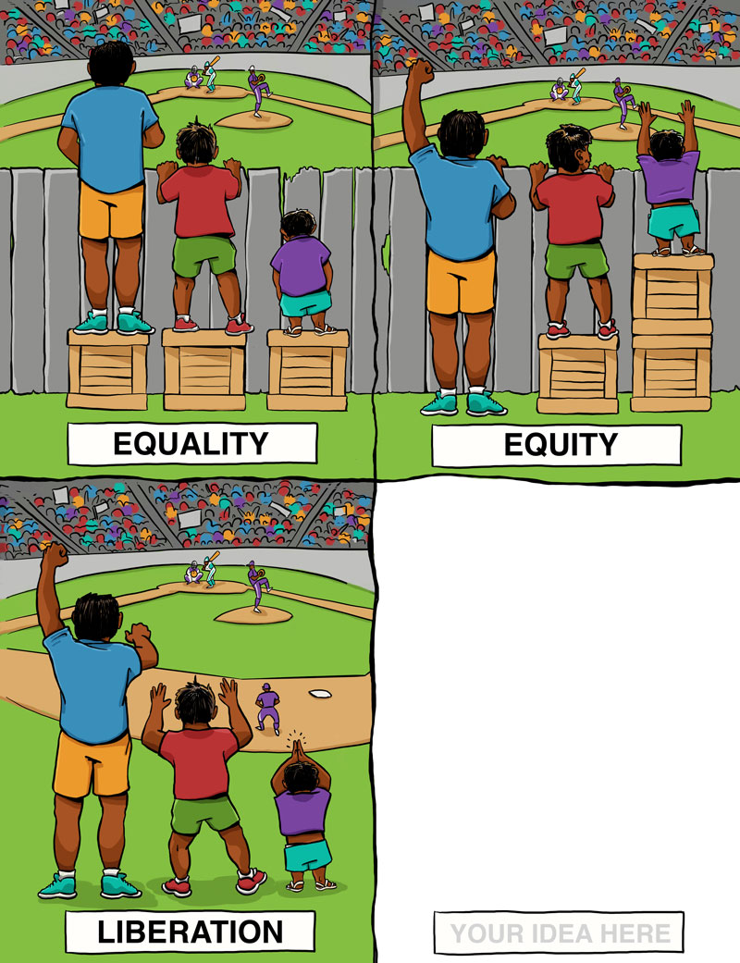
Common Notions of Equity

Slide 82
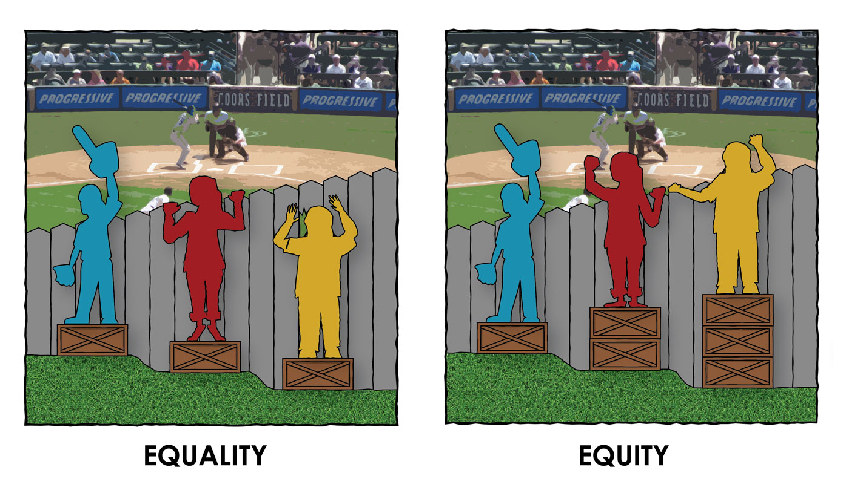
Rethinking Equity
http://culturalorganizing.org

Slide 83
Promising Practices
Student-centered approaches show great promise
Helping students set appropriate goals and supporting them to meet their goals show great promise
Teacher commitment and teacher-powered schools show great promise
The key ingredient in all effective youth-development efforts is developmental relationships

Slide 84
Build Relationships
Success in boosting student proficiency is much less about the specific program or intervention and much more about getting the school community involved. We need to be attending to the resources we have in people.
For education leaders, this means making connections with educators, students, and communities – learning about local wisdom, local needs, and local preferences.
Notes:
Individually and collectively

Slide 85
Acknowledge Resiliency
Some people call it grit or perseverance. For kids that you know and that you work with, or even your own children, they all have strengths that are not easily recognized or rewarded.
Whether it’s navigating multiple communities due to high mobility, translating English for your parents, or negotiating multiple generations in the home, kids are developing valuable skills we often fail to recognize, value, or advantage.
Notes:
We can help build connections here with the importance of instruction and assessment – helping teachers employ the resiliency skills kids bring to the classroom in academic ways. We continue to see these kinds of conditions as disadvantages – as disparities – instead of skills.

Slide 86
Tap Student Skills
With the way most schools are set up, it can be a major challenge for student communities with unique learning needs to apply their resiliency and the skills they use in everyday life to assignments in the classroom.
It all goes back to building relationships and truly getting to know teachers, students, and families so we can help them all succeed.

Slide 87
Expand Academic Knowledge
Everyday practice-based knowledge can and should be used to help students develop problem-solving skills with academic content.
Out of school knowledge can and should be used as a conduit to acquire in-school knowledge.
Tyrone Howard (2010)

Slide 88
Community Responsive Pedagogy
Use community knowledge, prior experiences, frames of reference, and performance styles of diverse students to make learning more relevant to and effective for them.
Teaches to and through the strengths of these students.
Affirm and validating community contexts.
Geneva Gay (2000)

Slide 89
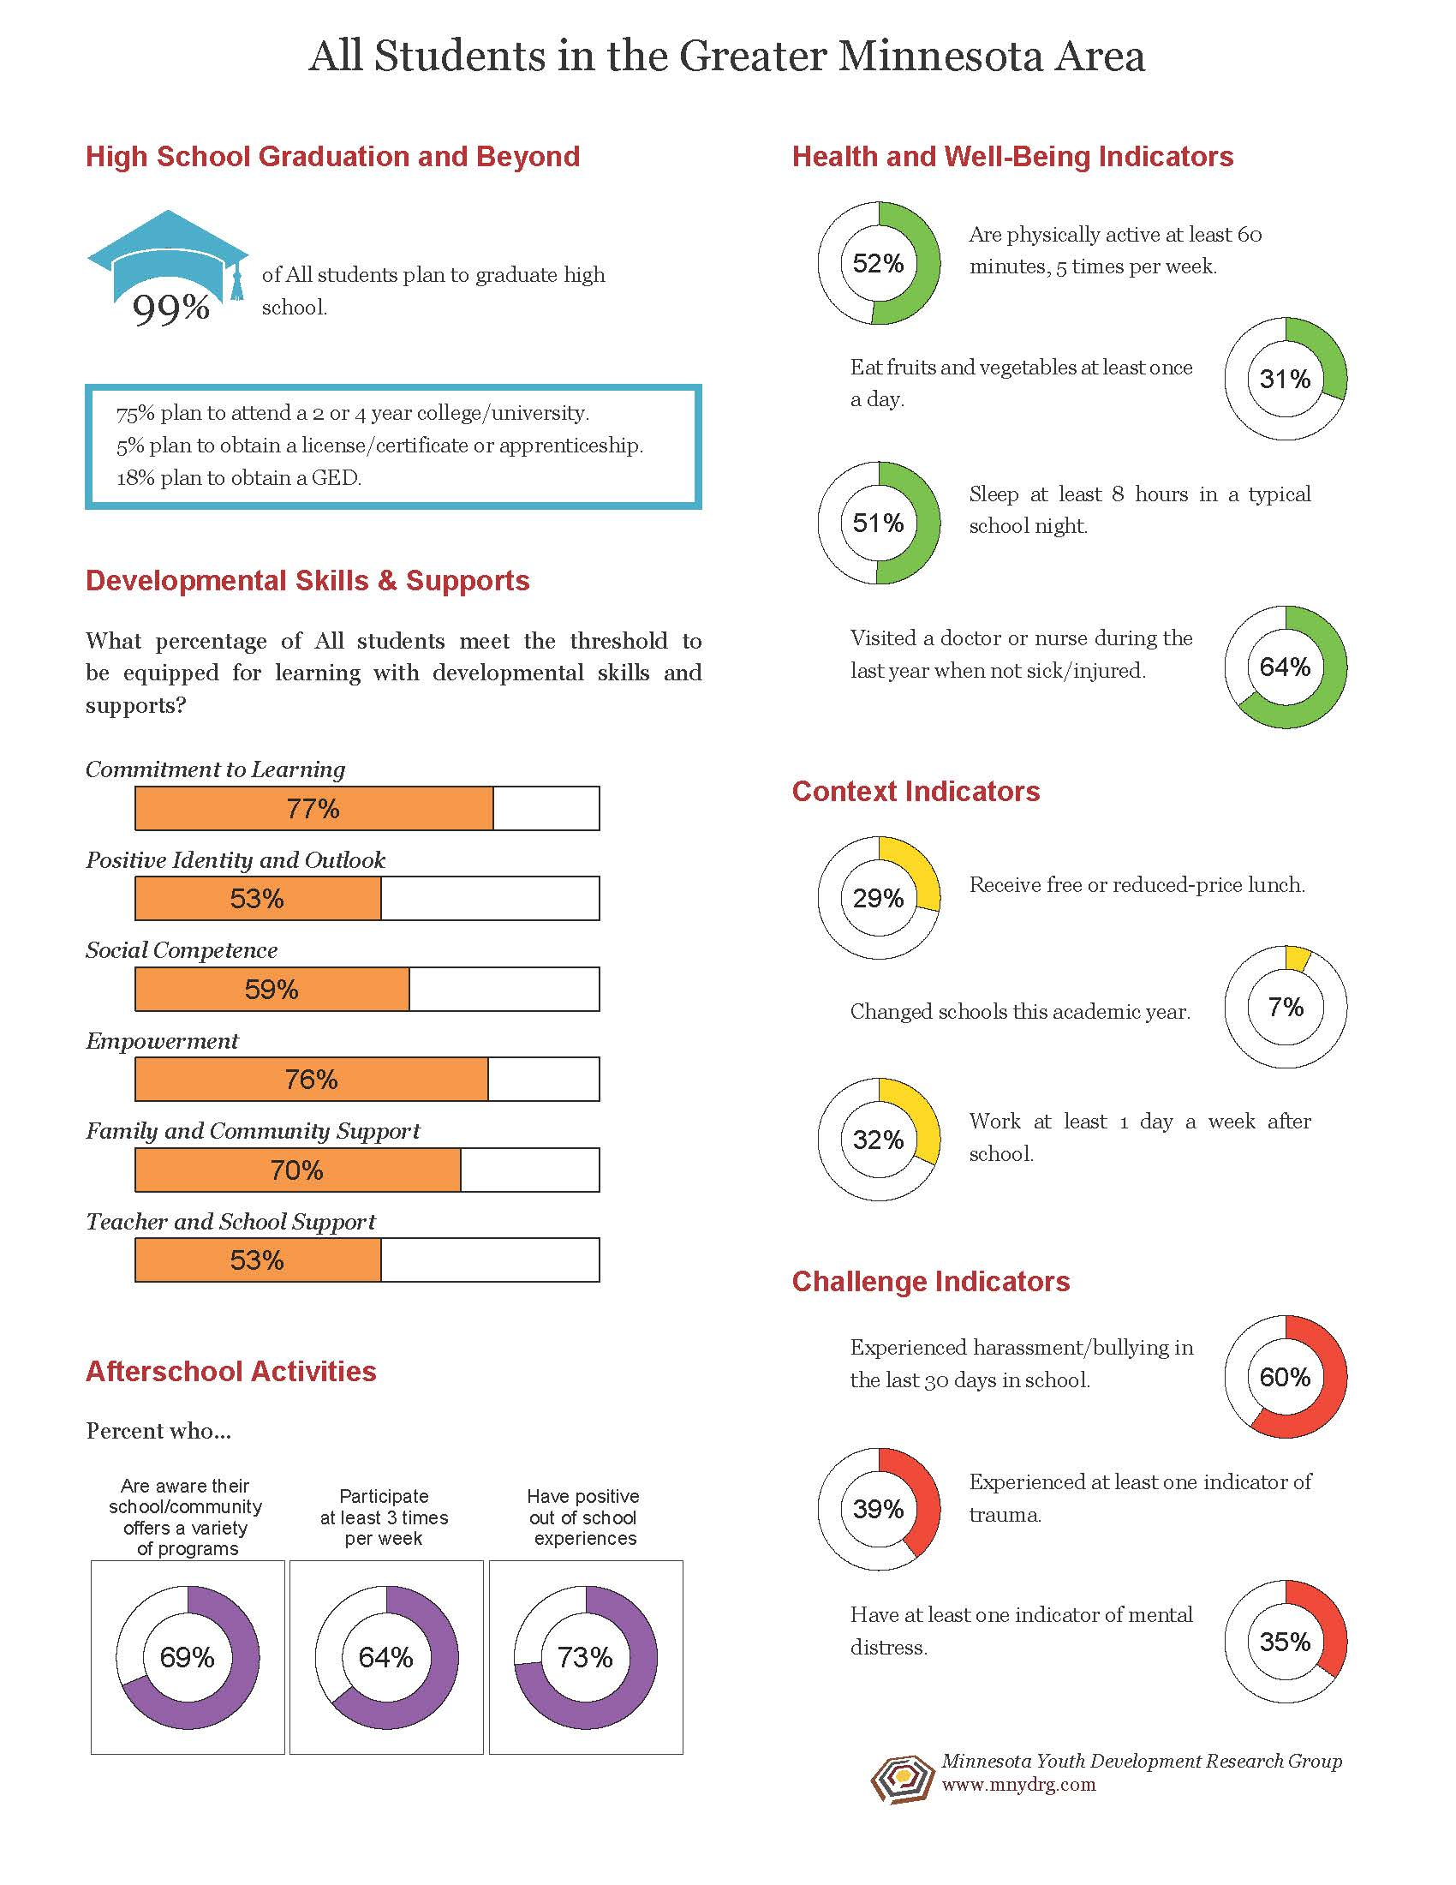
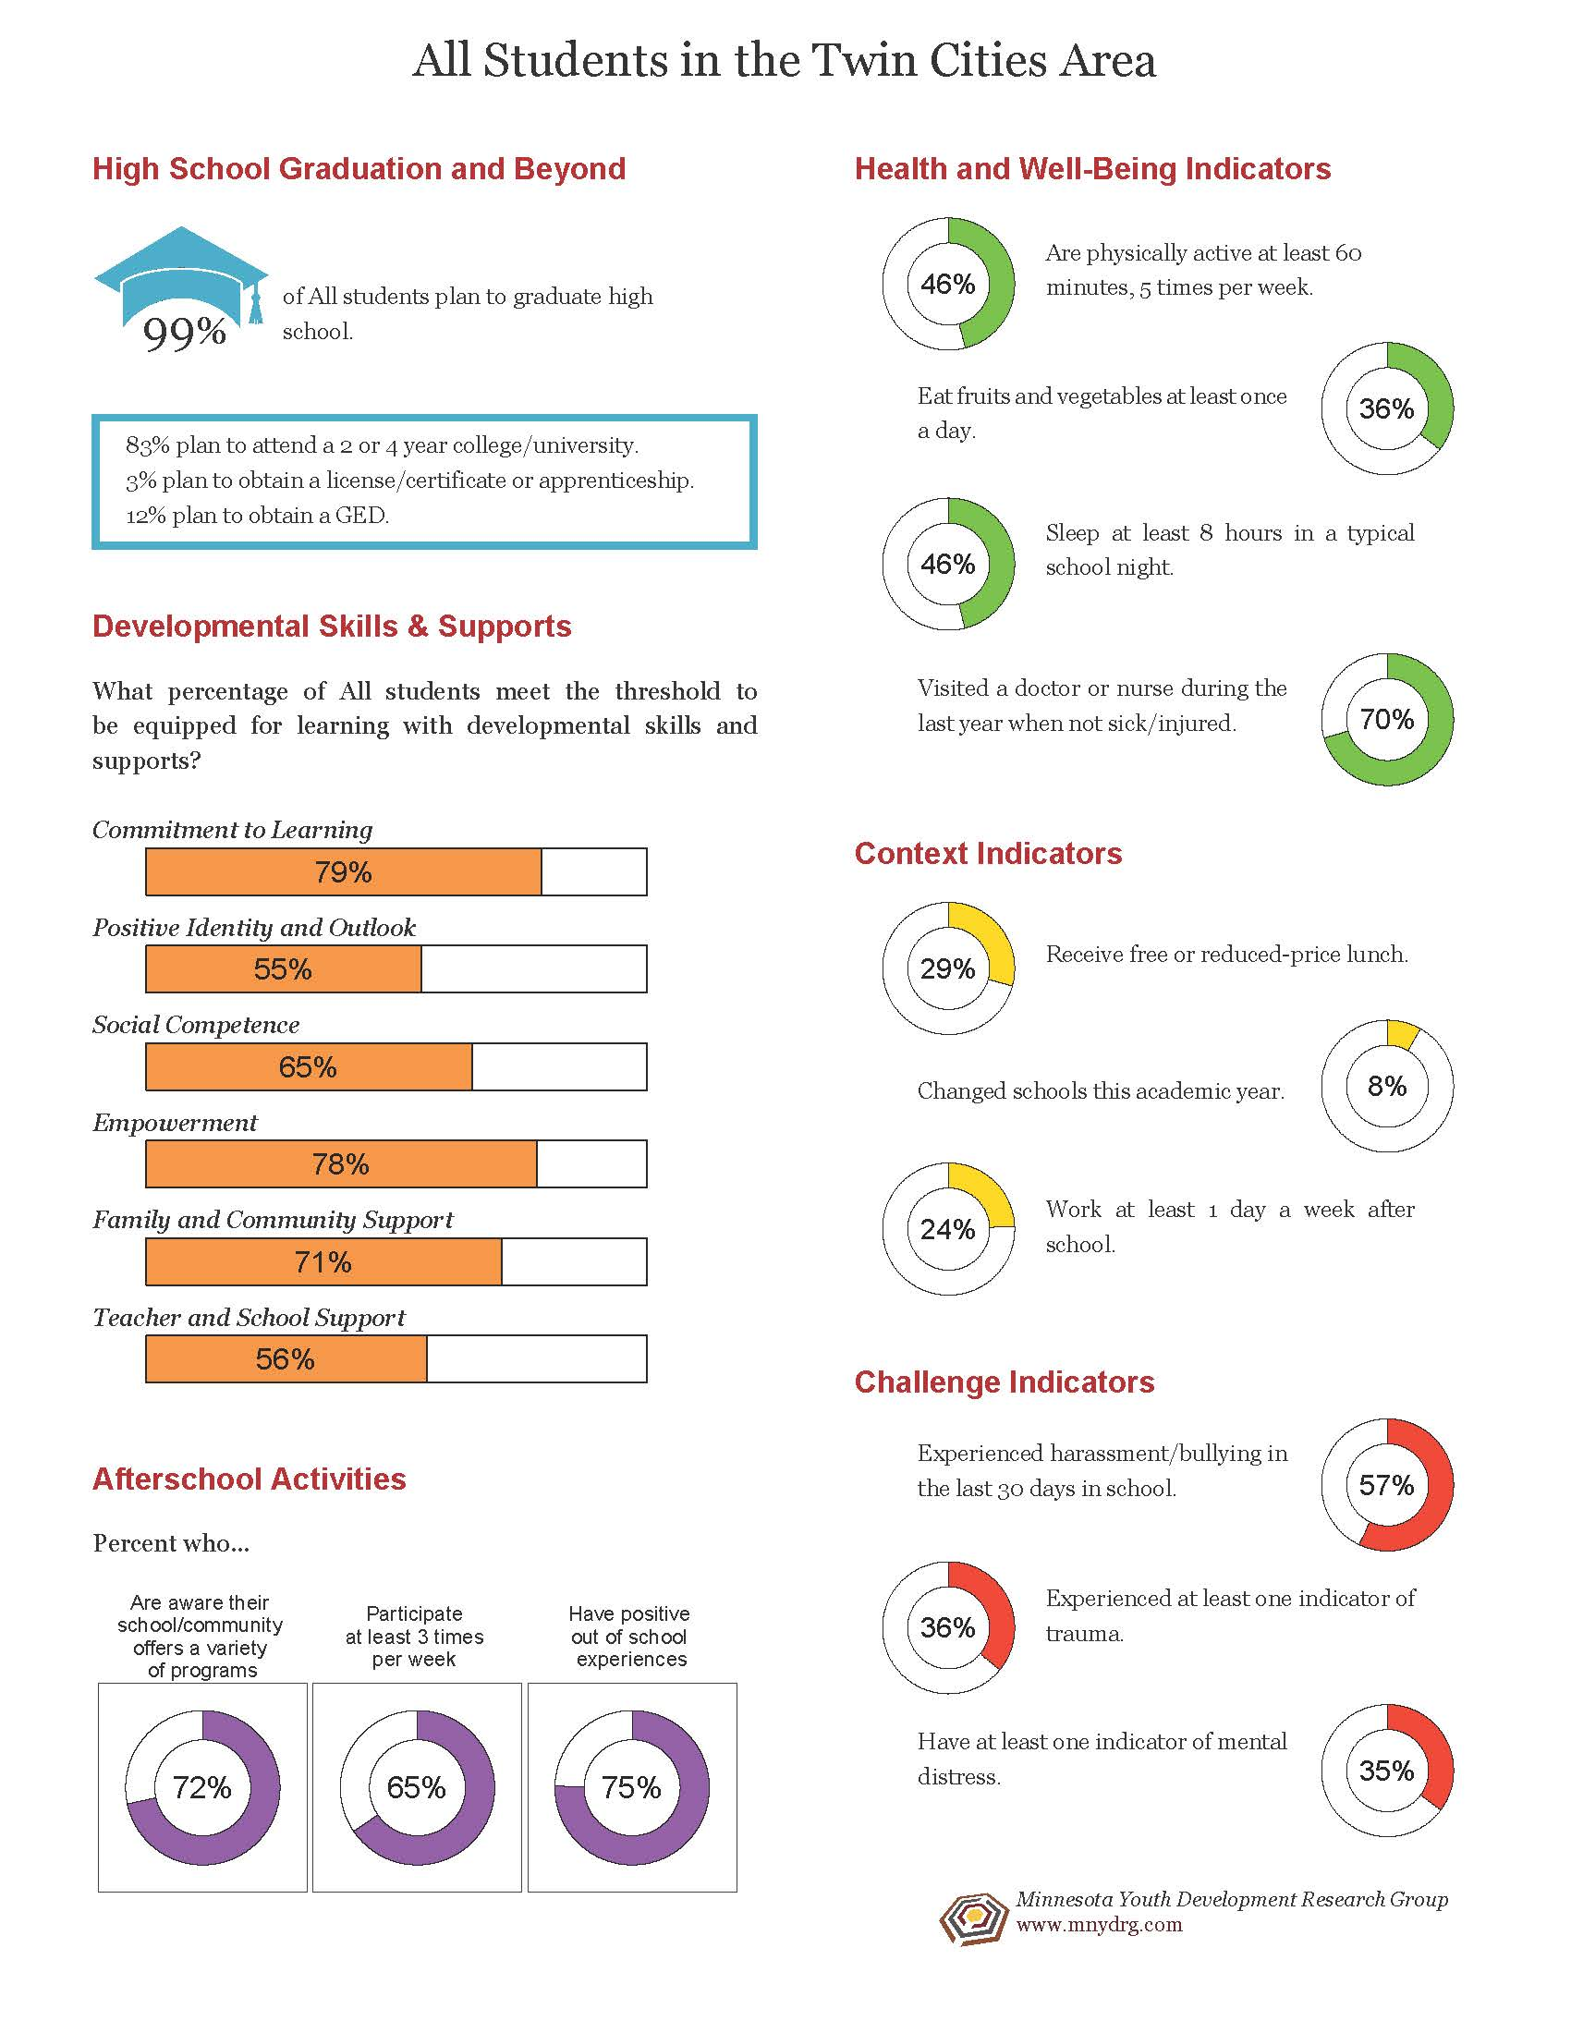

Slide 90
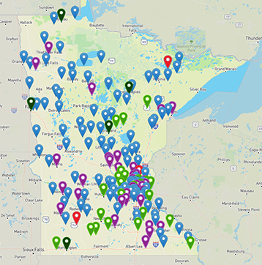
Educator & Community Resources www.gap.umn.edu
RESOURCES Tab
Art & Design
College Readiness
Early Childhood &
Youth Development
Language/Literacy
Leaders & Educators
Social Studies
STEM/Agriculture &
Environment

Slide 91



