Slide 1
Principles of Measurement to Support Teaching & Learning (to meet accountability demands)
Michael C. Rodriguez
Quantitative Methods in Education
Educational Psychology

Slide 2
www.edmeasurement.net/MAG

Slide 3
Competency Standards in Student
See the Competency Standards for
Teachers
Educational Administrators
Counselors
Test Users
Test Takers
These are available at the MAG resource website.

Slide 4
Using Principles of Measurement to Support Test Score Interpretation and Use in Minnesota

Slide 5
Validity First
Validity refers to the degree to which evidence and theory support the interpretations of test scores for proposed uses of tests.
Evidence of the validity of a given interpretation of test scores for a specified use is a necessary condition for the justifiable use of the test.
2014 Standards for Educational & Psychological Testing

Slide 6
Validity Issues
Intended claims and uses
Test score use (decisions) must be accompanied by additional data and relevant evidence
No decision should be made from a single test score
Validity is a matter of degree – more high-stakes decisions require stronger validity evidence

Slide 7
Validation
The process of validation involves accumulating relevant evidence to provide a sound scientific basis for the proposed score interpretation.
2014 Standards for Educational & Psychological Testing

Slide 8
Sources of Validity Evidence
Content is relevant, given OTL
Cognitive process
Internal (factor) structure
Relations to other conceptually related constructs
Relations to criteria or future performance
Consequences interfere with use

Slide 9
Validity Related Issues
Reliability is validity evidence, regarding score precision and generalizability of score interpretation and use
Subscale meaning and independence
Measurement invariance across subgroups

Slide 10
Reliability Related Issues
Reliability/precision is always important.
The need for precision increases as the consequences of decisions and interpretations grow in importance.

Slide 11
Applying Fairness Principles
Fairness is a fundamental validity issue and requires attention throughout all stages of test development and use.
Potential threats to score interpretation and use exist for individuals that differ in English proficiency (native and non-native English speakers), specific disabilities, cultural experiences, prior experience in the system.

Slide 12
Fairness
Fairness applies to
Treatment during the testing process
Lack of measurement bias (score level, prediction, precision)
Accessibility – opportunity to demonstrate standing on the measure
Opportunity to learn the relevant content (with appropriate supports)
Access to high-quality instruction
Validity of test score interpretations and uses

Slide 13
Lessons Learned about Testing
A Report of the National Research Council
Lessons Learned about Testing

Slide 14
Lessons re: Uses
In many situations, standardized tests provide the most objective way to compare the performance of a large group of examinees across places and times.
A test score is an estimate rather than an exact measure of what a person knows and can do.
High-stakes decisions about individuals should not be made on the basis of a single test score.
Tests should not be used for high-stakes decisions if test takers have not had an opportunity to learn the material on which they will be tested.

Slide 15
Lessons re: Uses
States, districts, and schools should aim to maximize the participation of English-language learners and students with disabilities in large-scale tests.
Teachers need professional development that helps them better understand core principles of assessment and how to apply these to their regular instruction and testing.

Slide 16
Lessons re: Design
In the design of tests, form must follow function.
Design process must ensure score interpretation is valid.
Design process must ensure scores are reliable and fair.
Testing professionals should consider the connections among cognition, observation, and interpretation—the “assessment triangle”—when evaluating the soundness of current educational tests or designing new ones.
Advances in cognitive sciences and measurement offer opportunities to develop assessments that better support learning.

Slide 17
Lessons re: Consequences
The people who design and mandate tests must be constantly vigilant about equity concerns, including opportunity to learn, cultural bias, or adverse impact.
In the absence of effective services for low-performing students, better tests will not lead to better educational outcomes.
Test results may be invalidated by teaching narrowly to a particular test.
New testing programs should build in an evaluation component.

Slide 18
Lessons re: Public Understanding
Test developers and policy makers should clearly explain to the public the purpose for a test and the meaning of different levels of test performance.
When test results are reported to students, teachers, and the public, the limitations of the test should be explained clearly to a lay audience.

Slide 19
National Academies (2009)
Board of Testing and Assessment
A test score is an estimate rather than an exact measure of what a person knows and can do. The items on any test are a sample from some larger universe of knowledge and skills, and scores for individual students are affected by the particular questions included.

Slide 20
National Academies (2009)
A student may have done better or worse on a different sample of questions. In addition, guessing, motivation, momentary distractions, and other factors introduce uncertainty into individual scores.

Slide 21
Interpreting Individual Scores
We observe a score, and due to sampling of items/time/occasions/settings/etc, we know an individual’s score will vary on average by the SEM, simply as a function of measurement error.

Slide 22
Measurement Error
Sampling Error

Slide 23
2016-2017 Technical Manual for Minnesota’s Title I and Title III Assessments
Understanding Measurement Error
When interpreting test scores, it is important to remember that test scores always contain some amount of measurement error. That is, test scores are not infallible measures of student characteristics… measurement error must always be considered when making score interpretations. (p. 71)
Notes:
185 pages

Slide 24
Because measurement error tends to behave in a fairly random fashion, when aggregating over students, these errors in the measurement of students tend to cancel out. (p. 71)

Slide 25
2016-2017 Technical Manual
Using Objective/Strand-Level Information
Strand or substrand level information can be useful as a preliminary survey to help identify skill areas in which further diagnosis is warranted. The standard error of measurement associated with these generally brief scales makes drawing inferences from them at the individual level very suspect; more confidence in inferences is gained when analyzing group averages. (p. 72)

Slide 26
2016-2017 Technical Manual
When considering data at the strand or substrand level, the error of measurement increases because the number of possible items is small. In order to provide comprehensive diagnostic data for each strand or substrand, the test would have to be prohibitively lengthened. (p. 72)

Slide 27
MCA for Individual Interpretation
2016-17 Yearbook Tables for
Minnesota’s Title I and Title III Assessments
Example: Grade 3 Reading
Score Distributions, p. 96

Slide 28
Scale Score | SEM | Achievement Level
338 | 4.4 | D
339 | 4.4 | D
340 | 4.4 | P
341 | 4.4 | P
…
348 | 4.9 | P
349 | 4.9 | P
350 | 4.9 | M
351 | 4.9 | M
Notes:
454 pages of tables
Does Not Meet
Partially Meets
Meets

Slide 29
Seeking More Information
Looking to Subscales for more info
Knowing subscales are shorter – less precision
Consider the role of measurement error in correlations
Randomness doesn’t correlate with anything
Measurement error (random noise) limits correlations
Reliability provides information about measurement error

Slide 30
2017 MCA-III Summary Statistics Grade 3 Reading (p. 125)
 | Items | Reliability
Total Scale | 40 | .93
Literature | 16-24 | .81
Information | 16-24 | .84

Slide 31
2017 MCA-III Subscale Correlations Grade 3 Reading (p. 158)
 | Literature
Information | .81

Slide 32
We know that a correlation can be no larger than the score reliabilities:
$${Correlation}_{XY}≤\sqrt{{Reliability}_{X}∙{Reliability}_{Y}}$$

Slide 33
Correlations can be corrected (disattenuated) for measurement error. To do so, we manipulate the above relation and divide the correlation by the corresponding reliabilities:
$$\frac{{Correlation}_{XY}}{\sqrt{{Reliability}_{X}∙{Reliability}_{Y}}}$$

Slide 34
3rd Grade Mathematics Subscale Corrected Correlations
 | Number & Operation | Algebra | Geometry & Measurement
Algebra | .99
Geometry & Measurement | .99 | .98
Data Analysis | .97 | .94 | .96
2017 MCAs

Slide 35
6th Grade Mathematics Subscale Corrected Correlations
 | Number & Operation | Algebra | Geometry & Measurement
Algebra | .98
Geometry & Measurement | .98 | .98
Data Analysis | 1.00 | .95 | .97
2017 MCAs

Slide 36
8th Grade Mathematics Subscale Corrected Correlations
 | Number & Operation | Algebra | Geometry & Measurement
Algebra | .99
Geometry & Measurement | .98 | .98
Data Analysis | .97 | 1.00 | .97
2017 MCAs

Slide 37
Grade |  |  | Uncorrected | Corrected
 |  | Reliabilities | Correlation | Correlation
3 | Literature | .81 |  | .97
 | Information | .84 | .80
4 | Literature | .81 |  | .98
 | Information | .83 | .80
5 | Literature | .80 |  | .99
 | Information | .80 | .79
6 | Literature | .80 |  | 1.00
 | Information | .84 | .82
7 | Literature | .80 |  | .98
 | Information | .86 | .81
8 | Literature | .80 |  | .99
 | Information | .84 | .81
10 | Literature | .75 |  | .98
 | Information | .88 | .80
2017 MCA Reading Subscale Corrected Correlations:
Literature & Information

Slide 38
National Academies 2009
The choice of appropriate assessments for use in instructional improvement systems is critical. Because of the extensive focus on large-scale, high-stakes, summative tests, policy makers and educators sometimes mistakenly believe that such tests are appropriate to use to provide rapid feedback to guide instruction. This is not the case.

Slide 39
Tests that mimic the structure of large-scale, high-stakes, summative tests, which lightly sample broad domains of content taught over an extended period of time, are unlikely to provide the kind of fine-grained, diagnostic information that teachers need to guide their day-to-day instructional decisions.
National Academies 2009

Slide 40
…BOTA urges the Department to clarify that assessments that simply reproduce the formats of large-scale, highstakes, summative tests are not sufficient for instructional improvement systems.
National Academies 2009

Slide 41
MCA Score Interpretation Cautions
Scores on different subjects and different grades are not comparable.
Score differences are not comparable across subjects or grades. A difference of 5 points on one subject in a grade will represent an ability difference that does not compare to a 5-point difference on other subjects or grades.
Source: MN Technical Manual (2017), p. 119-120

Slide 42
MCA Score Interpretation Cautions
Achievement levels can more safely be compared across subjects and grades – rely on the performance level descriptors for a given test/grade.
Scores over time (within the same content standards period) are comparable within subject and grade.

Slide 43
Appropriate Score Use
The tests in the Minnesota Assessment System are designed primarily to determine school and district accountability related to the implementation of the Minnesota standards. They are summative measures of a student’s performance in a subject at one point in time. They provide a snapshot of the student’s overall achievement, not a detailed accounting of the student’s understanding of specific content areas defined by the standards.
Source: MN Technical Manual (2017), pp. 68

Slide 44
Appropriate Score Use: Parents
The information can help parents begin to understand their child’s academic performance as related to the Minnesota standards.
Source: MN Technical Manual (2017), pp. 68

Slide 45
Appropriate Score Use: Placement Decisions
The information can be used to suggest areas needing further evaluation of student performance. Results can also be used to focus resources and staff on a particular group of students who appear to be struggling with the Minnesota standards.
Source: MN Technical Manual (2017), pp. 68

Slide 46
Appropriate Score Use: Placement Decisions
Students may also exhibit strengths or deficits in strands or substrands measured on these tests. Because the strand and substrand scores are based on small numbers of items, the scores must be used in conjunction with other performance indicators to assist schools in making placement decisions, such as whether a student should take an improvement course or be placed in a gifted or talented program.
Source: MN Technical Manual (2017), pp. 68

Slide 47
Appropriate Score Use: Program Evaluation
Test scores can be a valuable tool for evaluating programs. For example, a school may use its scores to help evaluate the strengths and weaknesses of a particular academic program or curriculum in their school or district as it relates to the Minnesota standards.
Source: MN Technical Manual (2017), pp. 68

Slide 48
Appropriate Score Use: Groups of Students
Test results can be used to evaluate the performance of student groups. The data should be viewed from different perspectives and compared to district and state data to gain a more comprehensive understanding of group performance. For example, the average scale score of a group of students may show they are above the district and/or state average, yet the percentage of students who are proficient in the same group of students may be less than the district or state percentages. One perspective is never sufficient.
Source: MN Technical Manual (2017), pp. 69

Slide 49
Grade 3 Reading
Student Score Distributions Vary by Race
Consider the role of variability

Slide 50
Student-centered approaches show great promise
Helping students set appropriate goals and supporting them to meet their goals shows great promise
Teacher commitment and teacher-powered schools show great promise
The key ingredient in all effective youth-development efforts is developmental relationships

Slide 51
2016 MN Student Survey

Slide 52
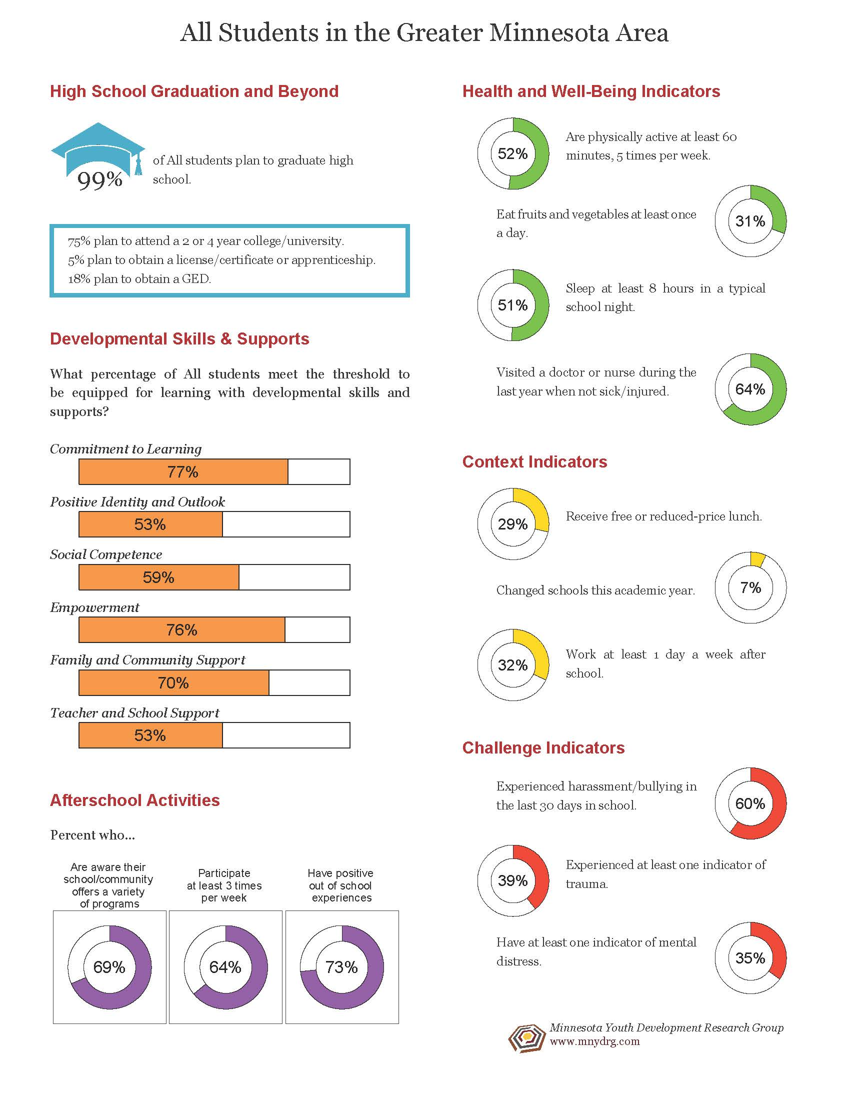
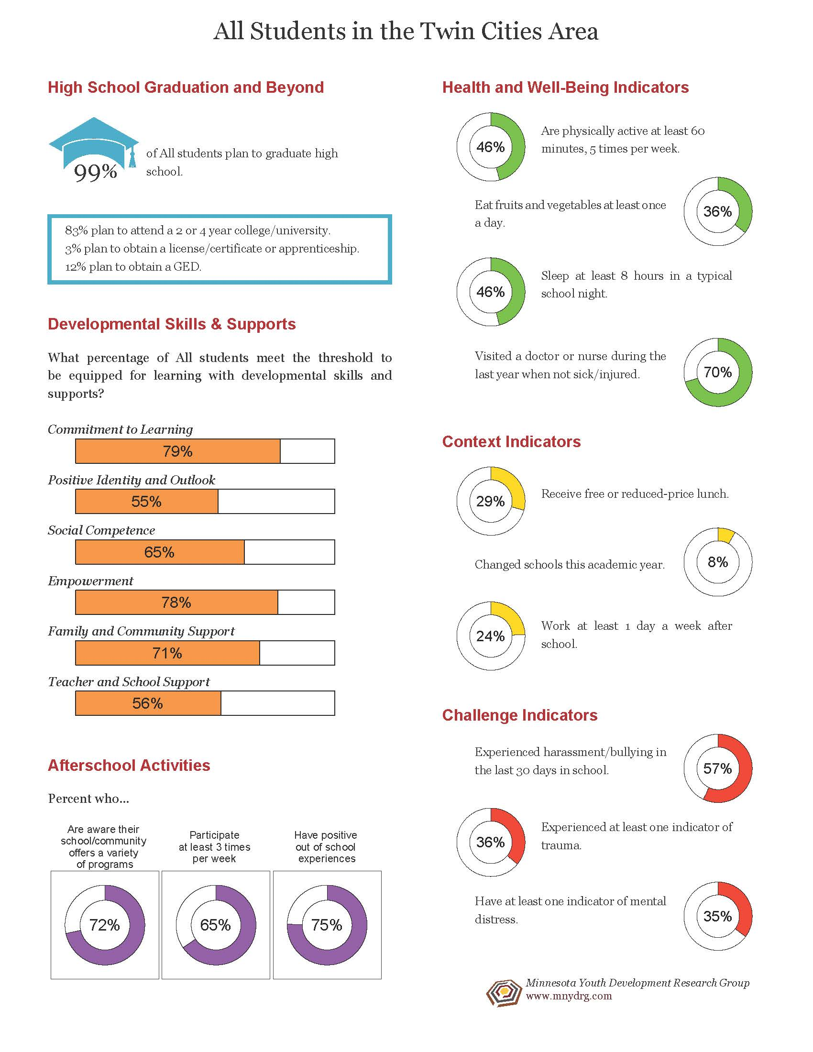

Slide 53
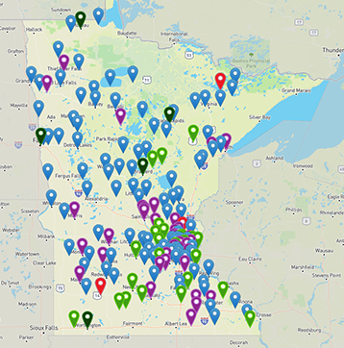
Educator & Community Resources www.gap.umn.edu
RESOURCE Tab
Art & Design College Readiness Early Childhood &
Youth Development Language/Literacy Leaders & Educators Social Studies STEM/Agriculture &
Environment

